Slide 1
Myths and Mischief in Medical Research
Goals:
1 - Think like a scientist
Evaluate rigorously
Terminology: Natural/Organic/Healthy
e.g., natural sugar

Slide 2
Myths and Mischief in Medical Research
Goals:
1 - Think like a scientist
Evaluate rigorously
Terminology: Natural/Organic/Healthy
e.g., natural sugar
2 – M.D. vs Ph.D. vs no Sci.D.
Education, Personality, Cognitive Skills (Memorize)

Slide 3
Myths and Mischief in Medical Research
Goals:
1 - Think like a scientist
Evaluate rigorously
Terminology: Natural/Organic/Healthy
e.g., natural sugar
2 – M.D. vs Ph.D. vs no Sci.D.
Education, Personality, Cognitive Skills (Memorize)
MD: Diagnose/Treat Disease
PhD.: Develop and Test Hypotheses
no Sci.D: Helpless

Slide 4
Myths and Mischief in Medical Research
Goals:
1 - Think like a scientist
Evaluate rigorously
Terminology: Natural/Organic/Healthy
e.g., natural sugar
2 – M.D. vs Ph.D. vs no Sci.D.
Education, Personality, Cognitive Skills (Memorize)
MD: Diagnose/Treat Disease
PhD.: Develop and Test Hypotheses
no Sci.D: Helpless
3 – Become an Annoyance:
Ask “How do you know that?”

Slide 5
Myths and Mischief in Medical Research
Goals:
1 - Think like a scientist
Evaluate rigorously
Terminology: Natural/Organic/Healthy
e.g., natural sugar
2 – M.D. vs Ph.D. vs no Sci.D.
Education, Personality, Cognitive Skills (Memorize)
MD: Diagnose/Treat Disease
PhD.: Develop and Test Hypotheses
no Sci.D: Helpless
3 – Become an Annoyance:
Ask “How do you know that?”
4 – Distinguish Good Science from Tainted Science
Methods/Statistics/Epidemiological “Tricks”

Slide 6
Myths and Mischief in Medical Research
Goals:
1 - Think like a scientist
Evaluate rigorously
Terminology: Natural/Organic/Healthy
e.g., natural sugar
2 – M.D. vs Ph.D. vs no Sci.D.
Education, Personality, Cognitive Skills (Memorize)
MD: Diagnose/Treat Disease
PhD.: Develop and Test Hypotheses
no Sci.D: Helpless
3 – Become an Annoyance:
Ask “How do you know that?”
4 – Distinguish Good Science from Tainted Science
Methods/Statistics/Epidemiological “Tricks”
5 – Learn About the Sad State of Modern Health Care:
Focus on Heart Disease and Cancer

Slide 7
No cure for heart disease, Clinton's case shows
February 12th, 2010 in Medicine & Health / Diseases
(AP) -- Bill Clinton has a new lease on life, but there's no cure for the heart disease that has twice forced the former president to get blocked arteries fixed.
Treatments like the quadruple bypass surgery Clinton had in 2004 last about a decade on average. Then the blood vessels used to create detours around the clogged arteries start to get blocked, too.
One such blockage sent Clinton to the hospital on Thursday. Instead of fixing it, doctors reopened the original clogged artery and placed two mesh props called stents to keep it open.
It's something he's likely to need again, heart experts say.
"We see people who come in like this every four to five years. Essentially, it's a tuneup," said Dr. Cam Patterson, cardiology chief at the University of North Carolina at Chapel Hill.
Surprisingly, this doesn't shorten someone's lifespan or give them a bad prognosis, said Dr. William O'Neill, a cardiologist and executive dean of clinical affairs at the University of Miami's Miller School of Medicine.
"I've done 10 or 15 in a single patient over a period of time," and they still live long lives as long as they don't have a heart attack and suffer damage, he said.
Clinton has not had a heart attack and has done everything right since his bypass - eating well, exercising, keeping his blood pressure and cholesterol in check, said his cardiologist, Dr. Allan Schwartz at New York Presbyterian Hospital.

Slide 8
"This was not a result of his lifestyle or his diet," Schwartz said at a news conference Thursday night. Since the bypass, "he has really toed the line."
And what good does that do, you may ask?
It can keep heart disease from getting worse and fresh blockages forming in new places, said Dr. Spencer King, a cardiologist at St. Joseph's Heart and Vascular Institute in Atlanta and past president of the American College of Cardiology.
Dr. Clyde Yancy, a cardiologist at Baylor University Medical Center in Dallas and president of the American Heart Association, agreed.
"This kind of disease is progressive. It's not a one-time event so it really points out the need for constant surveillance," he said.
About 1 million artery-opening angioplasty procedures are done each year in the United States. Nearly 1 in 5 patients who have one have previously had a bypass operation, said Dr. Ralph Brindis, a cardiologist at California-based Kaiser Permanente health plan and incoming president of the cardiology college.
"On average, a bypass operation lasts 10 years," Brindis said. "He's a little early for having a problem, but not that early."
Clinton also in the past has partly blamed his heart problems on genetics. There is a history of heart disease in his mother's family. He also has admitted being careless about his diet, has had high blood pressure and before his bypass, had stopped taking a cholesterol-lowering drug he'd been prescribed.
Schwartz emphasized how much of that had changed. Clinton's "numbers" were all good, he said. But heart disease "is a chronic condition. We don't have a cure for this condition, but we have excellent treatments."

Slide 9
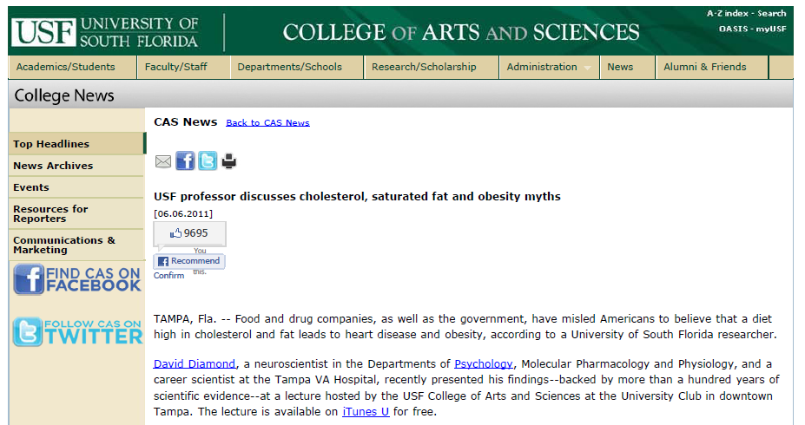
DD Lecture

Slide 10
Why Have I Researched Diet, Blood Lipids and Heart Disease?
Triglycerides
(mg/dl)
Heart Disease Risk
Years
Notes:
Pos – 1.87/1.75 Size 75/75% = 4.96/6.88 crop: 3/2

Slide 11
Bad News: Abnormal Blood Lipids
Total/HDL
Heart Disease Risk
Years
Notes:
Pos – 1.87/1.75 Size 75/75% = 4.96/6.88 crop: 3/2

Slide 12
The Solution: Diet Changes and Exercise
Total/HDL
Heart Disease Risk
Years
Notes:
Pos – 1.87/1.75 Size 75/75% = 4.96/6.88 crop: 3/2

Slide 13
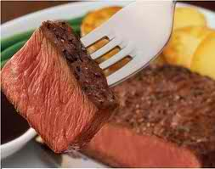
Diet
Skinless Chicken, Low Fat Foods (Cheese, Yogurt), Olive Oil, Bread, Vegetables, Fruit, Nuts, Cereal, Potatoes
Total/HDL
Heart Disease Risk
Years
Notes:
Pos – 1.87/1.75 Size 75/75% = 4.96/6.88 crop: 3/2

Slide 14
Diet
Skinless Chicken, Low Fat Foods (Cheese, Yogurt), Olive Oil, Bread, Vegetables, Fruit, Nuts, Cereal, Potatoes
Total/HDL
X
Heart Disease Risk
Years
Notes:
Pos – 1.87/1.75 Size 75/75% = 4.96/6.88 crop: 3/2

Slide 15
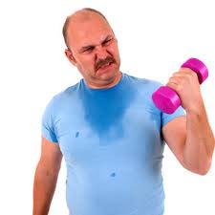
Diet
Skinless Chicken, Low Fat Foods (Cheese, Yogurt), Olive Oil, Bread, Vegetables, Fruit, Nuts, Cereal, Potatoes
Total/HDL
X
Heart Disease Risk
Years
Notes:
Pos – 1.87/1.75 Size 75/75% = 4.96/6.88 crop: 3/2

Slide 16
Really Scary News
Triglycerides
(mg/dl)
!
Heart Disease Risk
Years
Notes:
Pos – 1.87/1.75 Size 75/75% = 4.96/6.88 crop: 3/2

Slide 17
Really Scary News
Total/HDL
!
Heart Disease Risk
Years
Notes:
Pos – 1.87/1.75 Size 75/75% = 4.96/6.88 crop: 3/2

Slide 18
Obesity and Heart Disease in My Future
Body Weight
(lb)
!
weight in 1980
Years
Notes:
Pos – 1.87/1.75 Size 75/75% = 4.96/6.88 crop: 3/2

Slide 19
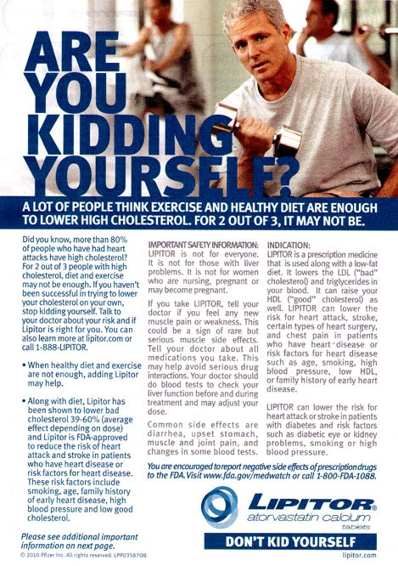
Notes:
Pos – 1.87/1.75 Size 75/75% = 4.96/6.88 crop: 3/2

Slide 20
My Diet (2007 – Present)
Eggs, Butter, Beef, Chicken (with the skin), Full Fat Cheese, Coconut,
Dark Chocolate, Nuts and Vegetables (Broccoli)
Very Little Fruit, Bread, Potatoes and Sugar
Triglycerides
(mg/dl)
Heart Disease Risk
Low Carb Diet
Years
Notes:
Pos – 1.87/1.75 Size 75/75% = 4.96/6.88 crop: 3/2

Slide 21
My Diet (2007 – Present)
Eggs, Butter, Beef, Chicken (with the skin), Full Fat Cheese, Coconut,
Dark Chocolate, Nuts and Vegetables (Broccoli)
Very Little Fruit, Bread, Potatoes and Sugar
Triglycerides
(mg/dl)
60% Fat
30% Protein
10% Carbs
Heart Disease Risk
Low Carb Diet
Years
Notes:
Pos – 1.87/1.75 Size 75/75% = 4.96/6.88 crop: 3/2

Slide 22
My Diet (2007 – Present)
Eggs, Butter, Beef, Chicken (with the skin), Full Fat Cheese, Coconut,
Dark Chocolate, Nuts and Vegetables (Broccoli)
Very Little Fruit, Bread, Potatoes and Sugar
Total/HDL
60% Fat
30% Protein
10% Carbs
Heart Disease Risk
Low Carb Diet
Years
Notes:
Pos – 1.87/1.75 Size 75/75% = 4.96/6.88 crop: 3/2

Slide 23
My Diet (2007 – Present)
Eggs, Butter, Beef, Chicken (with the skin), Full Fat Cheese, Coconut,
Dark Chocolate, Nuts and Vegetables (Broccoli)
Very Little Fruit, Bread, Potatoes and Sugar
Body Weight
(lb)
60% Fat
30% Protein
10% Carbs
weight in 1980
Low Carb Diet
Years
Notes:
Pos – 1.87/1.75 Size 75/75% = 4.96/6.88 crop: 3/2

Slide 24
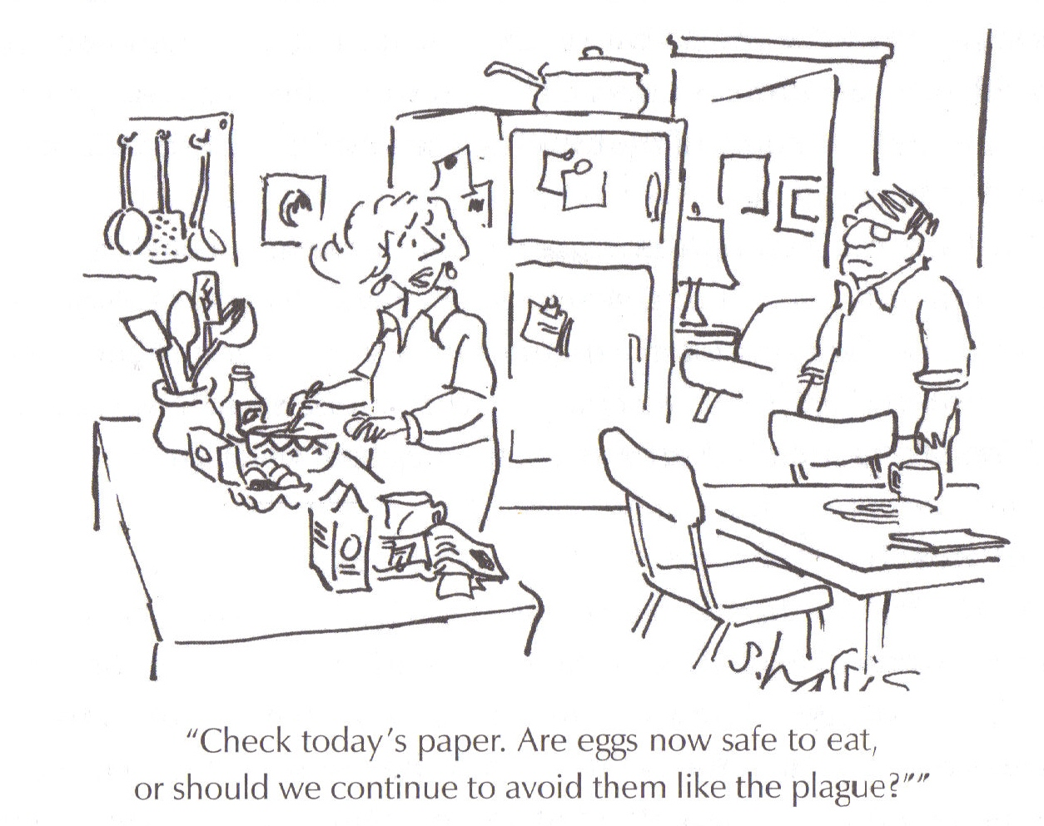
Our Current State of Confusion

Slide 25
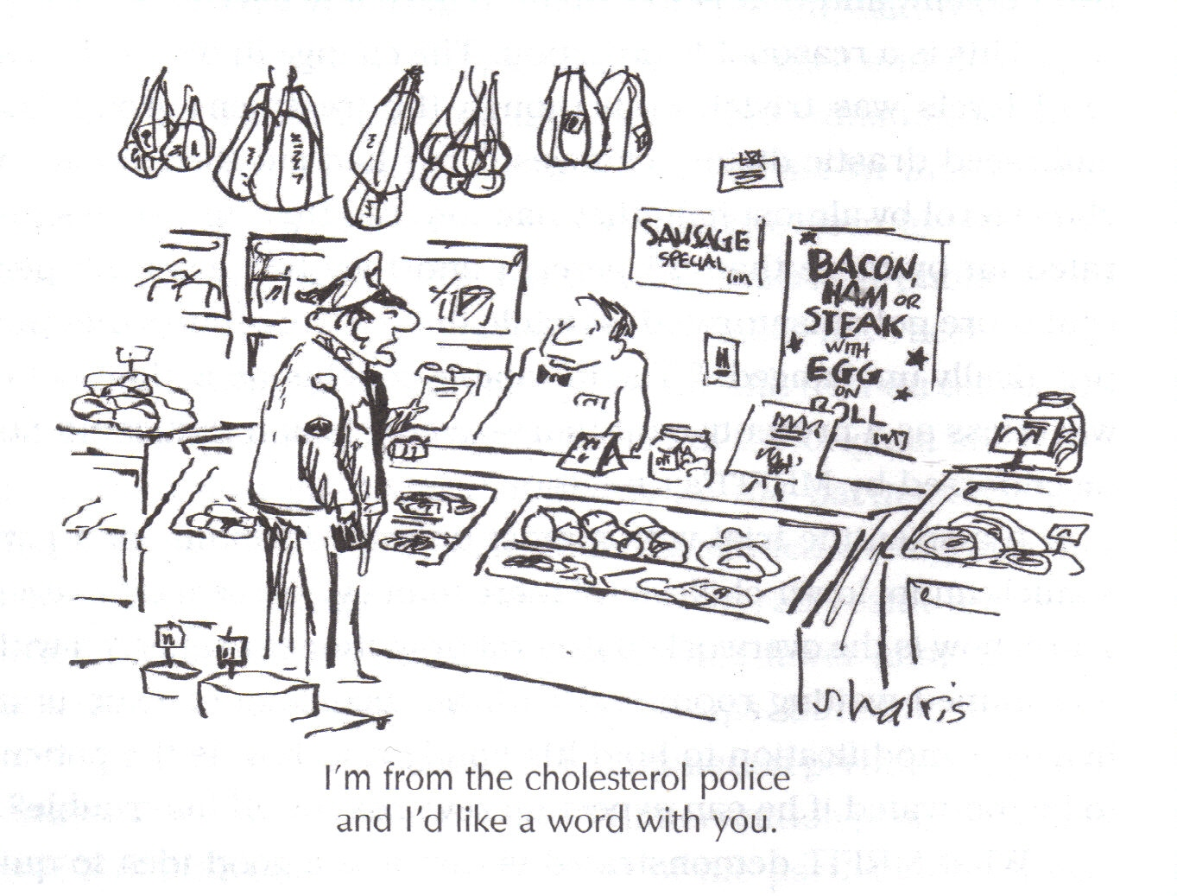
Steak for Dinner, Angioplasty for Dessert?
The Myth That Cholesterol Clogs Arteries

Slide 26

http://www.fathead-movie.com/index.php/2011/08/15/a-speech-on-bad-science-and-heart-disease/

Slide 27
DD Comments on Sat Fat
DD CAS Lecture Web Article
DD Comments on LDL cholesterol
Just in: Comments about DD Lecture

Slide 28
http://www.carbohydratescankill.com/
http://www.barrygroves.blogspot.com/
http://www.dietheartpublishing.com/diet-heart-timeline
http://www.heart.org/HEARTORG/Conditions/Top-10-Myths-about-Cardiovascular-Disease_UCM_430164_Article.jsp
http://www.heart.org/HEARTORG/GettingHealthy/FatsAndOils/MeettheFats/Meet-the-Fats_UCM_304495_Article.jsp
http://www.heart.org/HEARTORG/GettingHealthy/WeightManagement/LosingWeight/Use-Olive-Canola-Corn-or-Safflower-Oil-as-Your-Main-Kitchen-Fats_UCM_320268_Article.jsp
http://livinlavidalowcarb.com/blog/?s=%22david+diamond%22
http://thescreamonline.com/essays/essays5-1/vegoil.html
http://www.westonaprice.org/
http://www.coconutresearchcenter.com/
http://discovermagazine.com/2008/jul/20-wonder-drugs-that-can-kill/article_view?searchterm=Cholesterol&b_start:int=3
http://discovermagazine.com/2010/nov/11-the-problem-with-medicine-don.t-know-if-most-works
http://thincs.org/

Slide 29
http://www.beforeyoutakethatpill.com/index.php/category/cholesterol/
http://articles.mercola.com/sites/articles/archive/2011/05/24/american-cancer-society--more-interested-in-wealth-than-health.aspx
http://www.beforeyoutakethatpill.com/index.php/2009/01/28/flu-shots-are-still-for-idiots-2/
http://http://www.beforeyoutakethatpill.com/index.php/2009/06/25/angioplasty-found-to-be-useless-waste-of-money//
http://articles.mercola.com/sites/articles/archive/2010/08/10/making-sense-of-your-cholesterol-numbers.aspx

Slide 30
Burzynski Video
http://articles.mercola.com/sites/articles/archive/2011/05/24/american-cancer-society--more-interested-in-wealth-than-health.aspx
http://http://www.beforeyoutakethatpill.com/index.php/2009/07/01/cancer-drugs-found-to-not-be-worth-expense/

