Slide 1

New Tampa: USF Community Engaged Project
A Study of New Tampa’s Business Climate
A study conducted by USF MURP Students, with faculty guidance and community stakeholder participation, to gain a deeper understanding of business openings and closures in New Tampa along the Bruce B. Downs Corridor

Slide 2
USF Masters in Urban Regional Planning (MURP)
Study Overview
Origin & Contributions
Phase I: Background Research
Phase II: Qualitative Analysis
  Town Hall, Resident Interviews
Phase II: Quantitative Analysis
  GIS mapping
Phase III: Recommendations
Phase IV: Future Research Opportunities
  Community Survey Tool, USF Business Climate Report community feedback

Slide 3
Origin & Contributions
USF MURP student and then mayoral candidate Jane Castor discuss New Tampa business climate and residents concerns
New Tampa Project team is formed with USF MURP students and stakeholders from the community (1st meeting March 2019)
Students heard from stakeholders and formed early research assumptions:
  Wesley Chapel (SR 52, 54) attracting development, big box retail
  Bruce B Downs accessibility is improved, no longer an issue
  New Tampa needs an established Community Identity
Contributions:
USF Students: Sam Becker, Trinity Miller, Tyler DeMonde, Beau Giles, Amanda Harig, Connor MacDonald
USF Faculty: Mark Hafen, Ron Sanders, Stephen Neely, Stephen Fernandez
Stakeholders: John Iwanicki, Councilmember Luis Viera, Karen Frashier, Karen Tillman Gosselin

Slide 4
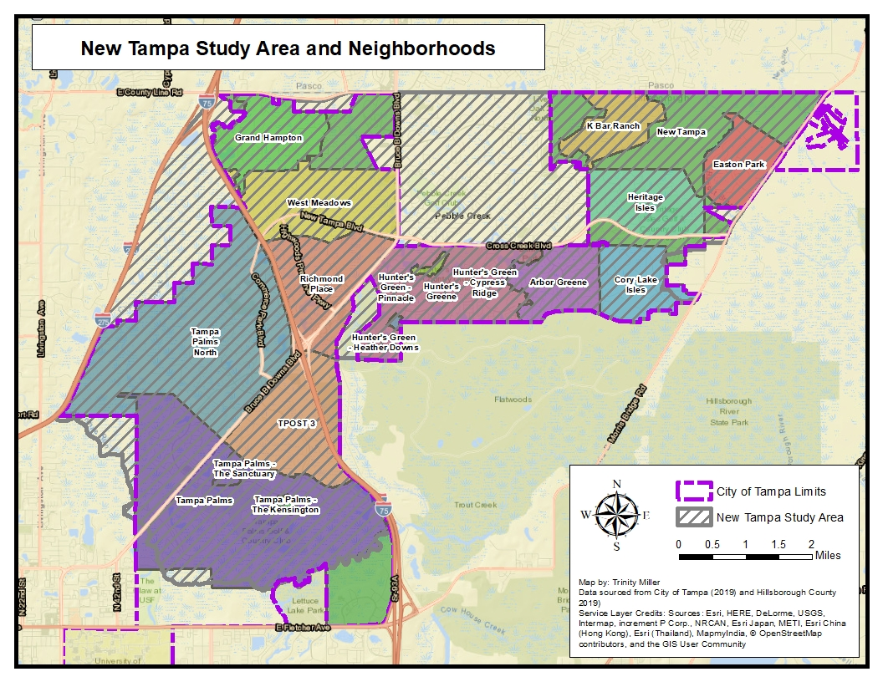
Phase I: Background Research
Our study boundaries included New Tampa zip code, 33647
We noted a high number of neighborhoods, mostly gated, Planned Developments within this small geographic area

Slide 5
Phase I: Background Research
White alone, not Hispanic or Latino | 33,706
Black or African American alone | 9,426
American Indian and Alaska Native alone | 254
Asian alone | 10,225
Native Hawaiian and Other Pacific Islander alone | 0
Some Other Race alone | 1,695
Two or More Races | 2,314
Hispanic or Latino (of any race) | 11,238
New Tampa has an estimated population of 66,380
Median age of 34.5
Median household income of $81,693
25,924 total housing units
8.6% of the population is below poverty level
95.5% of the population have a high school diploma or higher degree (United States Census Bureau, 2019).

Slide 6
Phase II: Qualitative Analysis
Town Hall: July 16th, 2019 @ Compton Park
Stakeholder panel: Commissioner Ken Hagan, Councilman Luis Viera, Rep Fentrice Driskell, USF SPA Director Ron Sanders, Karen Frashier of Rotary, and Randy Myhre from Oliver’s Cycle Sports, with John Iwanicki
What we heard:
  How they identify New Tampa
  The characteristics of New Tampa should make for a favorable business climate
  Concerned about lack of community gathering space and no “main street”
  Empty spaces left by big box departure
  Need for placemaking and branding of New Tampa’s desired image
  Lack of connectivity between neighborhoods and across Bruce B Downs
  Want of more cultural activities that bring people together out of their respective neighborhoods

Slide 7
Phase II: Qualitative Analysis
Resident Interviews (10)
Interviews came from recommendations of the chief stakeholders, and we used feedback from the town hall to create an Interview Protocol:
      Assets & Deficits
      Business Openings, Closings
      Placemaking & Tactical Urbanism
      Access & Transportation
What we learned:
Green space in the community is valued
Bruce B Downs construction in the past was a problem, no longer seen that way
Other communities are not immune to business closures; E-commerce as a national trend is closing the traditional commercial shopping strip nationwide
Residents prefer smaller adjustments to a larger fix, reuse/adapt the built environment in place
Establish a local brand identity
Diversify restaurant availability to be more adult oriented

Slide 8
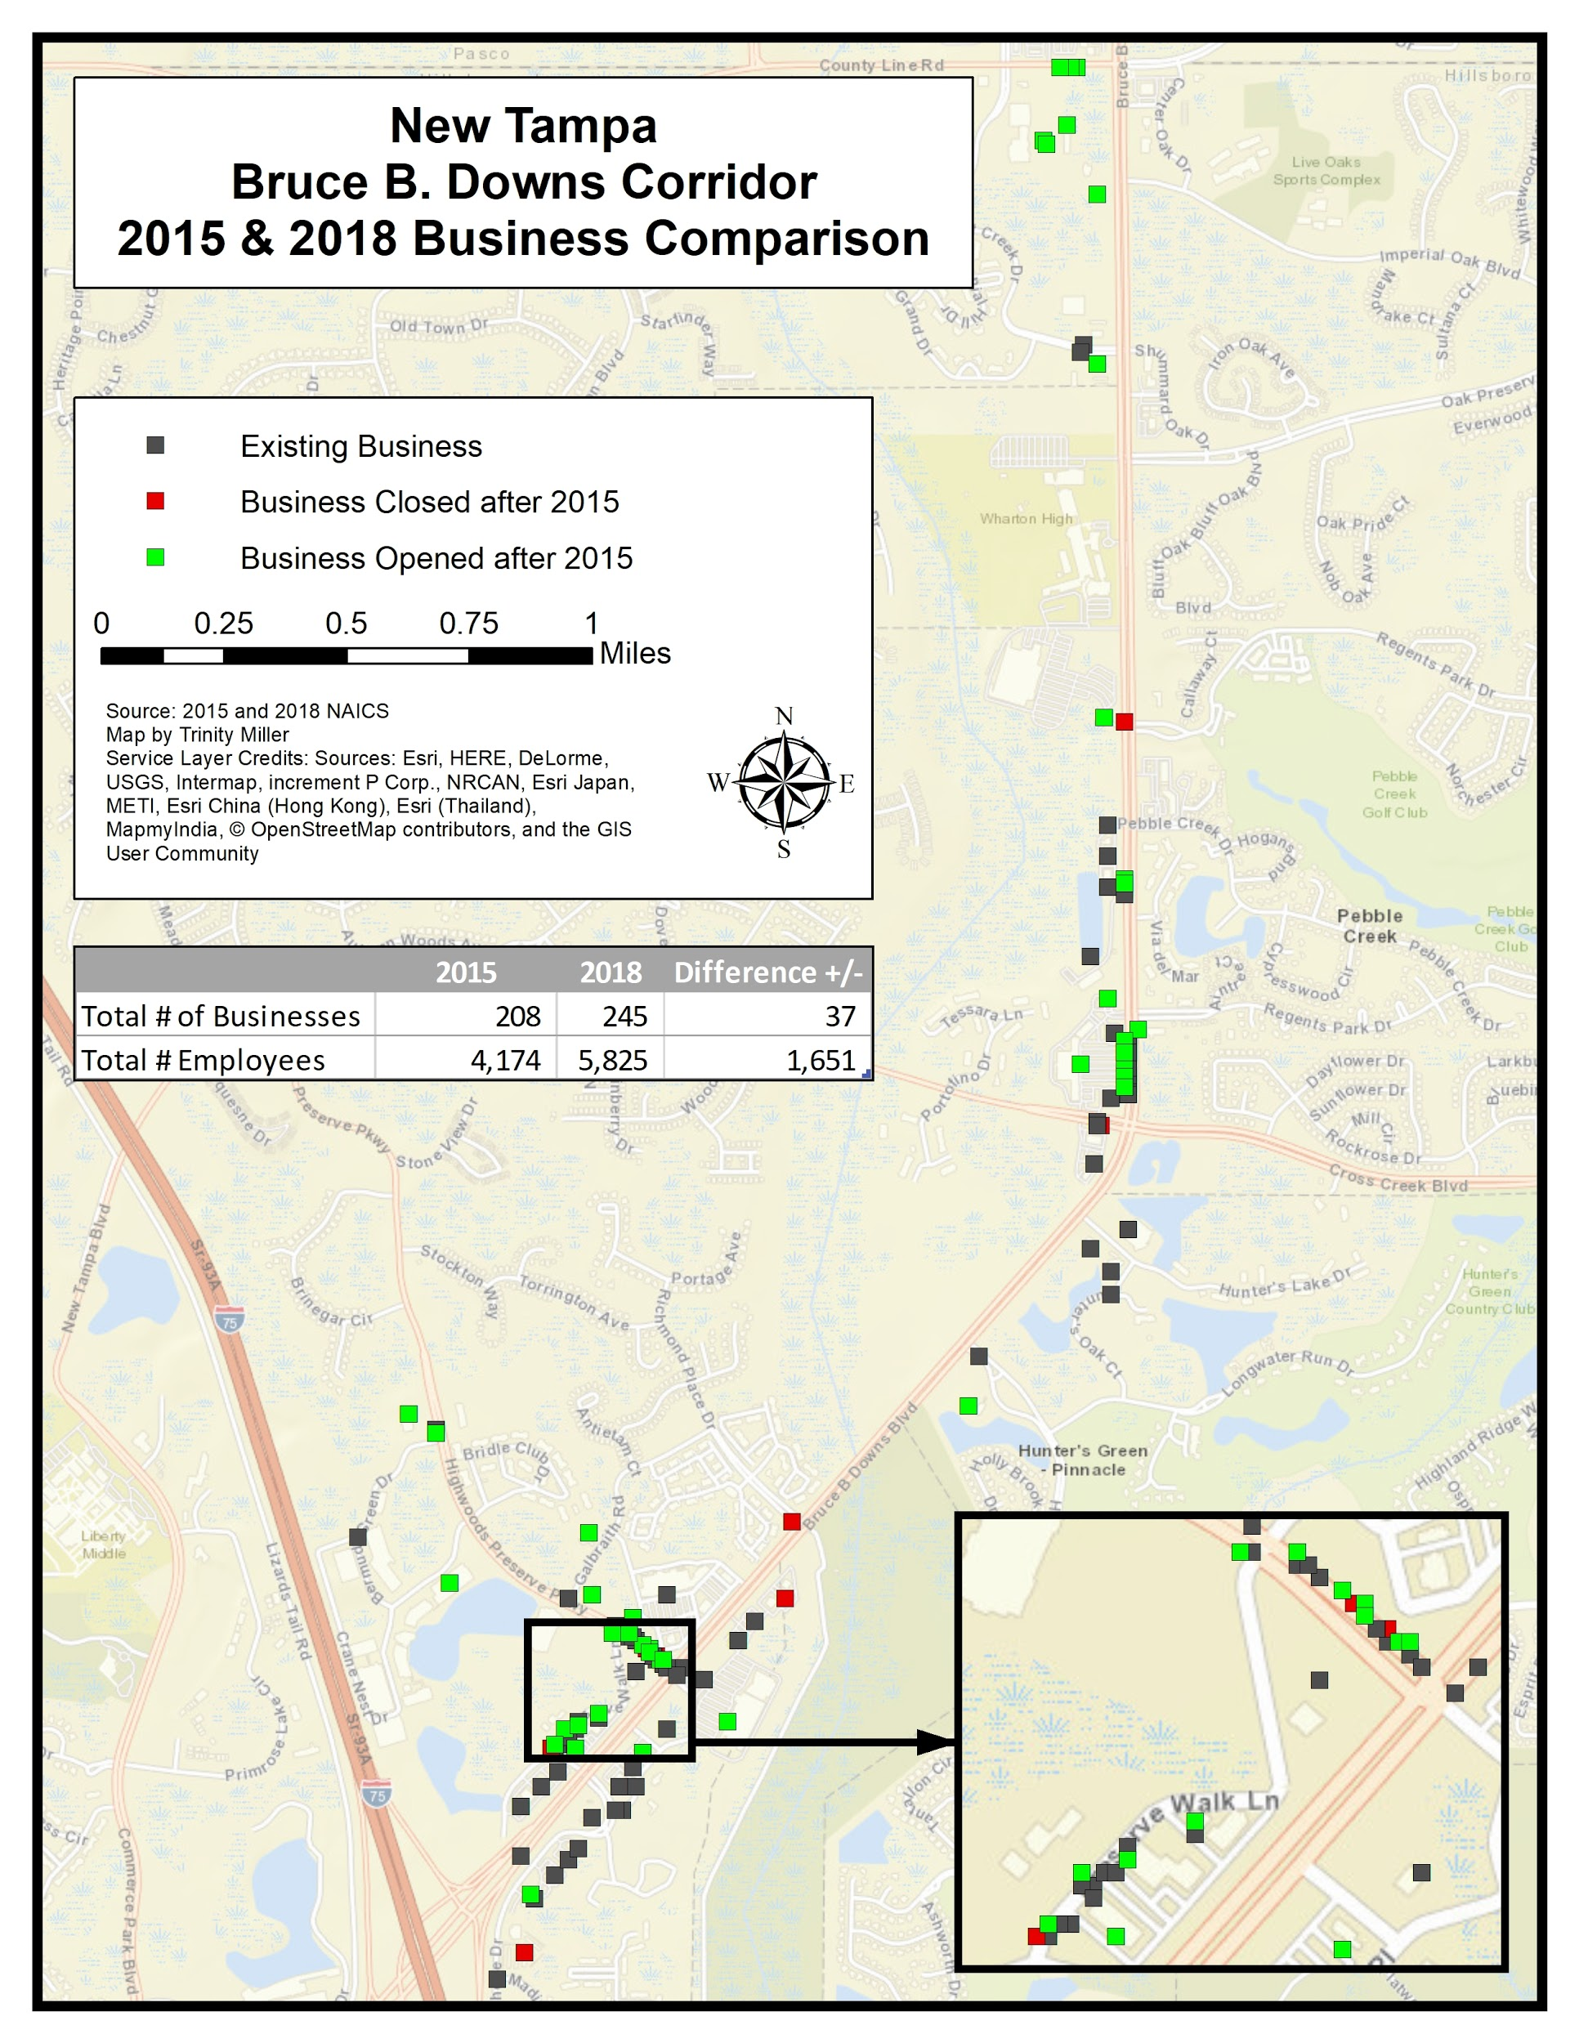
Phase II: Quantitative Analysis
The main corridor of economic activity analyzed was along Bruce B. Downs, the main ingress/egress of the area, from I-75 north to County Line Road
(2015-2018) 57 businesses closed within the study area, losing annual sales volume of $121,685,000
During the same time period, 94 new businesses opened and they generated $180,921,000 in annual sales volume
Net positive increase in total businesses (37), total employees (1,651), and total sales volume ($59,236,000) between 2015 and 2018
Notes:
Covers 19 square miles

Slide 9
Phase II: Quantitative Analysis
NAICS SQ FT Code | Example of Business (by SQ FT Code) | Total Business Closures | Total Employees | Total Sales Volume (in thousands)
A | WING ZONE | 21 | 75 | 6,418
B | ROMANO'S MACARONI GRILL | 23 | 273 | 54,735
C | PIER 1 IMPORTS | 8 | 69 | 25,320
D | WINN-DIXIE | 2 | 162 | 38,143
Of the business closures, 23 (42.6%) were NAICS SQ FT Code B (Table 4). Of the business openings after 2015, 26 (31.7%) were NAICS SQ FT Code 3 (Table 5).
Table 4 Business closures by NAICS SQ FT Code category
NAICS SQ FT Code | Example of Business (by SQ FT Code) | Total Business Openings | Total Employees | Total Sales Volume (in thousands)
1 | PURE NAIL BAR SPA INC | 4 | 7 | 963
2 | CHINA WOK | 13 | 37 | 3,507
3 | HUNGRY HOWIE'S PIZZA | 26 | 94 | 14,327
4 | BACKYARD POOL SUPPLIES INC | 17 | 108 | 14,063
5 | OPTICAL OUTLETS | 9 | 37 | 3,860
6 | 54 REALTY GROUP | 11 | 78 | 12,872
7 | PIER 1 IMPORTS | 4 | 79 | 10,952
8 | WINN-DIXIE | 8 | 1035 | 120,377
Table 5 Business openings after 2015 by NAICS SQFT Code
Notes:
Covers 19 square miles

Slide 10
Recommendations
Create a Business Retention and Expansion (BR&E) Committee, these committees can help organize local stakeholders to brainstorm solutions to problems we identified but are outside the scope of this research (commercial rent prices, adaptive reuse)
Increase small business activity by creating a comprehensive small business plan
Residents feel that New Tampa has no significant culture or landmarks. One urban planning concept to solve this problem and others is to create locality development goals:
  New Tampa could emphasize town scaping; identifying visual appearance that may draw on the area’s history or future. Include this in the new gathering spaces (Parks, Cultural Arts Center)
  Create a community slogan and signage so people passing by can identify that they are in New Tampa, and create a sense of place for the residents
Increase the offering of localized retail and dining options
  Ciccio's restaurant group, Buddy Brew, Blind Tiger Cafe, are all local brands that have name recognition, and could draw business from New Tampa and nearby areas (USF)
Connect with the MPO’s previous trail study and extend multi use trails in the community
  A trail network that connects neighborhoods, Tampa Palms was suggested as a first community to start the process
Notes:
Covers 19 square miles

Slide 11
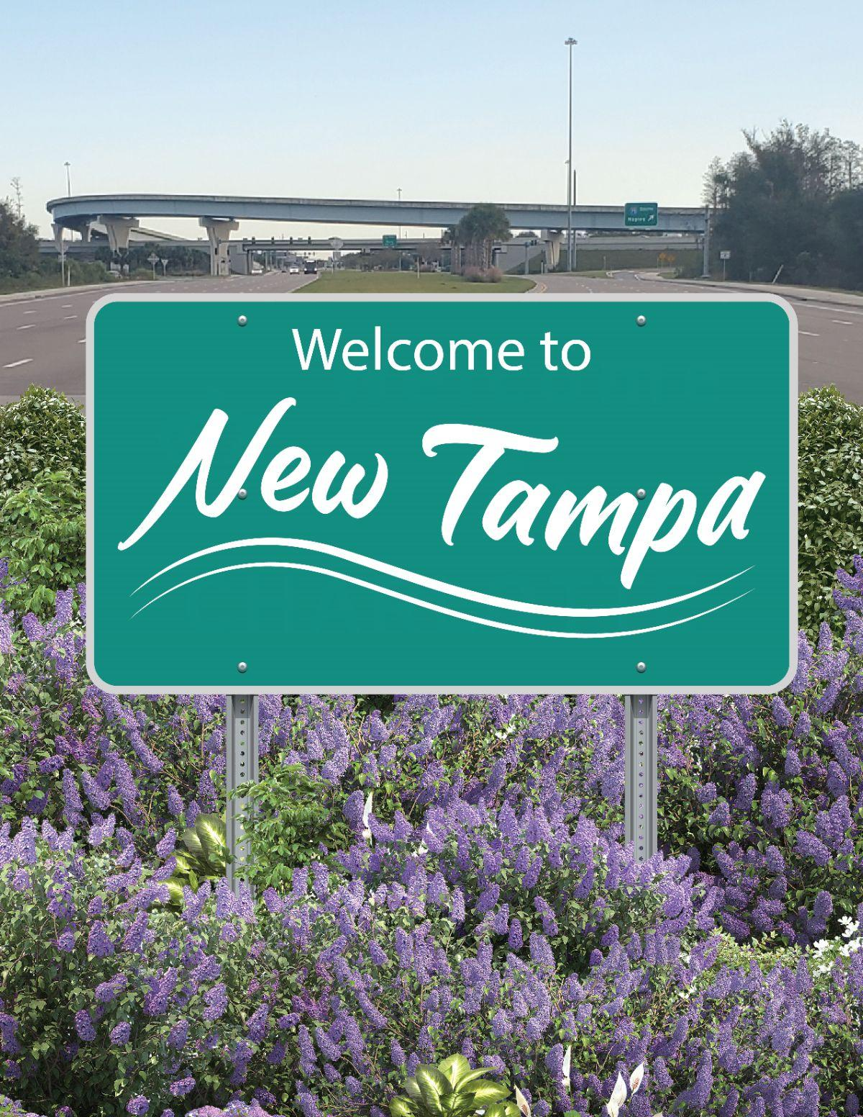
Example of Possible Community Sign/Slogan
Welcome to New Tampa:
“Something for Everyone”

Slide 12
Future Research Opportunities
Community Survey Tool: USF Community Preferences Survey
Developed with help from Dr. Neely and USF MPA students, who built a survey tool to gauge New Tampa residents community preferences and perceptions
Methodology:
Postcard mailing in 33647 zip code, City of Tampa customized, link for web access provided
Post Qualtrics survey link online
  This survey link on a created website could improve search optimization for New Tampa, when searching “New Tampa” on Google you are given inaccurate information like Wesley Chapel of 33544, and images of the Shoppes at Wiregrass Mall
New Tampa Business Climate Study: Presentation to community February 3rd, at Compton Park
Notes:
Covers 19 square miles

Slide 13

Special Thanks !
USF research team wants to give special thanks to Council Member Viera and Brannon Jordan Lazo, Mayor Jane Castor, John Iwanicki, Karen Frashier, Karen-Tillman Gosselin, Ron Sanders, Mark Hafen, and Stephen Neely
College of Arts & Sciences
School of Public Affairs

