Slide 1
Fiscal Year 2023-2024
Operating Budget
USF Board of Trustees
June 13, 2023

Slide 2
Objectives
Impacts on 2023-2024 Operating Budget
2023-2024 Operating Budget
2023-2024 Educational & General Budget Priorities

Slide 3
Proposed Actions
Approve the University of South Florida fiscal year 2023-24 Continuation and Operating Budgets and;
Authorize the President (or Designee) to implement state issued budget amendments or other immaterial changes during the fiscal year.

Slide 4
FY24 Operating Budget Calendar for USF
June 13, 2023
BOT Meeting
FY24 Continuation and Operating Budgets Approved
August, 2023
BOT Meeting
CF and FCO Plans Approved
August 18, 2023
Operating Budget Submitted to the Board of Governors
October 2, 2023
CF and FCO Plans submitted to the Board of Governors
Allocation Details Presented
June 30, 2023
President and Provost Meetings
Allocation decisions finalized and communicated

Slide 5
Impacts on FY24 Budget

Slide 6
Impacts on FY24 Budget
Record Legislative Session – State Appropriations
  $63.3M in recurring resources
  $20.8M in non-recurring resources
  $47.3M for new equipment and facilities construction
State Performance Based Funding ~$14.2M incremental (49.6M Total State Investment)
Enrollment and Tuition Collections
Bargained wage increases, internal equity and state-mandated benefit improvements
Balanced E&G Budget
Cost efficiencies and effectiveness opportunities remain

Slide 7
Net Tuition Collections by Budget Entity
NOTE: All amounts are in thousands
*Forecasted, not yet final
Health SCH excludes Professional Programs

Slide 8
2023-2024 Operating Budget

Slide 9
FY 2022-23 Results
NOTES:
Operating Budget Funding Sources exclude Transfers In category from Schedule I because DSO revenues are listed as a source
USF Financing Corp Revenues were not included as it is primarily a flow through entity

Slide 10
Funding Sources for University of South Florida
NOTES:
Operating Budget Funding Sources exclude Transfers In category from Schedule I because DSO revenues are listed as a source
USF Financing Corp Revenues were not included as it is primarily a flow through entity

Slide 11
FY 2023 Major Source Differences Explained
State Appropriations
  $44M – Operational Support
  $33.3M – Preeminence
  $14.2M - PBF
Contracts & Grants
  COVID-19 Institutional Federal Funds fully expended in FY23
Auxiliaries
  Post COVID return to operations
DSO’s
  FY24 Plans approved in BOT Finance Committee

Slide 12
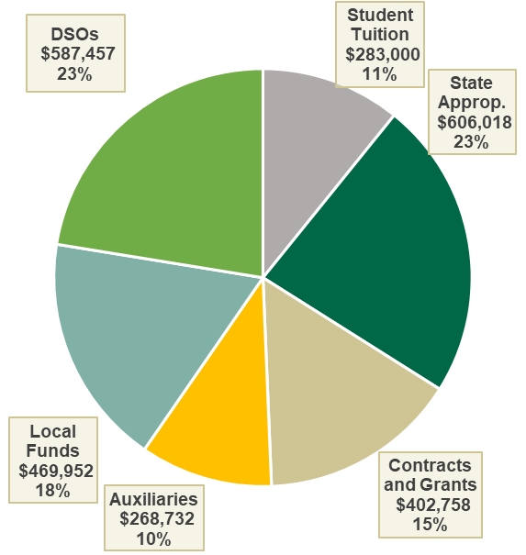
Funding Sources for University of South Florida
$2.6B Total
$2.6B Total
NOTE: All amounts in thousands

Slide 13
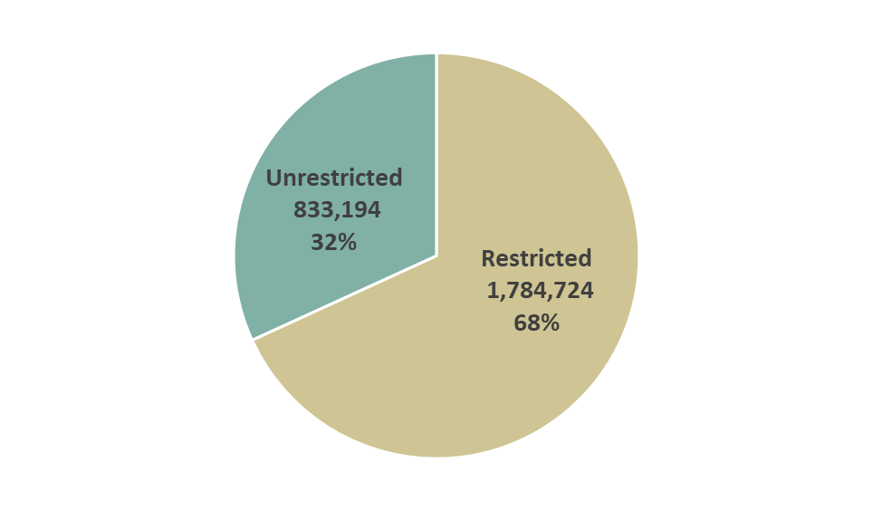
Operating Budget Sources - University of South Florida
NOTES:
All amounts in thousands
Operating Budget Funding Sources exclude Transfers In category from Schedule I because DSO revenues are listed as a source

Slide 14
Funding Uses for University of South Florida
NOTES:
All amounts in thousands
DSO figures exclude amounts transferred to the University as to not double count

Slide 15
2022-2023 Education & General Budget Priorities

Slide 16
State Funding for USF after the Legislative Session
Budget Committee made recommendations to President and Provost who will review and finalize allocation decisions across all budget entities
All allocations will align with our strategic plan, performance-based funding and our national ranking aspirations
The focus of distributions for FY24 include:
  Faculty & Staff Recruitment and Retention
  Student Success and Outcomes
  Infrastructure Support

Slide 17
Questions

Slide 18
Proposed Action
Approve the University of South Florida fiscal year 2023-24 Continuation and Operating Budgets and;
Authorize the President (or Designee) to implement state issued budget amendments or other immaterial changes during the fiscal year.

Slide 19
APPENDICIES

Slide 20
FY 24 Budget Priorities
Presented at the USF BOT Budget Workshop
Prasant Mohapatra
Provost & Executive Vice President
April 27, 2023

Slide 21
Focused List of Strategic Measures for Institutional Success
STUDENT SUCCESS
Incoming student profile
Academic Progress Rate
Class size <20
6-year Graduation Rate for FTICs
3-year graduation rate for Transfers
Bachelors employed 1 yr. post graduation
FACULTY SUCCESS
Proportion of Full-Time Faculty with highest degree
Total R&D Expenditures
Federal Research Expenditures
Faculty Awards, Fellowships, and Memberships
Citations (CNCI)
Alumni Giving & Endowment
Summary of Strategic Investments
Recruitment and retention of top-quality people (faculty & staff)
Student academic progress (quality of curriculum, advisors, mental health & wellness)
Infrastructure support (physical & technical)

Slide 22
Investing in Institutional Excellence
Invest in Faculty & Staff Recruitment & Retention
Invest in Student Success Outcomes
Ensure Infrastructure Support

Slide 23
Prioritized Investments in Institutional Excellence
Investments in Faculty & Staff Recruitment & Retention
  Recruit world-class faculty with terminal degrees at all levels
  Ensure that competitive faculty start-ups are fully supported
  Invest in outstanding administrative and technical staff
  Invest in Faculty and Staff Success

Slide 24
Prioritized Investments in Institutional Excellence
Investments in Student Success Outcomes
  Improve incoming student profile
  Invest in Strategic Enrollment Planning and Management
  Invest in academic advisors and in student mental health & wellness
  Provide individualized attention to students in small class sizes
  Streamline curriculum and optimize modes of delivery
  Invest in career readiness of students

Slide 25
Prioritized Investments in Institutional Excellence
Ensuring Infrastructure Support
  Develop needed physical facilities (new, deferred maintenance, renovate)
  Modernize technological platforms

Slide 26
Areas of Opportunity to Close Gaps
Richard Sobieray
Senior VP and CFO
April 27, 2023

Slide 27

Areas of Opportunity to Close Funding Gap - Completed
Growing revenue and optimizing its distribution through efficiency and effectiveness are the cornerstones to successfully closing the funding gap.
 | Opportunity | Decisions ● Completed | Status
1. | Budget Model Process | The university desired a new budget model that was transparent, predictable and moved it in the direction of tying investments to our strategic plan, rankings, performance-based funding and AAU membership. The new model has been implemented. Future improvements will be made through the RCM implementation. | ●
2. | ESCO | Energy service companies (ESCOs) are companies that offer energy services to customers, such as implementing energy-efficiency projects, reducing energy costs, and arranging financing for energy systems. ESCOs use the performance-based contracting methodology, which means their compensation is linked to the actual energy savings achieved. USF has finalized their ESCO with Siemens. Estimated value: $47M over 20 years | ●
3. | JP Morgan Chase Banking | An ITN for banking services was completed and all lots were awarded to JP Morgan Chase to optimize pricing of banking fees and procurement card rebate. Estimated value: $3M annually | ●

Slide 28
Areas of Opportunity to Close Funding Gap – In Process
Growing revenue and optimizing its distribution through efficiency and effectiveness are the cornerstones to successfully closing the funding gap.
 | Opportunity | Decisions ● Initial Recommendation ● In Discussion ● Pending Discussion | Status | Delivery Date
1. | Improving Net Tuition | Improving net tuition is primarily two-fold: 1) changing enrollment strategies and 2) optimizing discount strategies. Ruffalo Noel Levitz (RNL) has been engaged to address the university’s enrollment and discounting strategies. Target: $15M - $20M increase | ● | 9.30.2023
2. | Increasing Contracts and Grants | Having an effective research structure and funds flow model are critical elements for incentivizing the growth in research. Initial recommendations for both structure and funds flow are completed. Socialization has begun. Target: $50M - $100M increase | ● | 3.31.2023
3. | Philanthropy Growth | The top R1 universities rely on a large endowment to in part support its student scholarship and research enterprise. USF’s endowment size gap compared to AAU and top-25 universities as at least $1B. Target: TBD | ● | TBD
4. | Financing Strategies - Broadband | The university has assessed the viability of monetizing a lease currently executed for broadband access. Recommendations are completed and the process for securing this option has begun. Target: $25M - $40M | ● | 2.24.2023
5. | Financing Strategies – Parking and Housing | The university engaged Morgan Stanley in an initial assessment of the potential opportunity for monetizing the parking and housing revenue stream. As a result, a Parking Task Force has just been established to determine its feasibility. A Housing Task Force will follow. Target: $400M - $600M | ● | 9.30.2023/ 12.31.2023

Slide 29
Areas of Opportunity to Close Funding Gap – In Process
Growing revenue and optimizing its distribution through efficiency and effectiveness are the cornerstones to successfully closing the funding gap.
 | Opportunity | Decisions ● Initial Recommendation ● In Discussion ● Pending Discussion | Status | Delivery Date
6. | Responsibility Center Management | RCM provides a foundation for analysis including funds flow, portfolio, margin, service cost and strategic investment/subvention. This means it provides the university with better insight on how invested resources provide a high academic return relative to their net costs. | ● | 6.30.2023
7. | College Performance – Instructional Capacity | Realizing academic efficiencies is one approach to optimizing revenue distribution. Instructional capacity analysis surfaces under-filled classes, small classes and under-utilized instructional capacity. EAB has been engaged to assist with this analysis. Work beginning end of April. Target: TBD | ● | 12.31.2023
8. | College Performance – Academic Program Assessment | Academic Program Assessment develops a program portfolio review rubric and surfaces opportunities to start new programs, revitalize current programs or eliminate low-performing programs. In discussion with Gray & Associates to implement their technology and consulting services. Target: TBD | ● | 6.30.2024
9. | Administrative Efficiency | Effective transformation requires an enterprise-wide approach to improve and enhance organizational models, operating processes, technology, leadership and talent models. A consultant is being considered to assist through this process, including a zero-based budget for FY2025 to ensure maximal efficiency and effectiveness. Target: TBD | ● | 6.30.2024
10. | Space Optimization | The university is funneling resources into its physical campus, but it’s still not enough to keep up or much less advance future strategy. The university should consider repurposing space to meet evolving needs and minimize costs. Target: TBD | ● | 6.30.2024

Slide 30
Funding Sources Definitions

Slide 31
Education & General
Definition:
The Education and General (E&G) budget consists of State appropriated General Revenue, Educational Enhancement (Lottery) funding, and Student Tuition authority.
Restrictions:
E&G funds are available for use across all of the costs associated with general instruction, research, public service, plant operations and maintenance, student services, libraries, administrative support, and other enrollment-related and stand-alone operations of the university.
Specific components of Tuition Differential have to be spent on Need-Based Financial Aid.
*Additionally, USF provides Education and General Funds toward Financial Aid

Slide 32
Carryforward Funds
Definition:
Unspent E&G balance that carries into the following year(s)
Restrictions:
7% has to be set aside in BOG Required Reserve
Can only be spent on non-recurring expenditures
CF Spending plan has to be approved by the Board of Trustees each year
Capital Improvement projects can only be funded up to a certain $ limit

Slide 33
Contracts & Grants
Definition:
The Contracts and Grants (C&G) budget consists of funding from federal agencies, state agencies, foundations, and private sources that enables the university to conduct specific research projects or to provide specific non-research services.
Contracts & Grants funds include USF sponsored research projects
Other Research funds include RIA, F&A, Endowed Chair, and Convenience funds
Restrictions:
Expenditures to support research grants include:
direct costs such as salaries, wages, and benefits of research personnel, materials, supplies, travel, equipment, and rental of space that are directly attributed to the research project, and
indirect costs such as building and equipment use and depreciation, physical plant and maintenance, hazardous waste disposal, libraries, general administration costs (legal, purchasing, accounting), janitorial services, and utilities.
Notes:
Need to do a breakdown; get together with ORI to breakdown between grants and F&A funds

Slide 34
Auxiliary Enterprises
Definition:
The Auxiliary Enterprises consist of university business operations that are self-supporting through user fees, payments and charges.
Types of Auxiliaries:
Auxiliaries with Bond Financed Facilities
Other Auxiliaries
Restrictions:
Auxiliaries are required by Board Regulation to be self-supporting and are reviewed by external entities on a periodic basis to ensure compliance

Slide 35
Local Funds
Definition:
Funding sources for university operating units that include Student Activities, Financial Aid, Concessions, Intercollegiate Athletics, Technology Fee, Board-Approved Fees, and university Self-Insurance Plans
Restrictions:
Each of the above categories has their own restrictions

Slide 36
Local Funds
Financial Aid:
The Student Financial Aid budget consists of funding from student financial aid fees, support from federal and state financial aid awards, institutional programs, and private scholarships.
Funding is provided for a specific purpose and/or a specific student/program
Funds provided for financial aid that are not for specific student/program are managed by Financial Aid Policy Advisory Committee (FAPAC)
Athletics:
The Athletics Operating budget supports the university’s student athletics program. Funding is generated from student athletics fees as well as ticket sales to athletics events, game guarantees, NCAA distributions, sponsorships and private support. Intercollegiate Athletics is also supported by Title IX funding, waivers and scholarships, and a statutory tax on ticket sales to support women’s sports.

Slide 37
Local Funds
Student Activities (aka Activity & Service) Fee:
The Activity and Service budget consists of funds from the student Activity and Service (A&S) fee to support Student Affairs operations, student government operations, student activities such as clubs and organizations, student centers, and recreational sports for all campuses.
Technology Fee:
The fee revenues are used to enhance instructional technology resources for students and faculty.
Board Approved Fees:
Board Approved Fees are fees specific to the university and have been approved by the Board of Governors (Regulation 7.003(23)). The only such fee for USF is the Green Fee that funds sustainability projects on campus and is managed by a group of students and faculty.

Slide 38
Local Funds
Self-Insurance:
These are revenues received by the university to fund a self-insurance program for medical schools, including the Faculty Practice Plans. There shall be no state funds appropriated to a self-insurance program (Chapter 1004.24(3) Florida Statutes).
Concessions:
The Concessions fund contains all the commission-based revenues from beverage and pouring, snack vending, as well as student housing laundry machines. The commission revenues are used to support the purchase of food and refreshment items at university-wide events, faculty and staff recruitment, commencements, training, lecture series, board of trustees, student housing socials and convocation events. Funds shall not be expended for the construction or reconstruction of buildings except as provided under s. 1013.74 F.S.

Slide 39
Direct Support Organization Funds
Definition:
Per Florida Statute 1004.28 (1)(a), “University direct-support organization” means an organization which is:
A Florida corporation not for profit incorporated under the provisions of chapter 617 and approved by the Department of State.
Organized and operated exclusively to receive, hold, invest, and administer property and to make expenditures to or for the benefit of a state university in Florida or for the benefit of a research and development park or research and development authority affiliated with a state university and organized under part V of chapter 159.”
Restrictions:
Similar to Auxiliary Enterprises, DSO’s must be self-supporting; the key distinction is that DSO’s are formally incorporated.

Slide 40
DSO’s include:
Faculty Practice Plan (UMSA)
USF Alumni Association
USF Foundation
USF Health Professions Conferencing
USF Institute of Applied Engineering
USF Research Foundation
Sun Dome
NOTE: USF Financing Corp Revenues were not included as it is primarily a flow through entity. It does have immaterial revenues related to the ownership interest in INTO which is primarily Tampa related, but since these amounts are immaterial on the Financing Corp financial statements, they were not included in the presentation.

