Slide 1
Depository Accounts and Reconciliation
A journey through lockboxes and ACH’s

Slide 2
Agenda
Account Reconciliation Process:
    Banner
    PeopleSoft
ACH
Lockbox

Slide 4
Account Reconciliation Process
- Bank reconciliations are prepared at the beginning of each month for the previous month’s transactions.
- The process begins by completing a comparison. This is done by matching all transactions recorded to the general ledger by figures and deposit numbers against all deposits posted to the bank statement.
General Accounting is also responsible to complete daily audits of all transactions processed by the UCO cashier’s office. All discrepancies are submitted back to the cashiers office for corrections. This process corrects errors before the reconciliation is completed.
After researching differences against all original paperwork, all outstanding items and deposits remain in transit until the following month.

Slide 5
Account Reconciliation Process
If there are any discrepancies General Accounting will contact the department immediately and the department will be responsible for submitting a correction to the Cashier’s office.
Most common errors:
  A. Totaling - Differences between amount recorded and amount deposited
  B. Unrecorded deposits
  C. Transactions recorded to the wrong G/L account
  D. Timeliness, Timeliness, Timeliness…
  E. Discrepancies on the deposit slip totals on the actual deposit slip.
  F. Differences on the actual checks that are being deposited. The written out check amount overrides the numerical amount of the check.
All reconciliations are required to be completed and submitted to the Associate Controller by the end of month.

Slide 6
Account Reconciliation Process
An important fact to always remember to adhere to is Internal Controls.
This involves:
  The safety of all funds.
  The timeliness of recording the receipt of all funds.
  That reconciliations are completed and reviewed on a regular schedule by the different departments and General Accounting.

Slide 7

ACH
This Photo by Unknown Author is licensed under CC BY

Slide 8
ACH
Is an electronic transfer of funds in which the money is taken directly from a bank account, typically a checking account.
It is a representation of the paper check but it combines the security, speed and processing efficiencies of an electronic transaction.
The account’s routing and account number are used to draw funds from the account.

Slide 9
How does the process work?
Customer – Touch net System - Bank
Customer Initiates an ach and submits.
Once the transaction is submitted, payment information is securely transmitted via the Touchnet system Gateway and is accepted or rejected.
If accepted, Touchnet formats the transaction information and sends it to the bank.
Cashiers Office pulls a report and posts through Journal Entry to various chart fields.

Slide 10
Touchnet Payment Gateway
Touchnet is a leading provider of technological services that make self-service information access more efficient and convenient for both our institution and the individual user.
It provides students the ability to pay : It provides departments the ability to pay :
Tuition Deposits
Transcripts Fees for development classes
Housing Other miscellaneous fees
Make sure there are funds to avoid fees

Slide 11
Touchnet Security System
Touch net systems is protected behind a firewall access list. All data is encrypted for maximum security.
Data for each Department is maintained according to specific merchant or account configuration.
Each user has the ability to view data for his/her department after entering the system according to specific roles.

Slide 12
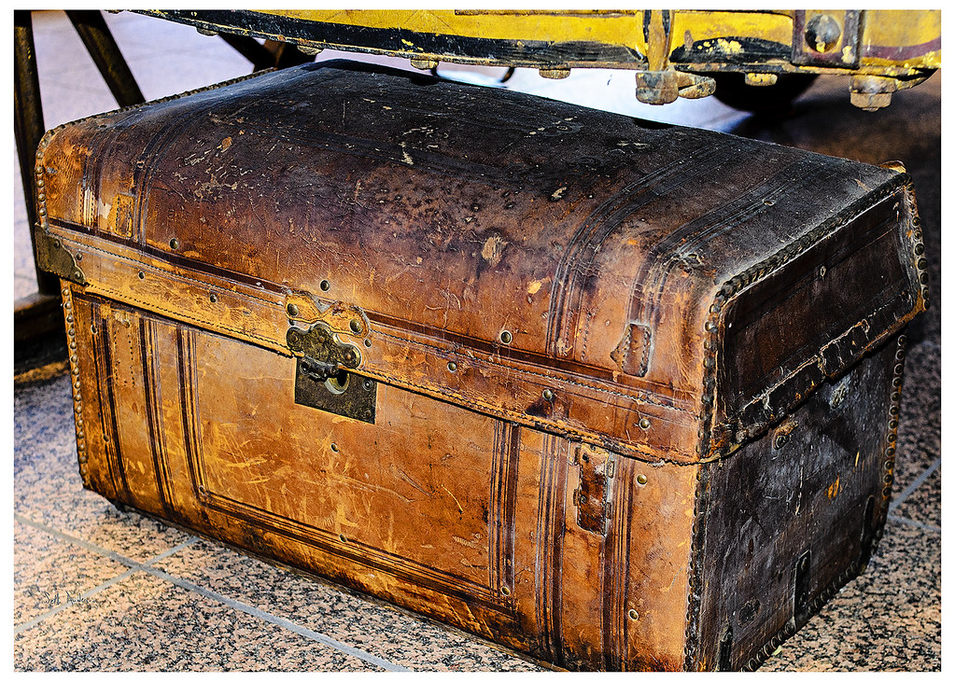
Lockbox
This Photo by Unknown Author is licensed under CC BY-SA-NC

Slide 13
Lockbox
Is a Banking service that works like a post office box the bank establishes for your department. The department will have to provide their customers a remit to address; this will allow them to send all payments to invoices directly to the lockbox.
The bank will control and receive all correspondence, deposit the checks into your account, and provide general accounting with an electronic access that allows us to view daily information and activities.

Slide 14
Lockbox Benefits
Faster Funds Availability – Directing your remittance to Wells Fargo for processing allows you to meet earlier deposit deadlines and benefit from improved cash forecasting and funds availability. Customer’s payments are sent directly to your department assigned box.
Advanced Image Technology – Within a matter of seconds, you have access to a Web based archive that provides all information you need.
Reports – On a same day basis, the payments are deposited, and an account batch listing and deposit summary report is available online.

Slide 15
How to record your deposits
After reviewing your deposits you are to complete a Miscellaneous Receipt form for all your previous day transactions. This form will be sent to the Cashier’s office for processing and recorded to the General Ledger. All forms are required to have an attached copy of the lockbox report.
Once the deposit is in the system, General Accounting will complete a monthly reconciliation.
Each Department’s revenue is reviewed and compared on a daily basis to the bank statement by using the assigned Lockbox number. It is very important that all information is complete and accurate; this will help avoid any errors in the recording and reconciliation process.

Slide 16
How to record your deposits? Continued…
In case there are any discrepancies, General Accounting will immediately contact the department via email and will attach a copy of the reconciliation for review.
To avoid any Audit criticism it is very important that all corrections are completed and sent to the Cashier’s office as soon as possible.
All deposits are to be submitted to the UCO Cashier’s office on a daily basis.

Slide 17
Lockbox Information
We suggest that you do an analysis for your department before deciding if this form of cash collection is beneficial for your department. Although a lockbox is very effective there are service fees involved and justification is required by administration.
For more information on Lockbox services please contact Cherie Carson at the University’s Controller’s office at (813) 974-7686

Slide 18
Contacts
Cherie Carson, Accounting Manager Jonathan Andrews, Accounting Manager
General Accounting Cashiers Office
  (813) 974-7686 (813) 974-5748
  Carsonc@usf.edu Andrews5@usf.edu
Depository Accounts Fast Accounts
Stancey Peprah- Staff Accountant Noemi Merced- Staff Accountant
(813) 974-2689 (813) 974-4914
stancey1@usf.edu nmerced@usf.edu

Slide 19
THANK YOU!

