Slide 1
Basic Accounting Concepts

Slide 2

Agenda
  Budget
  Guiding Principles
  Voucher
  Journal Masks / Entries
  Accrual Accounting
  UCO Resources

Slide 3
Budget
Managing and Checking Budgets
Incurred Expenses
RSA
Definitions

Slide 4
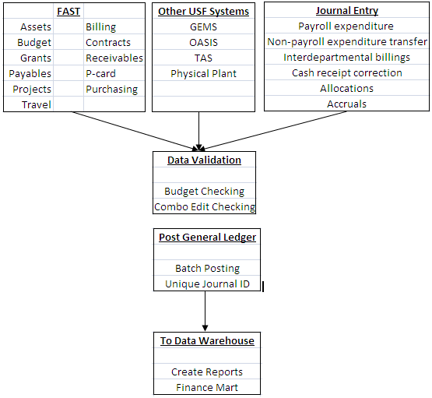
The Data Flow

Slide 5
Managing Our Budget
Commitment control is used two ways
  Expenses are budgeted for all funding sources
    Tracking with budget
    Full budget control
Budget is released to specific chart field strings
  A chart field is a way to tag a transaction
  Chart fields are grouped together as a chart field string to direct how the accounting entry is recorded and reported
  Also used for revenue tracking in auxiliary funds

Slide 6
When does USF budget check?
Budget checking is initiated when:
  A requisition is submitted
  A purchase order is created
  A change order is submitted
  An invoice is paid
  An expenditure transfer is submitted
  An interdepartmental billing is submitted
  Travel authorization is submitted
  Travel expense report is submitted
  PCard expense is posted
  A customer billing is created
  A deposit is recorded by a cashier
  During automated nightly processing
  On demand by authorized users

Slide 7
How does USF incur expense?
Expense Method | Budget Impact
Salary | Not encumbered; RSA is reduced when salary is posted
Travel Authorization | Encumbered when the travel authorization is created; reduces RSA
Travel Expense Report | Not encumbered; RSA is reduced when the expense is posted
PCard Purchases | Not encumbered; RSA is reduced when the expense is posted
Expense Action | Budget Impact
Item purchased with a purchase order | Encumbered when the requisition is created
Interdepartmental buying; departments sell to each other | Not encumbered; RSA is reduced when the journal entry is posted in general ledger
Expenditure transfers | Not encumbered; RSA is reduced on the new chart field string and increased on the old chart field string when the transaction is posted in general ledger

Slide 8
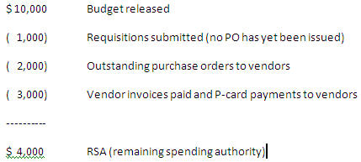
RSA – Remaining Spending Authority

Slide 9
How does USF account for Funds?
USF practices fund accounting
Funds are categorized in a fund group
Within the fund groups, there are individual fund IDs
All are subject to budget checking
Fund accounting helps ensure proper use of funds; accountability is the key

Slide 10
Definitions
Public purpose
  General revenue (often referred to as E&G)
    State funds allocated by the legislature to USF each fiscal year; derived from sales tax collections
    These funds begin with a “1”
  Carry-forward funds
    Unspent general revenue funding from the prior fiscal year
    These funds begin with a “1”; normally 10009
  Auxiliary funds
    Auxiliaries require an EBA approved by USF Controller’s Office to conduct commercial business activities with customers outside USF
    Auxiliaries at USFSP begin with a “07”; at USFSM with a “06”

Slide 11
Definitions
Special purpose
  Sponsored research funds
    Allocated by a federal, state or private agency to USF with a PI (project investigator) identified with a specific line item budget
  RIA - research initiative may include
    F&A recovery and residuals from fixed price contracts
    Faculty startup
    Internal awards
    These funds begin with “183”
    These funds are subject to full budget control
  Student fees
    Tuition and fees paid to USF by the students to be used only for student support

Slide 12
Definitions
Not USF money
  Student financial aid
    May be received from federal, state, or private sources
    May involve a transfer from the USF Foundation
  Agency funds
    For example sales tax collected from commercial sales of services to customers outside of USF
  Convenience funds
    Reimbursement received from a DSO - for example UMSA receiving funds in acknowledgement of effort expended by USF staff in support of the USF College of Medicine clinics

Slide 13
EBA – Educational Business Activity
An EBA is a revenue-raising activity that supports the overall mission of USF.
Departments and units submit the request to the Controller’s Office for authorization to conduct a business
  Find information and forms on the University Controller’s Website
  Submit a request to create a new EBA or to update an existing EBA
Include in the request
  EBA Request Form
  EBA Business Plan
  EBA Schedule

Slide 14
Guiding Principles
State Funds
Auxiliary Funds
Research

Slide 15
Guiding Principles – State Funds
Concepts
  State appropriations must be expended in accordance with the State Department of Financial Services, Division of Accounting and Auditing
  In general moneys may only be expended for reasonable and appropriate goods or services necessary to accomplish the mission of the University (teaching, research, and public service)
  Generally spending is allowed from any of the expense account code categories unless specifically addressed in Florida Statute or USF guidelines
  State and USF negotiated contracts with vendors must be observed
Restrictions
  If the item for payment is generally used solely for the personal convenience of employees and which generally are not necessary in order for the University to carry out its statutory duties, the unit must provide justification for the purchase of these items or perquisite approval by an appropriate official
  E&G moneys cannot be expended to satisfy the personal preference of employees
  For example, cannot be used for
    Portable heaters, fans, refrigerators, stoves, microwaves, coffee pots or supplies, picture frames, wall hangings, decorations, etc.

Slide 16
Guiding Principles – State Funds (continued)
More specific restrictions
  Expenditures from state funds for the following items are prohibited unless “expressly provided by law”
    Congratulatory telegrams
    Flowers and/or telegraphic condolences
    Presentment of plaques for outstanding service
    Refreshments such as coffee or doughnuts
    Decorative items (artwork, plants, etc.)
    Greeting cards

Slide 17
Guiding Principles – Auxiliary Funds
Concept
  Auxiliary moneys may be expended for any goods or services necessary to fulfill the mission and programmatic needs for which the auxiliary was established under the USF authorized EBA
  Find more information by searching for EBA on Business Processes
Generally spending is allowed from any of the expense account code categories unless specifically addressed in Florida Statute or USF guidelines

Slide 18
Guiding Principles - Research
Concept
  These funds are much more restrictive in that expenditures must meet the specific budgetary requirements of the project as specified in the Notice of Award.
    Some projects may also specify expenditures that would otherwise not be allowed
    Examples are payments to research participants and certain items of a personal nature that are necessary as part of the sponsored project (example: food or clothing items)
Sponsored Research
  Federal research governed by OMB circulars A-21, A-110 and A-133; there are also specific Cost Accounting Standards that apply
  State agencies and private foundations also have specific guidelines
  USF Internal Awards Program
    The mission of the Internal Awards Program is to foster excellence in research and scholarship by USF faculty and support activities aimed at securing extramural funding
Consult USF Research for more details

Slide 19
Voucher
What is a Voucher?
Voucher Accounting Entry
Voucher Information

Slide 20
What is a Voucher?
A voucher can be defined as a document used in an internal control system to contain and verify all information about a bill to be processed or paid
Vouchers are recorded in the Accounts Payable module and are managed by UCO Accounts Payable
Vouchers have unique identifying numbers
  At USF, voucher ID’s are eight digit beginning with a zero

Slide 21

The Voucher Accounting Entry
Vouchers are produced
  After receiving the vendor invoice
  After matching occurs (matching the PO, vendor invoice, and receiving document)
  After the bank bills USF for PCard activity
An accounting entry is created
  Recording the expense (a debit to expense)
  Recording a liability to the vendor (a credit to liability)
A typical voucher accounting entry would look like the below:

Slide 22
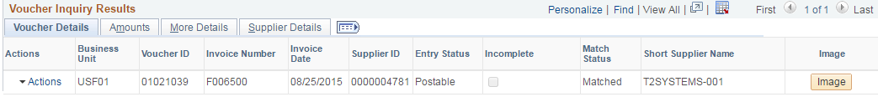
The Voucher Information
Remember the USF chart of account codes
  Liability accounts begin with a “2”
  Vendor expense accounts begin with a “5” or “6”
A voucher is packed with vendor and payment information
Find voucher information in the accounts payable module of FAST

Slide 23
Journal Masks / Entries
What is a Journal?
Journal Mask
Journal Entries
  How to submit a Journal Entries
  Deadlines for Journal Entries
  Where to send Journal Entries

Slide 24
What is a Journal?
Most transactions are created in various modules (aka subsidiary ledgers)
Transactions that are similar in nature are batched into journals
The journals are posted to the general ledger
The general ledger displays high level summary of accounting transactions based on chart fields and accounting periods
Journals have unique identifying numbers
The numbering scheme for journals is
  Letters (usually three); called a journal mask
  Seven digits automatically assigned by the system in sequence
The journal ID is unique
The journal mask (the letters) identifies either the character of the transactions or the source of the transactions
To understand journal masks, use the University Controller’s Office Website – Internal Accounting Services

Slide 25
Sample of Common Journal Masks
Journal Masks | Definition
APA | accounts payable accrual (vouchering)
APP | accounts payable payments to vendors
BNR | transactions originating in Banner/OASIS
TAS | telephone billings from USF IT
EXA | travel expense accrual
EXP | travel expense reimbursements
ARB | accounts receivable billings to customers
ETR | non-payroll expenditure transfer

Slide 26
Journal Entries
Journal entries are balanced accounting transactions posted directly to the general ledger
Journal entries may need to be created
  Resulting from discovery during reconciliation
  To initiate an expenditure correction
  To initiate a cash correction
  To initiate an interdepartmental billing
All journal entries are budget checked
  Including expenditure transfers
  Including interdepartmental billings
*Choose the right journal mask

Slide 27
Journal Entries can be delayed
Budget issues
  Insufficient RSA (remaining spending authority)
  Chart field string never had budget released
  If a grant, the transaction date is out of bounds
Accounting coding
  An invalid chart field is being used
  An invalid chart field string is being used (combination edit)
  A sponsored project may have passed it’s ending date

Slide 28
How to submit Journal Entries
Journal entries need supporting documentation for audit purposes - this provides a sound audit trail
Journal entries may be
  Non-payroll expenditure transfers
  Payroll expenditure transfers (may be referred to as RETS)
  Interdepartmental billings
Use the journal entry template
  It is in the format of an Excel spreadsheet
  Find it on the Controller’s Office Website - Journal Entry Template
Attach to the journal spreadsheet
  An image of the invoice
  An image of the finance mart page illustrating the original expense posting

Slide 29
Deadline for Journal Entries
RETS should be prepared promptly after the error occurs but no later than 90 days following the date of the occurrence unless a longer period is approved in advance
Cost transfers for expenditures being removed from sponsored research projects to a non-project related account due to clerical or bookkeeping errors should occur as soon as the error is detected regardless when the error occurred
All FWS RETS need to be submitted within 30 days and should be sent to Student Financial Services for secondary approval.

Slide 30
Where to send Journal Entries
Expenditure Transfers | RNSexpt@usf.edu
Cash Receipt Corrections | RNSinterdept@usf.edu
Departmental Billings | RNSinterdept@usf.edu

Slide 31
Accrual Accounting
What is Accrual Accounting?
Illustration of Expense and Vendor Payments
Illustration of Revenue and Customer Payments
Accounting Periods

Slide 32
Accrual Accounting
Two primary methods of accounting are
  Cash basis
  Accrual basis
USF uses a modified accrual method
Accrual is all about timing
For instance the timing of
  When an expense is recognized
    Expense is recognized when it occurs, not when it is paid
  When revenue is recognized
    Revenue is recognized when it is earned, not when it is collected
It leads to a more accurate reporting of our financial condition

Slide 33
Accrual Accounting (continued)
Accrual expense entries
  Expense is recorded subsequent to the voucher being created
    This is the point when the vendor debt is acknowledged
    Even though actual payment may not be paid for several days
    The accounting entry created by the voucher is
Accrual revenue entries
  Revenue is recorded when it is earned
    Revenue is earned when the customer is invoiced
    Customer invoicing is created in the billing module
    The accounting entry created by the customer invoice is
A debit to expense | Account beginning with 5 or 6
A credit to accounts payable | Account beginning with code 20000
A debit to accounts receivable | Account 12010
A credit to revenue | Account code beginning with 4

Slide 34
Illustration of Expense and Vendor Payment
Recognize Expense and Vendor Debt
 | Amount |  | Oper. Unit | Fund | GL Acct. | Dept. | Product | Initiative
Debit | $ 3,000.00 |  | TPA | 10000 | 53600 | 020600 | PFS001 | 0000000
Credit | $ (3,000.00) |  | TPA | 10000 | 20000
Record Vendor Payment and Clear Vendor Debt
 | Amount |  | Oper. Unit | Fund | GL Acct. | Dept. | Product | Initiative
Debit | $ 3,000.00 |  | TPA | 10000 | 20000
Credit | $ (3,000.00) |  | TPA | 10000 | 10031

Slide 35
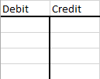
Look at it from a different view
This illustration may help
In the accounting world a “ T “ account is sometimes employed to work through an accounting issue
The left side of the “ T “ is for the debit or positive entry
The right side of the “ T “ is for the credit or negative entry

Slide 36
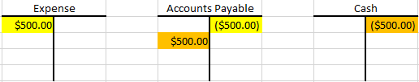
Look at it from a different view (continued)
Record expense and accounts payable after the voucher is created; the accounting entry appears in yellow
Pay the vendor and clear the account receivable; the accounting entry appears in orange

Slide 37
Illustration of Revenue and Customer Payment
Recognize Revenue
 | Amount |  | Oper. Unit | Fund | GL Acct. | Dept. | Product | Initiative
Debit | $ 500.00 |  | TPA | 03600 | 12010
Credit | $ (500.00) |  | TPA | 03600 | 44000 | 042700 | 000000 | 0000000
Record Customer Payment
 | Amount |  | Oper. Unit | Fund | GL Acct. | Dept. | Product | Initiative
Debit | $ 500.00 |  | TPA | 03600 | 10011
Credit | $ (500.00) |  | TPA | 03600 | 12010

Slide 38
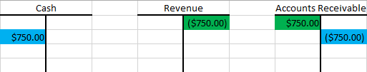
Look at is from a different view
An Auxiliary makes a sale; this accounting entry in green records the revenue of the sale and the account receivable
When the customer pays USF, the blue entry records the cash deposit and clears accounts receivable

Slide 39
Accounting – Things to look for
All accounting entries have a sign
  Debit is the term for a positive entry amount
  Credit is the term for a negative entry amount
All accounting entries must balance
  The credits (negatives) must balance to the debits (positives)
  An accounting entry will not post to general ledger unless it is in balance
GL account codes that naturally have a debit balance
  Expenses (beginning with 5, 6, or 75)
  Assets (beginning with a 1)
GL account codes that naturally have a credit balance
  Revenue (beginning with a 4 or 74)
  Liabilities (beginning with a 2)

Slide 40
Accounting – Things to look for
Expenses and Assets
  Increase with a debit (plus value)
  Decrease with a credit (negative value)
Revenue and Liabilities
  Increase with a credit (negative value)
  Decrease with a debit (plus value)

Slide 41
Accounting Periods
The USF fiscal year is July 1 through June 30
Our accounting periods
  Periods 1 through 12 represent July through June
  Period 998 is the adjustment period
  Period 0 represents balance sheet account balances brought forward from prior fiscal year to next fiscal year

Slide 42
University Controller’s Office Resources
Contacts
Additional Information

Slide 43
Helpful Resources
Email | Department
aphelp@usf.edu | Accounts Payable Help
Asset-help@usf.edu | Asset Management Help
billingarhelp@usf.edu | Billing and AR Help
cashiers@usf.edu | Cashiers Office Help
Electronic-media-disposal@usf.edu | Electronic Media
financemart@usf.edu | Finance Mart Questions
payrollhelpdesk@usf.edu | Payroll Questions
pcard@usf.edu | PCARD Questions
travelhelp@usf.edu | Travel Questions
usfpurchasing@usf.edu | Purchasing Help

Slide 44
Look for the TRAIN
The Research Administration Improvement Network
www.research.usf.edu/train
The Goals
  Building the knowledge base of research administrators
  Enhancing professional competencies
  Improving business processes and reporting
    Online Business Processes
  The address is www.usf.edu/businessprocesses
  Allows for keyword search or category search
  You may pose questions
  Look for information on
    Accounting practices
    HR-payroll
    Purchasing
    Research
    The USF Foundation
    And many other subject areas

Slide 45
University Controller’s Office (UCO)
http://www.usf.edu/business-finance/controller
    UCO Administrative Services, Accounting & Reporting, Student Services, Travel & Accounts Payable, Payroll & Tax Services, and Procurement.
Important ListServ accounts:
FAST ListServ
  Visit http://listserv.usf.edu/scripts/wa.exe?A0=FAST-LIST to subscribe; click Get Password
Travel ListServ
  Travel home page to subscribe
Payroll ListServ
  Look on the Payroll Overview page to subscribe
Purchasing ListServ

