Slide 1
USF Financial Systems
Intermediate

Slide 2
Agenda
  FAST Modules and Integration
  Building a Chartfield
  Primary Chartfields
Financial Data Systems
OASIS
GEMS (Fluid on 11/13/2019)
FAST

Slide 3
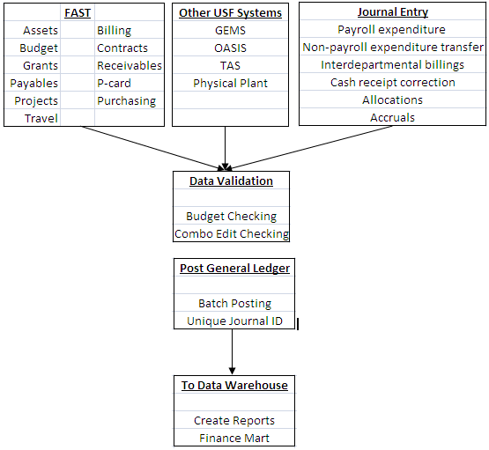
A Quick Overview
Subsidiary systems
  TAS (IT telecommunications application)
  FACNET (Physical Plant management application)
Supporting and Reporting applications
  TouchNet (web based bank card payment processing)
  IFIS (space management application)
  BDMS (document imaging application)
  Data Warehouse (data collection from multiple applications)
  Finance Mart (the official financial reporting application)

Slide 4
Direct Support Organizations (DSOs)
Component Units (CU)
Any organization for which the nature and significance of their relationship to USF is such that exclusion would cause the USF financial statement to be misleading or incomplete
Separate not-for-profit corporations
Provide supplemental resources from private gifts and bequests and valuable educational support services

Slide 5
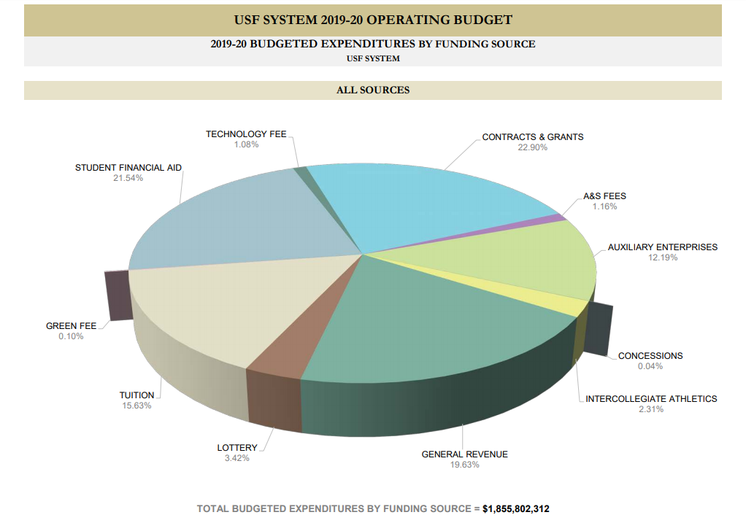

Slide 6
Module Integration
Modules are designed to integrate with other modules based on business flow
  Original entries may be created in one module
  Posted to another module
  Validated in a separate module
  Then posted to General Ledger – all financial transactions ultimately post to the General Ledger
Accounts Payable is designed to manage payments to vendors; the expense may originate in
  PCARD module
  Purchasing module
  If any of these are paid from a sponsored project, Grant module
  All of these are budget checked in Commitment Control module
  Payment to the supplier is issued from the Accounts Payable module
  Transaction is posted in General Ledger
  Up to five modules involved

Slide 7
Accounts Receivable is designed to manage customer debt; the customer invoice may originate in
  Billing module where the invoice is created
  Accounts Receivable where invoices and payments are posted by customer
  Commitment Control where all invoices are budget checked
  Grants module if a sponsored research project is involve
  Transaction is posted in General Ledger
  Up to five modules involved
The purchase of a capital asset (costs more than $5,000 with a useful life of more than one year) may link to multiple modules
  Begins in Purchasing module with a requisition/purchase order
  Vendor is paid through Accounts Payable module
  Asset records are retained in the Asset Management module
  If purchased for a sponsored research grant, the Grants module is involved
  Commitment Control module is used for budget checking
  The transaction ultimately posts to General Ledger
  Up to six modules involved

Slide 8
Commitment Control Module (Budget)
In FAST the Commitment Control module
  Expenses are budgeted for all funding sources
    Budget is reserved whenever a requisition or a purchase order is created
    Budget is consumed whenever a vendor invoice is paid
    Budget is consumed whenever a purchase is made with a USF P-card (procurement card)
  Budget is released to individual chart field strings
  Colleges and departments are accountable for their budgets
Commitment control is used two ways
Expenses are budgeted for all funding sources
  Tracking with budget
  Full budget control
  Also used for revenue tracking

Slide 9
Building a Chartfield String
How we code accounting transactions

Slide 10
Operating Unit
Identifies a USF campus
  TPA Tampa
  STP St. Petersburg
  SAR Sarasota
  HSC USF Health
  FIO Florida Institute of Oceanography
  UNV University wide operating unit (for central use only)
Operating Unit
(OU)

Slide 11
Fund ID (5 Digits with a logic)
Identifies the funding source
  “0”xxxx auxiliary; generated from a business activity
  “1”xxxx mainly E&G or Lottery Trust Funds
  “2”xxxx restricted; research funding, chairs, financial aid
  “3”xxxx loan funds; mainly student loans
  “5”xxxx capital projects; construction funding
  “6”xxxx renewal and replacement (reserved funds)
  “7”xxxx debt service; payment of bonds issued
  “8”xxxx capital asset; property, equipment, buildings
  “9”xxxx agency and convenience funds
Fund ID

Slide 12
Fund ID – Additional logic embedded
Funds beginning with a “0” (auxiliaries)
    Funds beginning with a “06” Sarasota/Manatee
    Funds beginning with a “07” St. Petersburg
Even more logic in the third digit
    Funds beginning with a “010xx” Arts and Sciences
    Funds beginning with a “011” Business Administration
    Funds beginning with a “012” Education
    Funds beginning with a “013” Engineering
    Funds beginning with a “015” USF Health/Medicine

Slide 13
Fund ID – Logic in the second digit
Funds beginning with a “1”
  Funds beginning with a “10, 12, or 13”
    E&G state funding
      10000 - current year E&G funding
      10009 - carryover of prior year E&G funding
  Funds beginning with a “11”
    Student Fee Trust Fund
  Funds beginning with a “17”
    Financial aid
  Funds beginning with a “183”
    RIA funding
Funds beginning with a “2” (generally grants but also others)
  Funds beginning with a “20”
    Federal funding source
  Funds beginning with a “21”
    State of Florida funding source
  Funds beginning with a “22”
    Private funding source
  Funds beginning with a “24”
    Endowed chairs
  Funds beginning with a “25”
    Student government
  Funds beginning with a “27”
    Financial aid

Slide 14
Operating Unit
(OU)
Fund ID

Slide 15
Account Code (GL – General Ledger)
Referred to as Chart of Accounts in accounting world
Accounts beginning with
  “1” assets appear on balance sheet
  “2’ liabilities appear on balance sheet
  “3” equity appear on balance sheet and never used in an accounting entry
  “4” revenue appear on the income statement
  “5’ expenses appear on the income statement
  “6” expenses appear on the income statement
  “7” interdepartmental appear on the income statement
  “8” budget appear on RSA report and the income statement
GL Account Code

Slide 16
Account Code – Additional logic
Accounts beginning with a “1” Assets
  Accounts beginning with a “10”
    Cash accounts
  Accounts beginning with a “11”
    Investments
  Accounts beginning with a “12”
    Accounts Receivable
Accounts beginning with a “5” or “6” Expenses
  Accounts beginning with a “50”
    Salary and benefits
  Accounts beginning with a “60”
    Travel expense
Accounts beginning with a “4” Revenue
  Accounts beginning with a “40 or 41”
    Student revenue
  Accounts beginning with a “42”
    Grant revenue
  Accounts beginning with a “44”
    Commercial revenue
Accounts beginning with a “7” Interdepartmental actions
  Accounts beginning with a “74”
    Revenue to selling department
  Accounts beginning with a “75”
    Expense to buying department

Slide 17
Chartfields and DSO’s
Financial activity occurs between USF and the DSO’s
These are transfers in and out for USF
They must be reported separately on the USF financial statement
Specific GL account coding is required

Slide 18
Chartfields and DSO’s
A unique GL account code series is used
  For transfers into USF
    49701 USF Foundation
    49702 USF Alumni Association
    49703 USF Research Foundation
    49704 USF Medical Services Support Corporation
    49705 USF University Medical Service Association
    49706 USF Sun Dome
    49707 USF Finance Corporation
    49708 USF Property Corp.
    49710 USF Health Professions Conferencing Corporation

Slide 19
Chartfields and DSO’s
A unique GL account code series is used
  For transfers out from USF
    69701 USF Foundation
    69702 USF Alumni Association
    69703 USF Research Foundation
    69704 USF Medical Services Support Corporation
    69705 USF University Medical Service Association
    69706 USF Sun Dome
    69707 USF Finance Corporation
    69708 USF Finance Corp.
    69710 USF Health Professions Conferencing Corporation

Slide 20
Good Resources for Expense Codes
For more definition of expense and revenue GL account codes explore the UCO web site
Under Library of Resources find the
  “Expense Account Code Descriptions”
  “USF Expenditure Guide”
  “Reference Guide for Revenue”

Slide 21
Operating Unit
(OU)
Fund ID
GL Account Code

Slide 22
Department ID
Department ID has embedded logic; first two digits
  Six digits identifying a specific department
    Beginning with a “0xxxxx” Central and Administrative
    Beginning with a “12xxxx” Arts and Sciences
    Beginning with a “14xxxx” Business Administration
    Beginning with a “6xxxxx” USF Health
    Beginning with a “5820xx” College of Behavioral/Community Sciences
Within USF Health
  More definition in the second through fourth digits
    Beginning with a “61xxxx” College of Medicine
    Beginning with a “6119xx” College of Medicine/Pediatrics department
    Beginning with a “62xxxx” College of Nursing
    Beginning with a “63xxxx” College of Pharmacy
Department
ID

Slide 23
Product
Initiative
A more detailed classification of the revenue and expense
Will be created at the discretion of the department or unit
May be a combination of digits and letters
Some logic (grouping) exists
Generic value is 000000 if no specific product codes exist
Typically used for each PI’s share of a grant, internal awards, and now also for non-research projects (not sponsored research)
A Generic value is 0000000
Product
Initiative

Slide 24
Operating Unit
(OU)
Fund ID
GL Account Code
Department
ID
Product
Initiative

Slide 25
Project ID
Used for both sponsored research and construction
Variable logic
  For sponsored research
    10 digits identifying the specific research project
    The project ID begins with the college/department values
  For construction
    14 characters; begins with the letter “P”
    “PF” indicates fund source is the State of Florida
    “PD” indicates departmental funding of the project
    “1” indicates Tampa, “2” indicates St Pete, “3” indicates Sarasota
Project ID*

Slide 26
Operating Unit
(OU)
Fund ID
GL Account Code
Department
ID
Product
Initiative
Project ID*

Slide 27
Additional Chartfields
Other chart fields
  The USF business unit by default is USF01
  The USF SetID by default is always USFSI
Research related transactions also include
  PC Business Unit
  Activity ID
  Analysis Type

Slide 28
Test your knowledge
Financial Systems - Intermediate

Slide 29
Requesting New Chartfields
University Controller’s Office controls chartfields
  Complete a request form
    Requires signature and GEMS ID of the accountable officer
    Send it to ALN 147 for processing
There are queries in FAST to produce lists of chart fields
  U_CF_FUND
  U_CF_ACCOUNT
  U_CF_DEPTID
  U_CF_PRODUCT
  U_CF_INITIATIVE

Slide 30
Things to be careful of…
Chart fields must be used in the right combinations
Combination edit checking
There are allowable and unallowable combinations
This helps ensure the accuracy and integrity of the financial reporting
We have 152 rules
Operating Unit HSC can be used only with departments beginning with “6”
Department IDs beginning with “034” requires use only with a product code value of “IT….” or no product code
A GL account beginning with a “7” can be used only with another GL code beginning with “7”

Slide 31
Where to find this information?
Finance Mart is the official reporting tool for USF for reconciliation and reporting
Finance Mart:
  Budget reports (which includes budget code also)
  Expenditure reports
  Revenue reports
  Balance Sheet
  Encumbrance reports
Search FAST with clues you find in Finance Mart
  In General Ledger search by chart field or journal ID
  In Accounts Payable search by voucher or supplier
  In Purchasing search by PO or requisition number
  In Billing and AR search by invoice or customer number
  In Grants Information search by PI or project ID

Slide 32
Look for the TRAIN
The Research Administration Improvement Network
www.research.usf.edu/train
The Goals
  Building the knowledge base of research administrators
  Enhancing professional competencies
  Improving business processes and reporting
    Online Business Processes
  The address is www.usf.edu/businessprocesses
  Allows for keyword search or category search
  You may pose questions
  Look for information on
    Accounting practices
    HR-payroll
    Purchasing
    Research
    The USF Foundation
    And many other subject areas

Slide 33
University Controller’s Office (UCO)
http://www.usf.edu/business-finance/controller
    UCO Administrative Services, Accounting & Reporting, Student Services, Travel & Accounts Payable, Payroll & Tax Services, and Procurement.
Important ListServ accounts:
FAST ListServ
  Visit http://listserv.usf.edu/scripts/wa.exe?A0=FAST-LIST to subscribe; click Get Password
Travel ListServ
  Travel home page to subscribe
Payroll ListServ
  Look on the Payroll Overview page to subscribe
Purchasing ListServ

Slide 34
Helpful Resources
Email | Department
aphelp@usf.edu | Accounts Payable Help
Asset-help@usf.edu | Asset Management Help
billingarhelp@usf.edu | Billing and AR Help
cashiers@usf.edu | Cashiers Office Help
Electronic-media-disposal@usf.edu | Electronic Media
financemart@usf.edu | Finance Mart Questions
payrollhelpdesk@usf.edu | Payroll Questions
pcard@usf.edu | PCARD Questions
travelhelp@usf.edu | Travel Questions
usfpurchasing@usf.edu | Purchasing Help

