Slide 1
Payment Collection and Internal Controls

Slide 2
Agenda
Enhance USF Business Practices
Establish Internal Controls related to accepting payments at the University
How to apply appropriate segregation of duties
The roles, responsibilities, procedures and constraints associated with each step
Record Keeping
Custody
Reconciliation
Authorization
Four Functions of Segregation of Duties

Slide 3
Accountability & Internal Controls
Defining Accountability
Internal Controls
Examples

Slide 4
Defining Accountability
Delegation of authority to qualified persons to:
  Initiate, approve, process and review business transactions
Holding these persons responsible for:
  The validity, correctness and appropriateness of their actions

Slide 5
Accountability
Everyone is accountable for their actions
Of all the individuals involved in the receipt, recording and balancing of funds, the person of ultimate responsibility is the custodian
Payment processors are accountable for
  Recording payments accurately
  Observing all of the USF internal controls
  Protecting the cardholders information
Supervisors are accountable for
  Proper allocations of payments
  Assignment of duties that comply with separation of duties guidelines
Others are accountable for
  Proper transfer of custody of payments
Accountable officers are ultimately responsible for payment transactions.

Slide 6
Internal Controls
Protect
  USF
  USF staff
Are designed to provide reasonable assurance regarding:
  Effectiveness and efficiency of operations
  Reliability of reporting
  Compliance with applicable rules, laws, and regulations

Slide 7
Internal Controls as They Relate To Cash Management
Internal controls specifically ensure:
  The safety of all funds
  The timeliness of recording the receipt of all funds
  That assignment of duties complies with separation of duties guidelines
  That reconciliations are completed and reviewed on a monthly schedule
  A sound audit trail and adequate documentation are created
Find specifics on internal controls on:
  www.usf.edu/businessprocesses

Slide 8
Internal Controls - Examples
Generally, access to credit card terminals and POS systems must be limited to a primary and a secondary custodian
Physical safety of the information and equipment must be ensured at point of collection and then stored overnight
All adjustments must be documented and approved by a supervisor (authorizer)
The payments must balance to the system where the payments were recorded
Deposits must be reconciled to the general ledger

Slide 9
Segregation of Duties
Defining Segregation of Duties
The Four Functions of Segregation of Duties
  Record Keeping
  Authorization
  Custody
  Reconciliation
When Segregation is not possible
Examples

Slide 10
Separation of Duties
Separation of duties protects USF and the individual by ensuring that no one person has the ability to control all of the steps involved in handling and accounting for money received by USF.
Custody
Record Keeping
The ideal is that any one person performs only one function; four people are needed for the four functions
Authorization
Reconciliation

Slide 11
Four Functions of Segregation of Duties
The four functions are Record Keeping, Authorization, Custody and Reconciliation
The ideal is that any one person performs only one function; four people are needed for the four functions
If one person performs two functions
  Risk exists that presents the opportunity for something to go wrong
  A compensating control is needed to reduce the risk
  The compensating control might be an extra layer of review

Slide 12
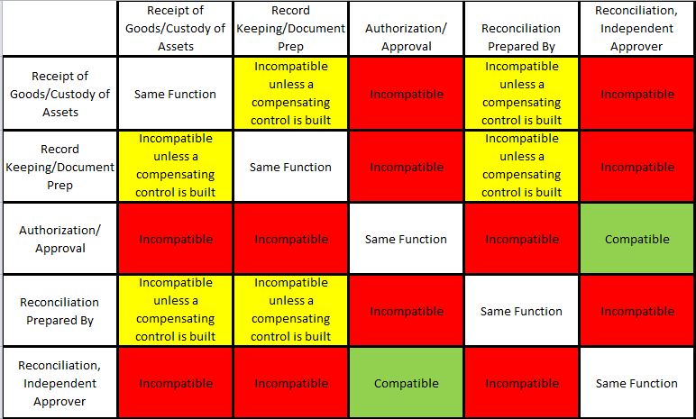
Segregation of Duties

Slide 13
When Segregation Is Not Possible
If one person performs two or more of the functions:
  Risk exists that presents the opportunity for something to go wrong
  A compensating control is needed to reduce the risk
  The compensating control might be an extra layer of review

Slide 14
Examples of Compensating Controls
A manager may perform a high level of review of detailed transaction reports
A manager may periodically sample transactions and request supporting documentation to ensure the transactions are complete, appropriate, and accurate.
Someone from an another area may perform an external review of a reconciliation. For instance two departments within a college may share responsibility to review each others reconciliations.
Some colleges and units have a centralized business services department

Slide 15
Record Keeping
Defining Record Keeping
Retention
Examples

Slide 16
Record Keeping
Record keeping is the process of creating and maintaining official records
Record keeping may occur manually or through an automated data system
Record Keeping Examples:
  Mail log – paper or electronic
  Customer receipts
    Official USF pre-numbered cash receipts
    System generated cash receipts
  Deposit slips
  Credit card receipts
  Cash register reports
  EFT (electronic funds) payment documents
  Balancing and reconciliation reports

Slide 17
Record Keeping - Retention
Observe record retention requirements
  Find information on Online Business Processes
  Also find information on the Purchasing web site
Records serve multiple needs
  Compliance with best business practices
  Helpful in researching a question

Slide 18
Authorization
Defining Authorization
Best Practices

Slide 19
Authorization
Authorization is the process of granting formal approval to perform a specific function
For example, someone must be authorized in order to perform one of the following functions:
  Verify cash collections
  Review daily balancing reports
  Approve discounts, voids, or refunds

Slide 20
Authorization
The person who originally created a transaction should not be:
  The one who makes a correction
  The one who creates a void
  The one who creates/approves a refund
The best practice is to have a supervisor take these actions

Slide 21
Custody
Defining Custody
System Passwords
Register Keys
Storage of Funds

Slide 22
Custody
Having access to or control over any physical asset
Custodians:
  Collect and handle payments
  Prepare deposits
  Have access to safes, lock boxes, & file cabinets where funds are kept
  Custodians of petty cash funds or change funds

Slide 23
Custody – System Passwords
All cash registers or Point of Sale (POS) systems should be password protected to assign accountability and fix responsibility
Every person must have their own password
Passwords must never be shared
Don’t write your passwords down
If you need to leave the work area, sign off your password; log back on when you return
Passwords should be changed periodically
Passwords should be inactivated whenever a custodian vacates the position

Slide 24
Custody – Register Keys
If your cash register or point-of-sale system uses key access:
  Only essential staff should possess the keys
  An inventory of the keys should be kept
  Keys should never be shared
  Keys must be collected whenever a custodian vacates the position
Custody – Storage of Funds
The safe or lock box combination should be changed:
  Any time an employee with knowledge of the combination or access to the key terminates or is reassigned
  Periodically
  Funds should never be stored in a desk, even if it is locked

Slide 25
Reconciliation
Defining Reconciliation
Why Reconcile?
Transaction Reconciliation
Non-Inventory Reconciliation
Credit Card Reconciliation
Reconciliation Guidelines

Slide 26

Reconciliation & Balancing
Cashier Balancing
Check Log Balance

Slide 27
Defining Reconciliation
A reconciliation is simply a comparison of two sets of information as of the same point in time
Identify the differences between what actually did post in Finance Mart vs. what you expected to post in Finance Mart
Why Reconcile?
Good internal controls and sound business practices necessitate the reconciliation of funds by business staff
USF needs assurance that all assets are safeguarded and used to the best benefit of the university

Slide 28
What Do We Reconcile?
Point of sale transactions ( POS )
Check logs
Bank card payments
E check payments
Transaction posting in FAST and FM
Credit Cards
Inventory

Slide 29
Point of Sale Transactions ( POS )
The POS system should
  Record sales and cash collections
  Produce a daily detailed sales report
  Produce a pre-numbered customer receipt
Reconciliations to perform
  Balance the cash drawer
  Balance the day’s sales to actual collections
  Reconcile daily balancing sheet to deposit

Slide 30
Transaction Reconciliation
Reconcile
  Deposits to accounts receivable postings
  Deposits to general ledger postings
  Inventory to sales
Finance Mart is the official reporting system
  Confirm that correct chart fields were used
  Submit corrections immediately
  Confirm that corrections posted correctly
  Find detail in FAST or OASIS

Slide 31
Non-Inventory Reconciliation
Some sales may not involve tangible inventory
To ensure that all billings have been completed, review
  Room usage logs
  Equipment or lab usage logs
  Participant lists or class rolls
  Order forms or contracts for services

Slide 32
Credit Card Reconciliation
When credit cards are used with a POS
  POS system should produce a report of credit card transactions
  Compare the POS report to the daily settlement report
  Supervisor reviews this

Slide 33
Reconciliation - Guidelines
Reconciliation must be performed by a person with no cash handling responsibilities
The reconciliation must be dated and signed or initialed
The reconciliation should be reviewed by an independent party
The prescribed procedure should be followed; find reconciliation resources on the UCO web site

Slide 34
Good Business Practices
Oversight and Monitoring of Accounts Receivable (AR)

Slide 35
Oversight & Monitoring of Accounts Receivable
Outstanding AR is reviewed at least monthly
Someone other than the person who maintains AR conducts the review

Slide 36
Are you ready for the Quiz?
Let’s review some important information

Slide 37
Review for the Quiz
Accountability
  Payment processors are accountable for
    Recording payments correctly
    Observing USF internal controls
Internal controls exist
  To protect the staff
  To protect the cash
Custody
  Having access to or control over any physical asset

Slide 38
Review for the Quiz
Record Keeping
  The process of creating and maintaining departmental documents
  A supervisor should always review your balancing report; then initial and date the form
Authorization
  The person who receives a payment should never make a correction, issue a refund, or void a transaction
  The authorizer performs these actions
Balancing
  Your department should have a standard balancing report

Slide 39
Resources
Office of University Audit & Compliance
  Generalcounsel.usf.edu
Online Business Processes
  http://www.usf.edu/businessprocesses
Additional training resources are available on the University Controllers Office website
  UCO Website > About UCO > Training > Banking and Cash Management
    Credit Card Reconciliation Process
    Lock Boxes and ACH’s
    Internal Controls
    Separation of Duties

