Slide 1
Separation of Duties
Internal Controls

Slide 2
Agenda
  Collaborative presentation of cash collection practices and reconciliation
  Addressing cash, bank cards, and e-checks
  Supports building knowledge for everyone involved
General Concepts
Accountability & Internal Controls
Separation of Duties Concepts
Helpful Resources

Slide 3
PCI Compliance
Cash Collections
Visit the training website
Review the Payment Card Industry (PCI) documentation
Take the PCI certification quiz
All must re-train and successfully pass the PCI quiz annually; testing is designed on a calendar year basis
This is a requirement for USF to be in compliance with PCI standards and certification
Visit the training website
Review the Cash Collections documentation
Take the cash collections certification quiz
All new cash handlers must train and pass the test immediately after hire
All cash handlers must re-train and pass the test annually

Slide 4
Accountability
Delegation of authority to qualified persons to:
  Initiate, approve, process and review business transactions
Holding these persons responsible for:
  The validity, correctness and appropriateness of their actions

Slide 5
Good Business Practice
Become familiar with the USF policy regarding fraud prevention and detection
  http://generalcounsel.usf.edu

Slide 6
Internal Controls
Protect
  USF
  USF staff
Are designed to provide reasonable assurance regarding:
  Effectiveness and efficiency of operations
  Reliability of reporting
  Compliance with applicable rules, laws, and regulations

Slide 7
Internal Controls as They Relate To Cash Management
Internal controls specifically ensure:
  The safety of all funds
  The timeliness of recording the receipt of all funds
  That assignment of duties complies with separation of duties guidelines
  That reconciliations are completed and reviewed on a monthly schedule
  A sound audit trail and adequate documentation are created
Find specifics on internal controls on:
  www.usf.edu/businessprocesses

Slide 8
Separation of Duties
Separation of duties protects USF and the individual by ensuring that no one person has the ability to control all of the steps involved in handling and accounting for money received by USF.
Custody
Record Keeping
The ideal is that any one person performs only one function; four people are needed for the four functions
Authorization
Reconciliation

Slide 9
When Segregation Is Not Possible
If one person performs two or more of the functions:
  Risk exists that presents the opportunity for something to go wrong
  A compensating control is needed to reduce the risk
  The compensating control might be an extra layer of review

Slide 10
Examples of compensating controls may include:
  A manager may perform a high level of review of detailed transaction reports
  A manager may periodically sample transactions and request supporting documentation to ensure the transactions are complete, appropriate, and accurate.
  Someone from an another area may perform an external review of a reconciliation. For instance two departments within a college may share responsibility to review each others reconciliations.
  Some colleges and units have a centralized business services department

Slide 11
Custody
Having access to or control over any physical asset
Custodians:
  Collect and handle payments
  Prepare deposits
  Have access to safes, lock boxes, & file cabinets where funds are kept

Slide 12
Record Keeping
Record keeping is the process of creating and maintaining official records
Record keeping may occur manually or through an automated data system
Record Keeping Examples:
  Customer receipts
  Deposit slips
  Credit card receipts
  Cash register reports
  EFT (electronic funds) payment documents
  Balancing and reconciliation reports

Slide 13
Record Keeping - Retention
Observe record retention requirements
  Find information on Online Business Processes
  Also find information on the Purchasing web site
Records serve multiple needs
  Compliance with best business practices
  Helpful in researching a question

Slide 14
Authorization
Authorization is the process of granting formal approval to perform a specific function
For example, someone must be authorized in order to perform one of the following functions:
  Verify cash collections
  Review daily balancing reports
  Approve discounts, voids, or refunds

Slide 15
Authorization
The person who originally created a transaction should not be:
  The one who makes a correction
  The one who creates a void
  The one who creates/approves a refund
The best practice is to have a supervisor take these actions

Slide 16

Reconciliation & Balancing
Reconciliation in FAST and Finance Mart

Slide 17
What Do We Reconcile?
Point of sale transactions ( POS )
Bank card payments
E check payments
Transaction posting in FAST and FM
Inventory

Slide 18
Transaction Reconciliation
Finance Mart is the official reporting system
  Confirm that correct chart fields were used
  Submit corrections immediately
  Confirm that corrections posted correctly
  Find detail in FAST or OASIS

Slide 19
Reconciliation - Guidelines
Reconciliation must be performed by a person with no cash handling responsibilities
The reconciliation must be dated and signed or initialed
The reconciliation should be reviewed by an independent party
The prescribed procedure should be followed; find reconciliation resources on the UCO web site

Slide 20
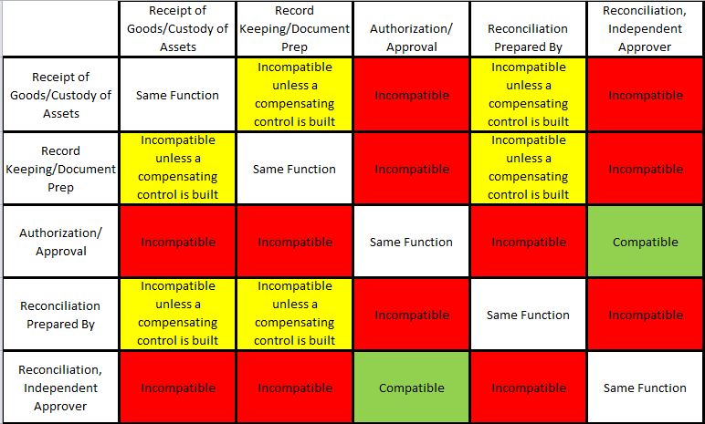
Segregation of Duties

Slide 21
Custody – System Passwords
  Every person must have their own password
  Passwords must never be shared
  Don’t write your passwords down
  If you need to leave the work area, sign off your password; log back on when you return
  Passwords should be changed periodically
  Passwords should be inactivated whenever a custodian vacates the position

Slide 22
Resources
Office of University Audit & Compliance
  Generalcounsel.usf.edu
Online Business Processes
  http://www.usf.edu/businessprocesses
Controller’s Office > About UCO > Training
  http://www.usf.edu/business-finance/controller

Slide 23
Contacts
Cherie Carson
Accounting Manager
General Accounting
(813) 974-7686
carsonc@usf.edu
Johnathan Andrews
Accounting Manager
Cashiers Office
(813) 974-5748
andrews5@usf.edu
Stancey Peprah
Staff Accountant
Depository Accounts
(813) 974-2689
stancey1@usf.edu
Noemi Merced
Staff Accountant
FAST Accounts
(813) 974-4914
nmerced@usf.edu

