Slide 1
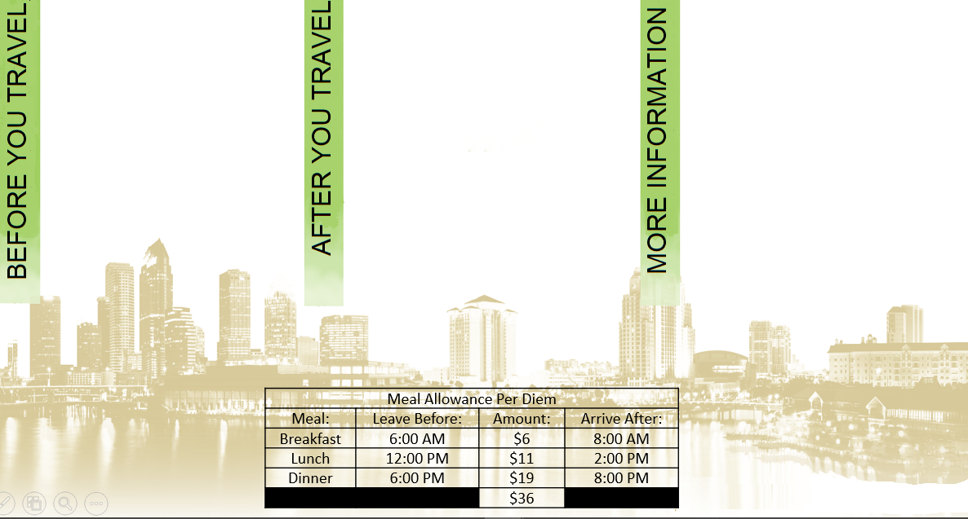
Archivum Travel Request (TR) approval prior to travel.
Travel over 30 consecutive business days requires signed/documented preapproval from the President prior to TR.
Airfare comps at the time of booking are required based on fare thresholds and/or personal elements.
Reimbursement of a Flat Amount should be agreed to by the traveler/dept head in writing at the time of TR prior to Travel. Pg 14 Travel Manual (TM)
Submit receipts to Travel Coordinator.
Complete Expense Report (ER) in Archivum within 30 days of travel end date. Pg 10 TM
ER’s not fully approved in departmental workflow:
  over 60 days from the travel end date require a signed timeliness approval document by the dean or director. Pg 10 TM
  over six (6) months from the last date of travel require signed approval by appropriate vice president. Pg 10 TM
PCard: Tax free in the state of Florida.
Tips can not exceed 18%
Mileage rate: $0.445
Personal vehicle mileage claims only in excess of regular commute to official USF headquarters.
Mileage-only ER’s may be submitted quarterly.
Airport parking: Economy/Long-term parking only.
Travel Manual

Slide 2

Include Airfare comps at the time of booking for Airfare exceeding:
  $750 for North America (including Puerto Rico and US Virgin Islands.
  International flights $1,500 (excluding Canada & Mexico)
Airfare comps at the time of booking with personal element.
Maximum reimbursement of 2 checked bags.
*Economy/Coach allowable.
*Business class allowed with 1 flight segment lasting 8 hours. *See Airline Class Guide.
Include cancellation/change approval document for related charges. Pg 17 TM
Provide itemized receipt.
Rental cars for official business are required to use the State of Florida contract with Avis Budget Group (ABG). Contract #’s: Avis: A113400 Budget: T417600
Outside the U.S. – use a reputable vendor.
Allowable rental class: Compact/Economy. Business justification selection required in Archivum for all other classes.
It is the Traveler’s responsibility to ensure contract terms are applied.
Insurance coverage included in state contract business rentals.
Avis Budget Roadside Assistance: 800-354-2847
In the event of an accident, business use renters should supply responding law enforcement with the ABG self insurance card located in the glovebox.
Provide itemized receipt.
Exceeding Domestic lodging cost of $250/night incl. taxes and fees, requires business justification selection in Archivum.
Must include itemized zero balance receipt.
Maximum allowable foreign lodging rates are determined by the U.S. Dept of State; exceeding requires business justification selection in Archivum.
Flat per diem ($80) may be claimed in lieu of actual lodging & meal allowance on both foreign/domestic travel.
Valet parking only allowable when no self parking is available.
Unallowable Airfare Expenses
Personal expenses
First Class
Travel Insurance
Unallowable Rental Car Expenses
Luxury/Premium class
Fuel Service Option
Accident Insurance (unless associated with Foreign Travel)
Roadside Assistance Plan
Unallowable Lodging Expenses
Lodging w/in 50 miles of campus HQ.
Room Service, Laundry, Early/Late Check-in/out fees

