Slide 1
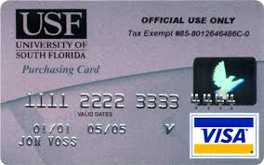
Reimbursement of PCard charges by USF Direct Support Organizations (DSO)

Slide 2
How can a USF Pcard be used for DSO expenses?
It may sometimes benefit the USF mission to allow use of the USF PCard for payment of expenses that will ultimately be funded by a USF Direct Support Organization (DSO).
Expenses incurred must be allowable under ordinary USF System Regulations, Policy and Procedure.
If the expense is not allowed under USF System Purchasing regulations, Policies and Procedures, PCard Policy and Procedures and Travel Policy, written approval must be secured from the University Controller prior to incurring the expense.

Slide 3
What type of expenses are allowable on a PCard?
Reimbursement must be received by USF within 30 days of the close of the quarter in which the charge is incurred.
The cardholder and the department are jointly responsible for ensuring that the particular expense can and will be covered by the DSO, and that sufficient DSO funds are available.
Funds that cannot be recouped from the DSO for expenses that are not allowable under USF System Regulations and policies will become the cardholder’s responsibility.

Slide 4
How do we account for these charges?
All DSO reimbursement expenses must be charged to an auxiliary or convenience fund using:
  Account 12420, PCard Reimbursement
Reimbursements will be posted to account 12420

Slide 5
Who keeps track of the Pcard Charges?
Account 12420 will be reconciled by the department on a regular basis and funds recovered from the DSO to clear the intercompany balance due.
PCard and Travel Policy will apply for out of policy purchases made without preapproval by the University Controller, and cards may be subject to suspension or cancellation.

Slide 6
Travel Expenses
Note: PCard charges charged to a PCard for reimbursement from a DSO are no longer pulled into a travel expense report. The expense is not considered a USF expense, therefore the PCard charge will not be associated with a travel request.

Slide 7
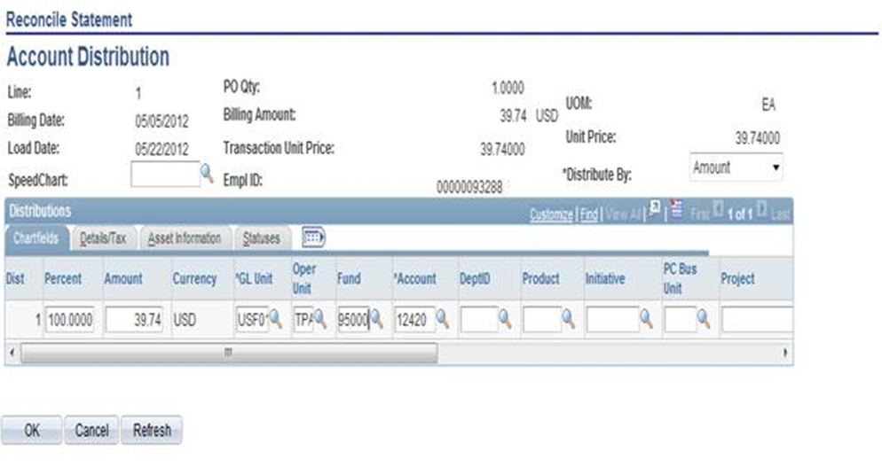
How are charges reimbursed?
Pcard Module
Enter the Operating Unit, Fund and Account code 12420 only, leaving all other chartfields blank.
  (Reconcilers who do not have access to remove the department from the chartfield string should request a special departmental role by completing a FAST access form requesting the new role and send it to FAST SECURITY ACCESS at ALN 147. Note: the form must be signed by an Accountable Officer.)
Include a note in the description section for the transaction as follows: “Charge will be reimbursed by name of the reimbursing DSO”.
  The same note should be written on the receipt submitted to PCard Services along with the monthly statement.
University Controller preapproval should be included in the statement package for all out of policy expenses

Slide 8
Questions?
Please contact
Cherie Carson: (813) 974-7686 carsonc@usf.edu
Karen Haubenstock: (813)974-1453 karenh@usf.edu
Tony Alvarez: (813) 974-4861 antonio@usf.edu

