Slide 1

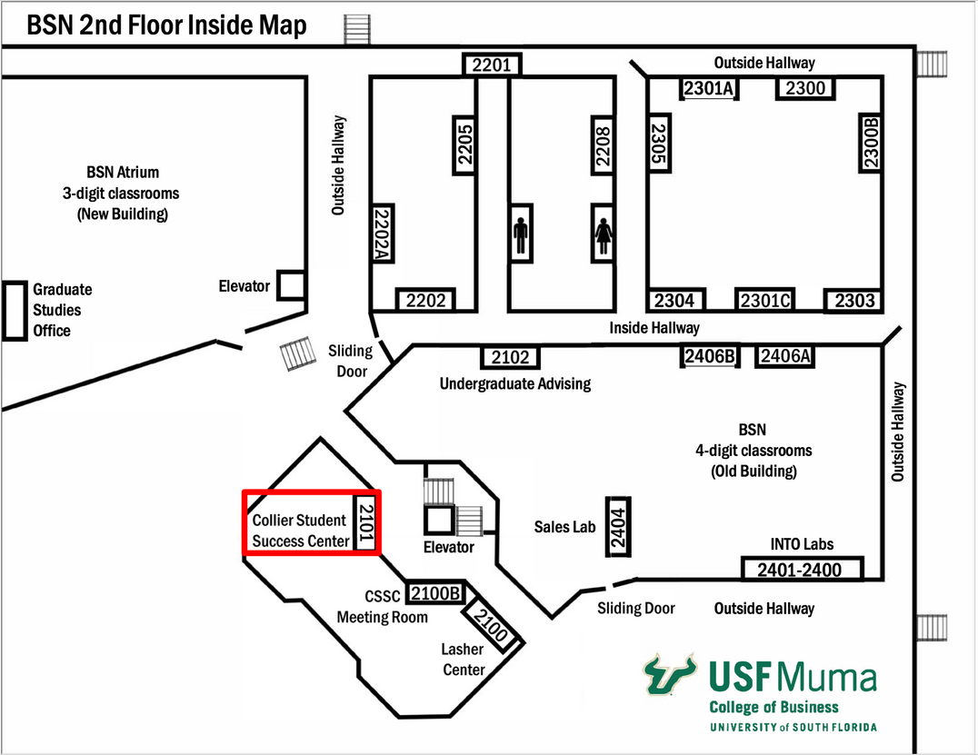

Muma College of Business Undergraduate Advising
DUE TO RENOVATIONS
THE ADVISING OFFICE IS CLOSED
Academic advising will continue utilizing Archivum. The appointment options will ONLY be MS TEAMS or by PHONE
For any urgent advising issues go to the Collier Student Success Center, BSN 2101. A student assistant or staff member at the front desk will assist.

