Slide 1
Physician-Assisted Suicide
Abhilash Padi, MS MD
Hospice and Palliative Medicine PGY-4
University of South Florida
June 12th, 2024

Slide 2
Objective
No assertions on personal or professional position
Destigmatize possible perception of sensitivity/controversy
Encourage open discourse
Educate on history and evolution
“Explore the gray”
Highlight potential role of PAS in mental anguish/suffering
Professor Richard Feynman: “I would rather have questions that can’t be answered than answers that can’t be questioned.”

Slide 3
Multiple Aspects To Consider
Patient Autonomy – Individuals have the right to make decisions about their own lives if they are of sound mind
Quality of Life – Advocates argue can help end patient lives with dignity/avoid prolong suffering, thus a compassionate option
Medical Ethics – Some argue PAS is a violation of “do no harm.” Argument for palliative care - not actively assisting in death
Legal Considerations – Illegal in most jurisdictions. Calls into question role of state in regulating end-of-life decisions. Potentially counters autonomy
Religious/Cultural Perspectives – Moral opposition with view that only a “higher power” has the “right” to determine timing of death

Slide 4
Multiple Aspects To Consider
Vulnerable Population/Safeguards – Concerns for potential abuse, “cost-savings” in end-of-life. How to ensure decision to pursue is truly voluntary
Impact on Physician Practice – Possibly contradicting forces for physician to conscientiously object to PAS, while still respecting patient wishes
Psychological Impact – Emotional (ongoing) toll of PAS decisions, even once made, and need for support for all involved parties
Alternatives to PAS – Critics of PAS argue hospice/palliative care are superior than active hastening of death
Public/Political Impact – Public opinion varies and questions arise as to political advocacy/influence of special interests in shaping public policy

Slide 5
AAHPM Definition
Physician-Assisted Suicide (PAS) is defined as a physician providing, at the patient’s request, a prescription for a lethal dose of medication that the patient can self-administer by ingestion, with the explicit intention of ending life.
https://aahpm.org/positions/padbrief

Slide 6
Historical Perspective: The Netherlands
First country to decriminalize euthanasia
Law passed in April 2001, enforced April 2002: Termination of Life on Request and Assisted Suicide Act
Officially tolerated in practice since 1985
Doctor will not be prosecuted for terminating a person’s life if convinced request is voluntary, well-considered, and has “unremitting” suffering
At least one other physician must have reached same conclusion of terminal illness
Surveys suggested 90% public support
Dutch director of Euthanasia Society: “The best possible care should be given before the issue of euthanasia arises. However, a discussion of euthanasia should be part of the palliative care package”
https://www.ncbi.nlm.nih.gov/pmc/articles/PMC2566446/pdf/11436481.pdf

Slide 7
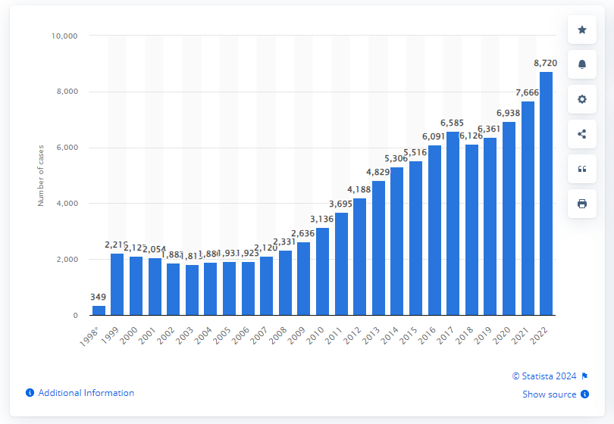
The Netherlands
Number of euthanasia cases 2000-2022
8720 reported cases highest in recorded period
2000 vs 2022 Deaths: 140k vs 170k
2000 vs 2022 Percentage of Deaths PAS: 1.5% vs 5.1%
https://www.statista.com/statistics/1363041/netherlands-euthanasia/

Slide 8
The Netherlands: PAS in Mental Health
Euthanasia for mental distress/disorders
Spanish media outlet El Pais reporting
2023: 138 PAS for psychiatric conditions, 20% increase from previous year
First case of euthanasia of a minor (16-18 yo) who did not require parental consent by law – parents were informed and supportive
  Report posted on Regional Commissions (RTE) – oversees all euthanasia cases
Experts reviewed request and verified it was sound, voluntary, met criteria for severity and lack of alternative solutions
Psychiatrists must balance suicide prevention with requests for euthanasia
https://english.elpais.com/international/2024-04-19/debate-ignites-in-the-netherlands-over-rise-in-euthanasia-for-mental-disorders.html

Slide 9
Mental Health Concerns in Gen Z
American Psychological Association (APA): Gen Z individuals more likely to report mental health concerns, such as depression/anxiety, than previous generations
2022 survey of 1055 Gen Z adults: 56% report depression, 42% had a diagnosed mental health condition
More than a quarter of those diagnoses received diagnosis during pandemic or later
Gen Z is LESS likely to seek mental healthcare than Millennials: 28% vs 40% sought help in the last year
Will PAS be more commonly utilized for mental anguish/suffering?

Slide 10
The Netherlands: PAS in Mental Health
Zoraya ter Beek – physically healthy 29 yo female
Officials gave final approval to die by PAS on the grounds of unbearable mental suffering
First applied for PAS in 2020
Must be evaluated by team of physicians, have a second opinion on eligibility, then the whole case has to be reviewed by a third independent doctor
“People think that when you’re mentally ill, you can’t think straight, which is insulting”
“In the three and a half years this has taken, I’ve never hesitated about my decision...”
Update 6/1/24: Did die the previous week by PAS
https://nypost.com/2024/05/17/world-news/dutch-woman-zoraya-ter-beek-granted-euthanasia-final-approval-over-her-severe-depression/

Slide 11
Current Jurisdictions Worldwide
Belgium Canada
Spain The Netherlands
Switzerland Luxembourg
Australia New Zealand
Germany* Austria*
Italy* Columbia*
*Still legislating; legal protections for physicians; developing law
United States

Slide 12
United States – 11 Jurisdictions
California
Colorado
District of Columbia
Hawaii
Maine
Montana* - State Supreme Court ruled that assisted suicide did NOT violate Montana legal precedent or state statutes, even though no Montana laws specifically allow
New Jersey
New Mexico
Oregon
Vermont
Washington

Slide 13
United States
Law: distinguishes legal act of “medical aid in dying” from the act of helping someone die by suicide, which is prohibited
Source: "D.C. physician-assisted suicide law goes into effect". The Washington Times.

Slide 14
Oregon – First State
Measure 16 of 1994 – Death with Dignity Act
“DWDA allows terminally ill patients who meet specific qualifications to end their lives through voluntary self-administration of a lethal dose of medications prescribed by a physician for that purpose.”
Law requires Oregon Health Authority to collect information about the patients and physicians who participate in the Act and to publish an annual statistical report.
2023: 560 received prescriptions, 367 died from prescriptions, including 30 who received prescriptions in previous years

Slide 15
Oregon – First State
Specific patient requirements to participate:
  18 years or older
  Capable of making and communicating health care decisions to practitioners
  Diagnosed with a terminal illness that will lead to death within six months
Attending and consulting physicians must determine whether patient meets criteria and report to OHA
2023: Oregon residency requirement stricken from Act – information on patient’s state of residence is not collected during DWDA process
  Has this change opened the state to the potential for “medical tourism” for the purpose of dying?
  Vermont passed same provision in May 2023
https://www.oregon.gov/oha/PH/PROVIDERPARTNERRESOURCES/EVALUATIONRESEARCH/DEATHWITHDIGNITYACT/Documents/year26.pdf

Slide 16
Overview of Safeguards and Protocols
PAS laws vary by jurisdiction, but most share core safeguards
Eligibility Requirements:
  Terminal diagnosis with limited prognosis (less than 6 months)
  Mentally competent to understand decision and its implications
  Typically limited to adults >18
Informed Consent:
  Multiple requests with waiting period in between
  Often requires second opinion for both diagnosis and decision-making capacity
  Physician must full disclose all treatment options, including palliative/hospice care
  Usually require witnessing by two independent parties
  Patients retain the right to withdraw from the process at any point
Patient and Physician Privacy: Laws typically protect identities of participating patients/physicians

Slide 17
Potential Subjectivity of Safeguards
Prognosis – notoriously difficult to accurately assess
  Landmark article (1999) in Palliative care showed physicians are only about 20% accurate in prognosis, with most errors over-optimistic in timeline
  May affect patient decision-making as may pursue more aggressive care, or may pursue options such at PAS to limit suffering
Competence – consensus for competence generally exists but brings into question PAS for mental anguish/suffering/depression
Adults/Age >18 – May question when, or under what conditions, a minor achieves “autonomy,” especially if they can demonstrate accepted mental competency/consciousness/self-awareness

Slide 18
AAHPM Advisory Brief: Guidance on Responding to Requests for PAS
Determine the nature of the request – Immediate assistance or future? Thoughts with/without a plan or intent? Frustrated or serious thoughts?
Clarify cause of intractable suffering – Loss of functional autonomy? Perception burden on others? Severe pain/sx? Emotional/spiritual distress?
Evaluate decision-making capacity – Pt seem rationale and proportionate to clinical situation? Request consistent with long-standing values?
Explore emotional factors – Feelings of depression, worthlessness, guilt, fear interfere with judgement? Patient have untreated depression?
Explore situational factors – Poor social network? Coercive influences? Subject to emotional, financial, or other forms of exploitation/abuse?
https://aahpm.org/positions/padbrief

Slide 19
AAHPM Statement on Physician-Assisted Dying
AAHPM takes a position of “studied neutrality” on whether PAS should be legally permitted or prohibited
Has concerns about a shift to include PAS in routine medical practice, including Palliative Medicine
Risk of unintended long-range consequences, including effects of the relationship and integrity between medicine and society and patient/physician
Recommend augmentation of patient psychosocial and spiritual resources to better manage suffering, making PAS requests more rare
Where legally permitted, physicians should not be obligated if they hold moral/professional objections
https://aahpm.org/positions/pad

Slide 20
Physicians’ Beliefs about PAS: A National Study
2019 Yale Study – survey sent to 1000 randomly chosen physicians in US
60% thought PAS should be legal
  13% answered “yes” when asked if they would perform the practice, if legal
49% agreed that most patients who seek PAS do so because of pain
58% agreed that the current safeguards in place are generally adequate
30% thought legalization would lead to legalization of euthanasia
  60% disagreed with the statement that non-psychiatrist physicians are adequately trained to screen for depression
  60% disagreed with the idea that physicians can prognosticate with a 6-month or less certainty
46% agreed that insurance companies would preferentially cover PAS over possible life-saving treatments if PAS legalized nationally
https://www.ncbi.nlm.nih.gov/pmc/articles/PMC6913834/

Slide 21
Patient Attitudes Towards PAS
May 2020 Gallup poll – random sample of 1028 adults > 18 yo, from all 50 states and District of Columbia
74% of US adults support PAS at their request, by painless means
White: 77%
Non-white: 65%
Democrat/Leaning Independents: 85%
Liberal: 87%
Moderate: 80%
Conservative: 57%

Slide 22
Patient Attitudes: Why Pursue
Retrospective chart survey in British Columbia in 2016
250 assessments – 112 patients had PAS
  Disease-related sx (60%)
  Loss of autonomy (53%)
  Study showed similar to other jurisdictions, but different proportions
APA – recent update neither endorses nor opposes PAS
  Two decades of evidence from Oregon – desire to hasten death comes from wanting to maintain some power over one’s own life
  “…really wanted to have control over the circumstances of dying.”
  Concern for loss of autonomy and function, or worries about future pain
  https://www.apa.org/monitor/2017/12/ce-corner
https://www.ncbi.nlm.nih.gov/pmc/articles/PMC6135145/

Slide 23
National Hospice and Palliative Care Organization Position
Supports individuals’ rights to exercise autonomy as is legal in their communities and seeks to provide assistance where medical aid in dying is an option
NHPCO opposes MAID as a societal option to alleviate suffering
Palliative care “intends to neither hasten nor postpone death”
Is it rational to support an individual’s right to exercise autonomy for a specific act (PAS), while opposing said act itself?
https://www.nhpco.org/wp-content/uploads/Medical_Aid_Dying_Position_Statement_July-2021.pdf

Slide 24
Inpatient Hospice – Medically Hastened Death?
2007 article assessing causes of death in an inpatient hospice program
Pneumonia present in 79% of all patients
Appeared to be major cause of death in 44% of patients
Other deaths: cancer direct effects, heart disease, hepatic/renal failure, PE, hypercalcemia
Opioids and other common-used inpatient hospice medications may cause respiratory suppression in patients with potentially already weak respiratory drive
Risk of above weighted against benefit of addressing dyspnea/suffering
https://pubmed.ncbi.nlm.nih.gov/17803410/

Slide 25
Future of PAS – Many Topics
Ethics and morality
Existentialism of “suffering”
Eligibility
Implementation
Political
Financial implications (however unsavory)
Will PAS become more widely utilized in end-of-life care?

Slide 26
Future Considerations: Political
California (Blue)
Colorado (Blue)
District of Columbia (Blue)
Hawaii (Blue)
Maine (Blue)
Montana* (Red)
New Jersey (Blue)
New Mexico (Blue)
Oregon (Blue)
Vermont (Blue)
Washington (Blue)

Slide 27
Future Considerations: Political Religious Affiliation
Pew Research Center
  Party affiliation: 37% lean Republican, 44% Democrat
  Importance of religion – “very”: 61% Republican, 47% Democrat
Does religion influence political affiliation?
  2019 Pew study suggests Americans agree upon separation of church and state
  No clear answer as to whether this can be definitely answered

Slide 28
Future considerations: Religion
Axiom: (IF) we acknowledge religion as a potential barrier to widely accepted PAS
Pew-Templeton Global Religious Futures project – surveys in more than 95 countries asking 200,000 people about their religious identities, beliefs, and practices
“The percentage of American adults who identify as Christian has been declining each year, while the share who do not identify with any religion has been rising rapidly.”
Does declining participation in religious activities affect acceptance/normalization of PAS?

Slide 29
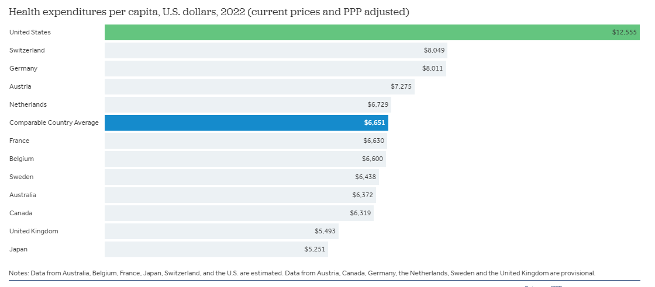
Future Considerations: Financial
AMA: Health spending increased in the U.S by 4.1% in 2022, to $4.4 trillion
Health expenditures per person: $12555 in 2022, over $4000 more than any other high-income nation
1998: “Typical uninsured patient dying one month earlier by PAS might save his/her family $10000, having already spent as much as $2000 that year.”
https://www.nejm.org/doi/full/10.1056/NEJM199807163390306
https://www.healthsystemtracker.org/chart-collection/health-spending-u-s-compare-countries/

Slide 30
Future Considerations: “Standard of Care”/Commonly Accepted Practice
If more accepted by the public, will this lead to “expectation” of PAS as a mandatory option in end-of-life care?
Onus on physician to potentially forego option, based on personal moral/ethical conflict – further added physician burden?
Would there be a “duty” to provide PAS, if this were to become common practice, especially in Palliative care?
Would limiting wide PAS utilization to certain diseases/conditions be another way to safeguard?
Should timeline of prognosis be a rigid requirement, given limits of prognostication?

Slide 31
Discussion
Questions?
Comments?
Thoughts?
Thank you.

