Slide 1
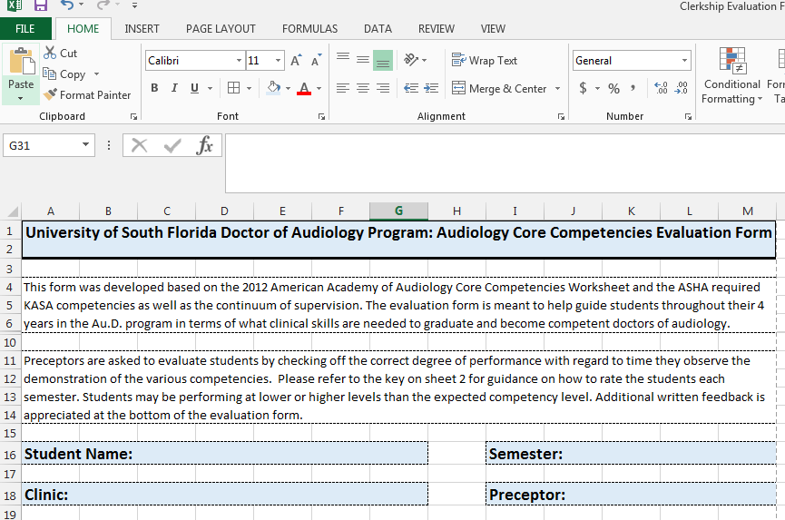

Evaluation Form Instructions
Open the grading form (which is an excel document)
Once you open the form fill out the cover page….
  Enter Student Names, Semester (Summer, Fall, or Spring) and Clinic/Preceptor Info

Slide 2
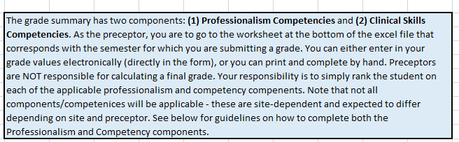
Instructions

Slide 3
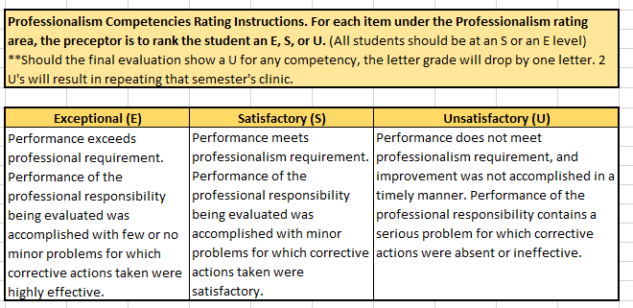
Instructions

Slide 4
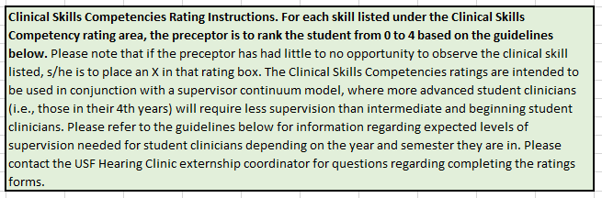
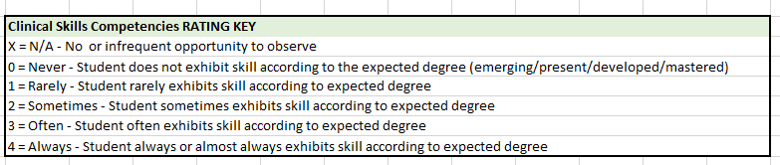
Instructions

Slide 5
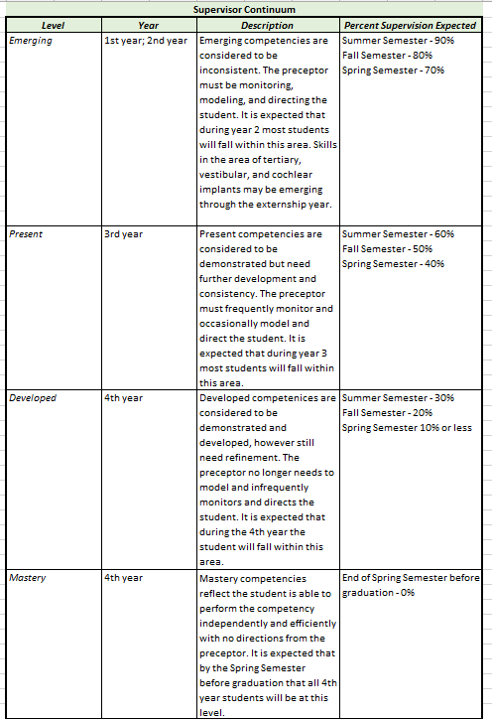
When evaluating the student, if they are meeting the competency at the expected level per the grading form, then they should be assigned a 4. However, if they are not meeting the expected level then please assign an appropriate numeric value.

Slide 6
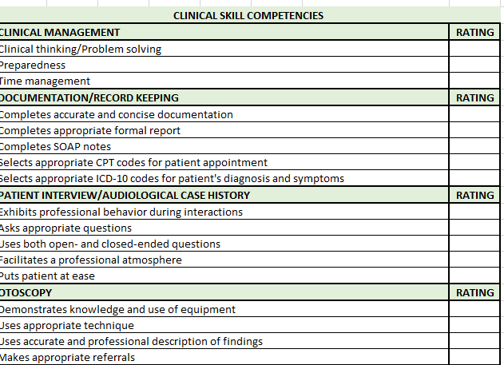
You DO NOT need to calculate a final grade, this will be done by the Clerkship/Externship Coordinator based on this evaluation form and additional requirements required by USF.

Slide 7
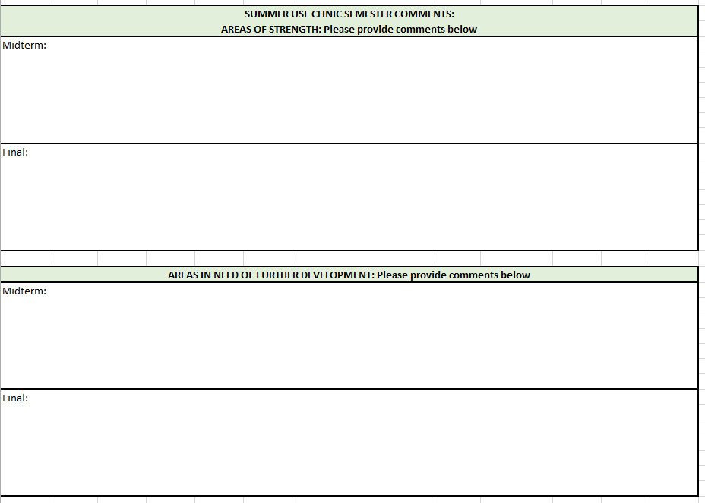
Fill in appropriate comments for both midterm and final. These comments are important because they provide both positive and constructive feedback.

Slide 8
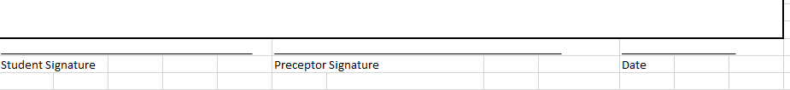
Please review the eval with the student and then provide appropriate signatures.

Slide 9
Please return the eval forms back to the Clerkship Coordinator by the requested semester end date.
The forms can be completed electronically or by printing and filling out by hand.
Please return forms, Attn: Devon Weist
  Email @ dlweist@usf.edu
  Fax @ 813-905-9819
  Have the student hand delivery

