Slide 1

TUITION WAIVERS

Slide 2

The University has six classification codes for graduate assistants (see section 2.1 of the Graduate Assistant Handbook: https://www.usf.edu/graduate-studies/funding/graduate-assistantships-resource-center/graduate-assistant-handbook.aspx). Section 2.5 provides the definitions. Section 5 has a chart of criteria for GAs. Here are the titles and job codes:
Graduate Research Assistant (GRA) Class Code 9182
Graduate Research Associate (GRA) Class Code 9181
Graduate Teaching Assistant (GTA) Class Code 9184
Graduate Teaching Associate (GTA) Class Code 9183
Graduate Assistant (GA) Class Code 9185
Graduate Instructional Assistant (GIA) Class Code 9550

Slide 3

Graduate Assistants – RA
Research Associate – 2 or more years research experience
9182 Research Assistant – first two years of study, no experience
Only research duties / supporting research
Salaried
.25 FTE minimum to qualify for health insurance and tuition waiver/payment

Slide 4

Graduate Assistants – TA
9183 Teaching Associate – must have completed 30 hours @ grad level
9184 Teaching Assistant – must have completed 18 hours @ grad level
9550 Instructional Assistant – no hours required, must not be assigned to teach
Only teaching duties / supporting instruction
Salaried
.25 FTE minimum to qualify for health insurance and tuition waiver/payment

Slide 5

Graduate Assistants – GA
9185 Graduate Assistants – Administrative, not teaching or performing research
Non-exempt hourly employees (non-salaried) and must complete timesheets
Duties performed must directly contribute to the graduate student’s program of study
.25 FTE minimum to qualify for health insurance and tuition waiver/payment

Slide 6

Please note that, for 9181 and 9183, the student must have completed a minimum of 30 graduate credit hours. For 9184, they must have completed a minimum of 18 graduate credit hours. 9185 GAs cannot be involved in teaching or research

Slide 7

The Dean’s office is responsible for processing CBCS tuition payment applications for E&G and Auxiliary Funded GA/GIA/GTA appointed students with class codes of 9183, 9184, 9550, & 9185 who meet the tuition waiver eligibility criteria. Students are required to enroll in at least 9 hours for fall/spring (6 hours in summer) with the exception of their final term of enrollment, i.e., graduating.

Slide 8

C&G funds are expected to pay in-state tuition for GRA appointments (9182 & 9181). However, the College will consider requests for tuition waivers according to the following guidelines:
Tuition waivers typically are NOT granted by the college for PhD students covered by stipends funded by grants, when the grant budgets are large enough to accommodate tuition support (e.g., more than $175,000 direct costs per year)
Tuition waivers typically are granted by the college for PhD students who are covered by stipends funded by grants when sponsor guidelines do not allow tuition to be charged.
Tuition waivers must be adequately justified for smaller grants (e.g., when the grant requirements cannot be fulfilled if tuition waivers are included as a direct cost).

Slide 9
If a grant is paying the in-state tuition for a non-resident RA (Codes 9181 or 9182), we will need to assign a code “50” exemption. This code requests the college to waive/pay the out-of-state tuition charges. Use the CBCS waiver application to request a non-resident exemption (code 50) for C&G appointed RAs.

Slide 10

If you are requesting tuition waivers for an E&G, Auxiliary, RO or START-UP funded RA (Codes 9181 or 9182), Form 1 is required (refer to http://www.grad.usf.edu/Tuition-Waiver-Forms-Information.php, and Form 1 instructions), and code “50” exemptions will need to be assigned.

Slide 11
If you are employing an RA (Codes 9181 or 9182) from outside of the college, refer to the OGS website, for instructions, forms (under revision) http://www.grad.usf.edu/Tuition-Waiver-Forms-Information.php, Form1 and instructions.
If the grant is NOT paying tuition and you are requesting the college to waive the student’s tuition, please include a letter/email with approval from Dr. Jennifer Lister.

Slide 12
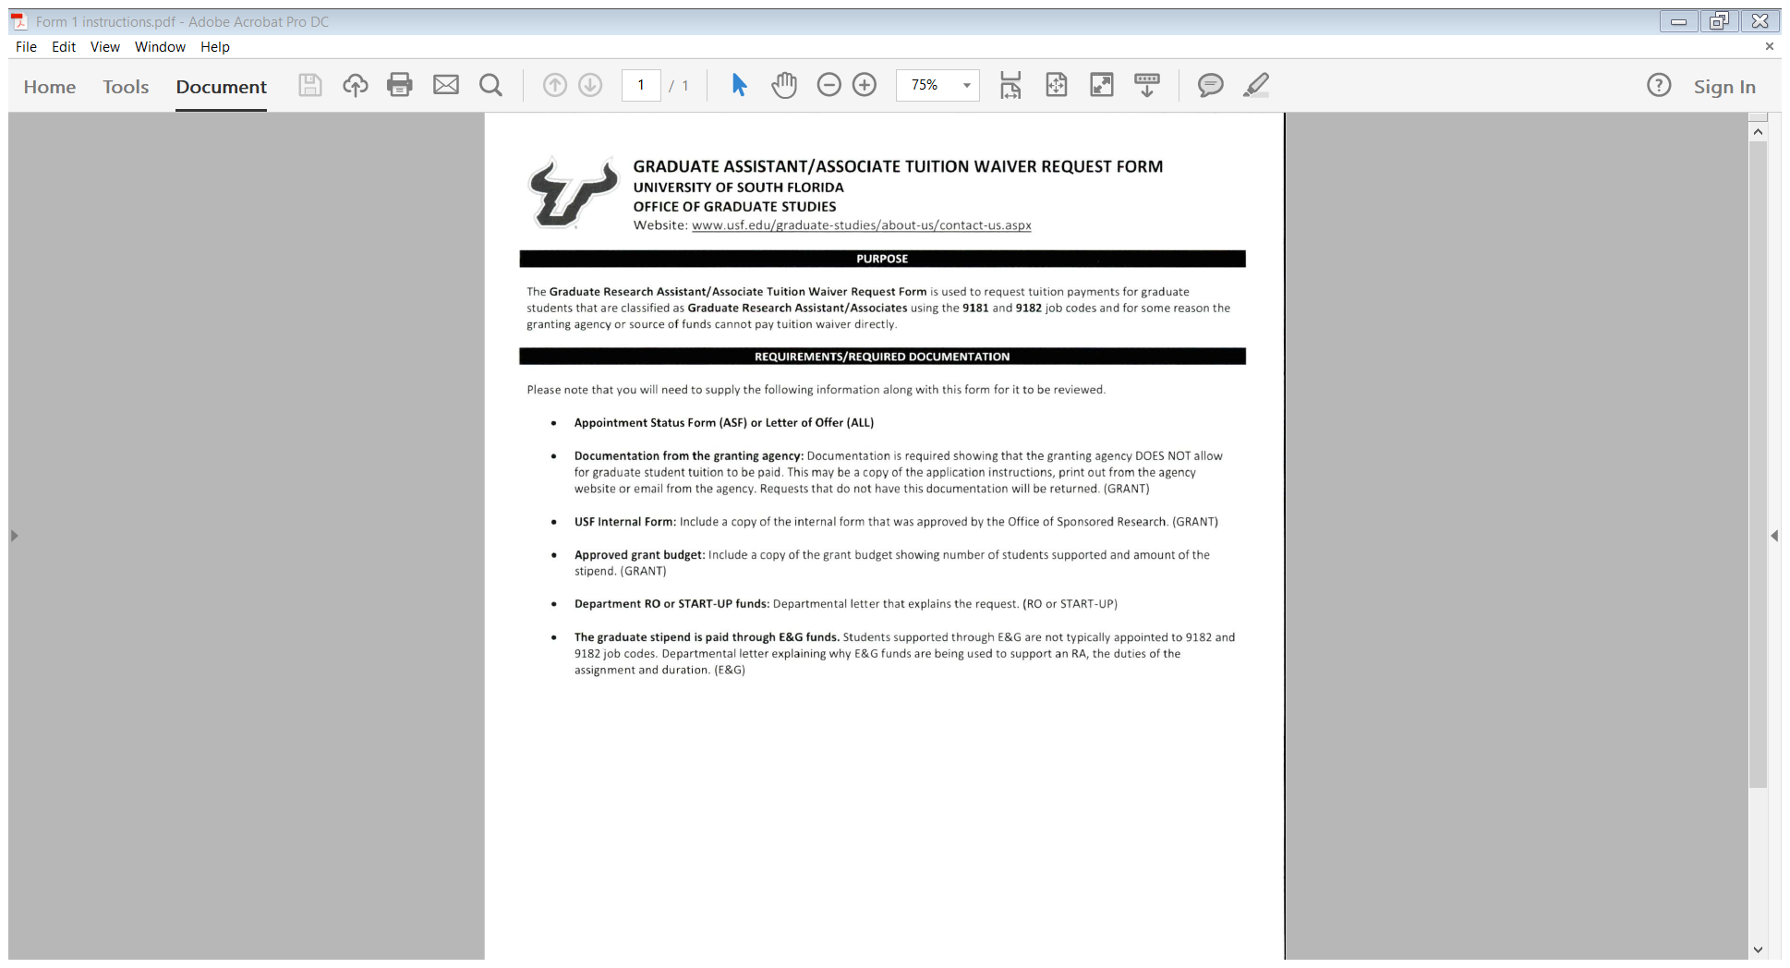

Slide 13
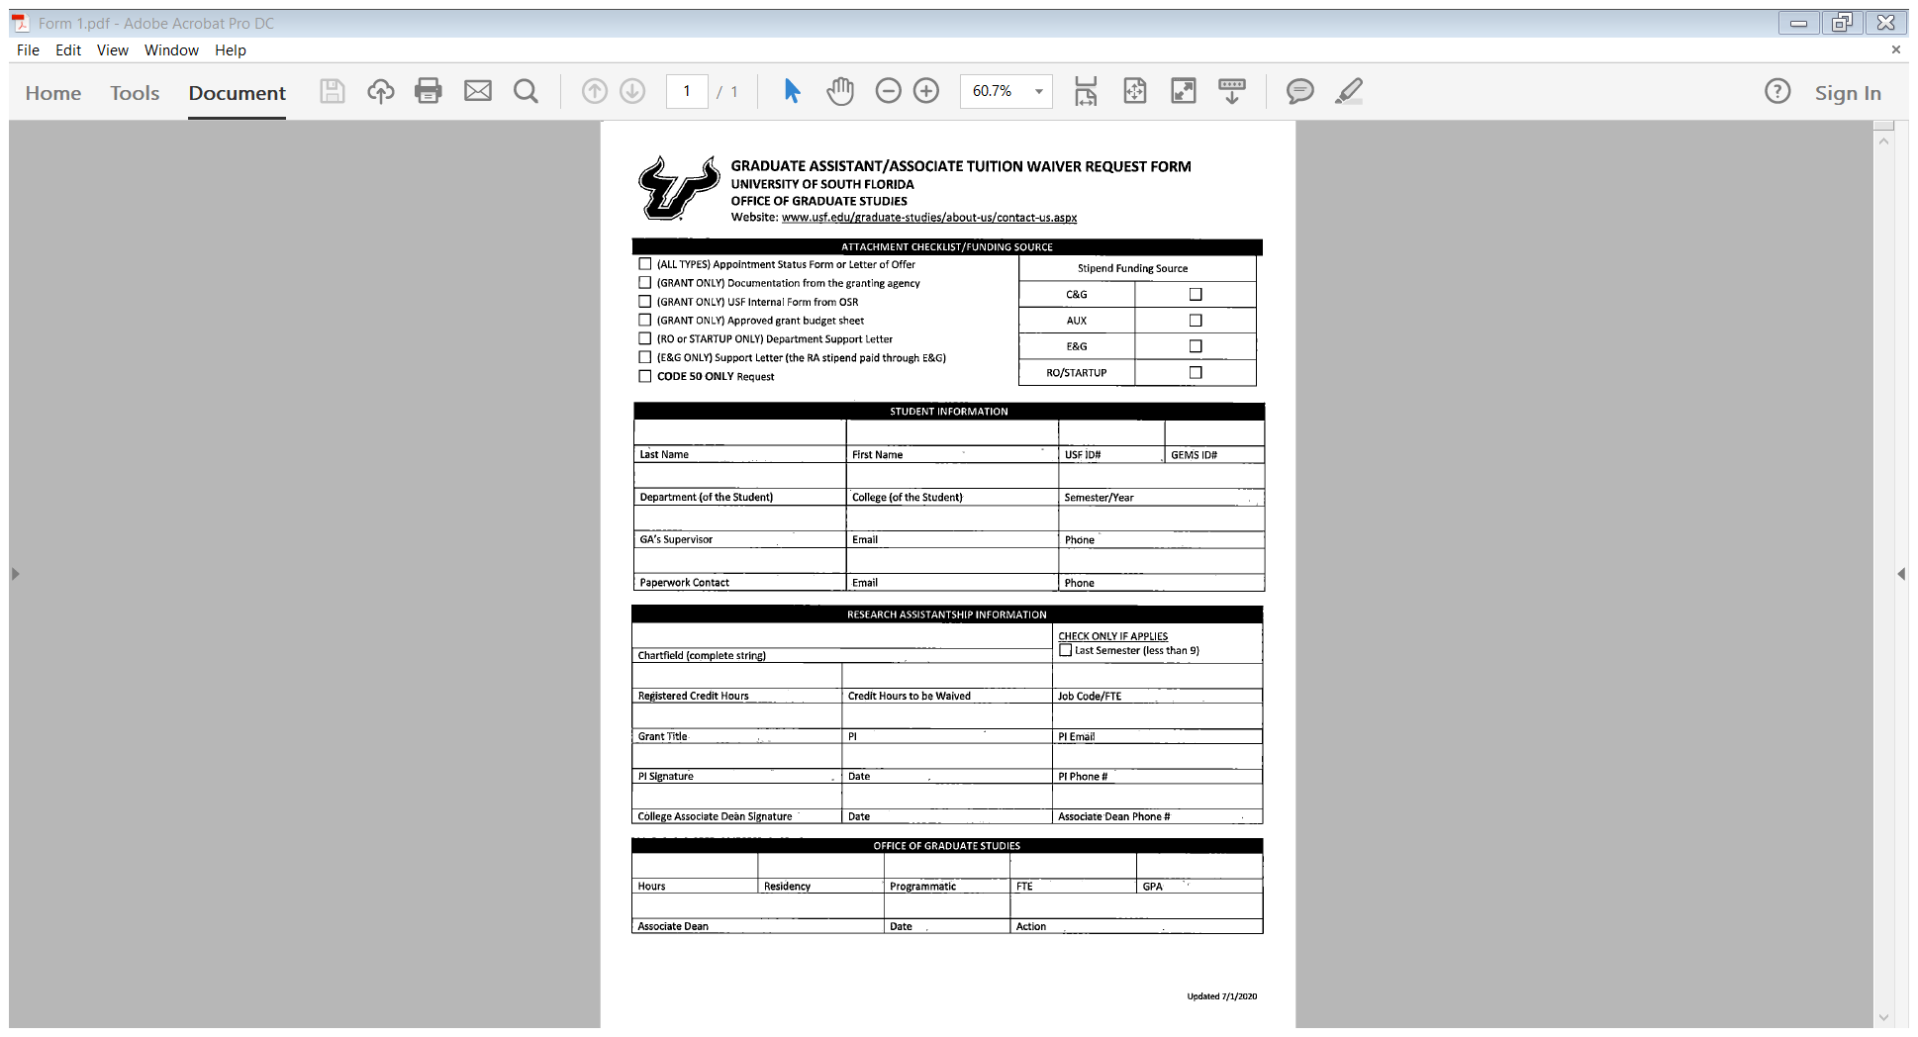

Slide 14

Out-of-college appointed TA/GAs should use the CBCS Out-of-Unit waiver application form.

Slide 15
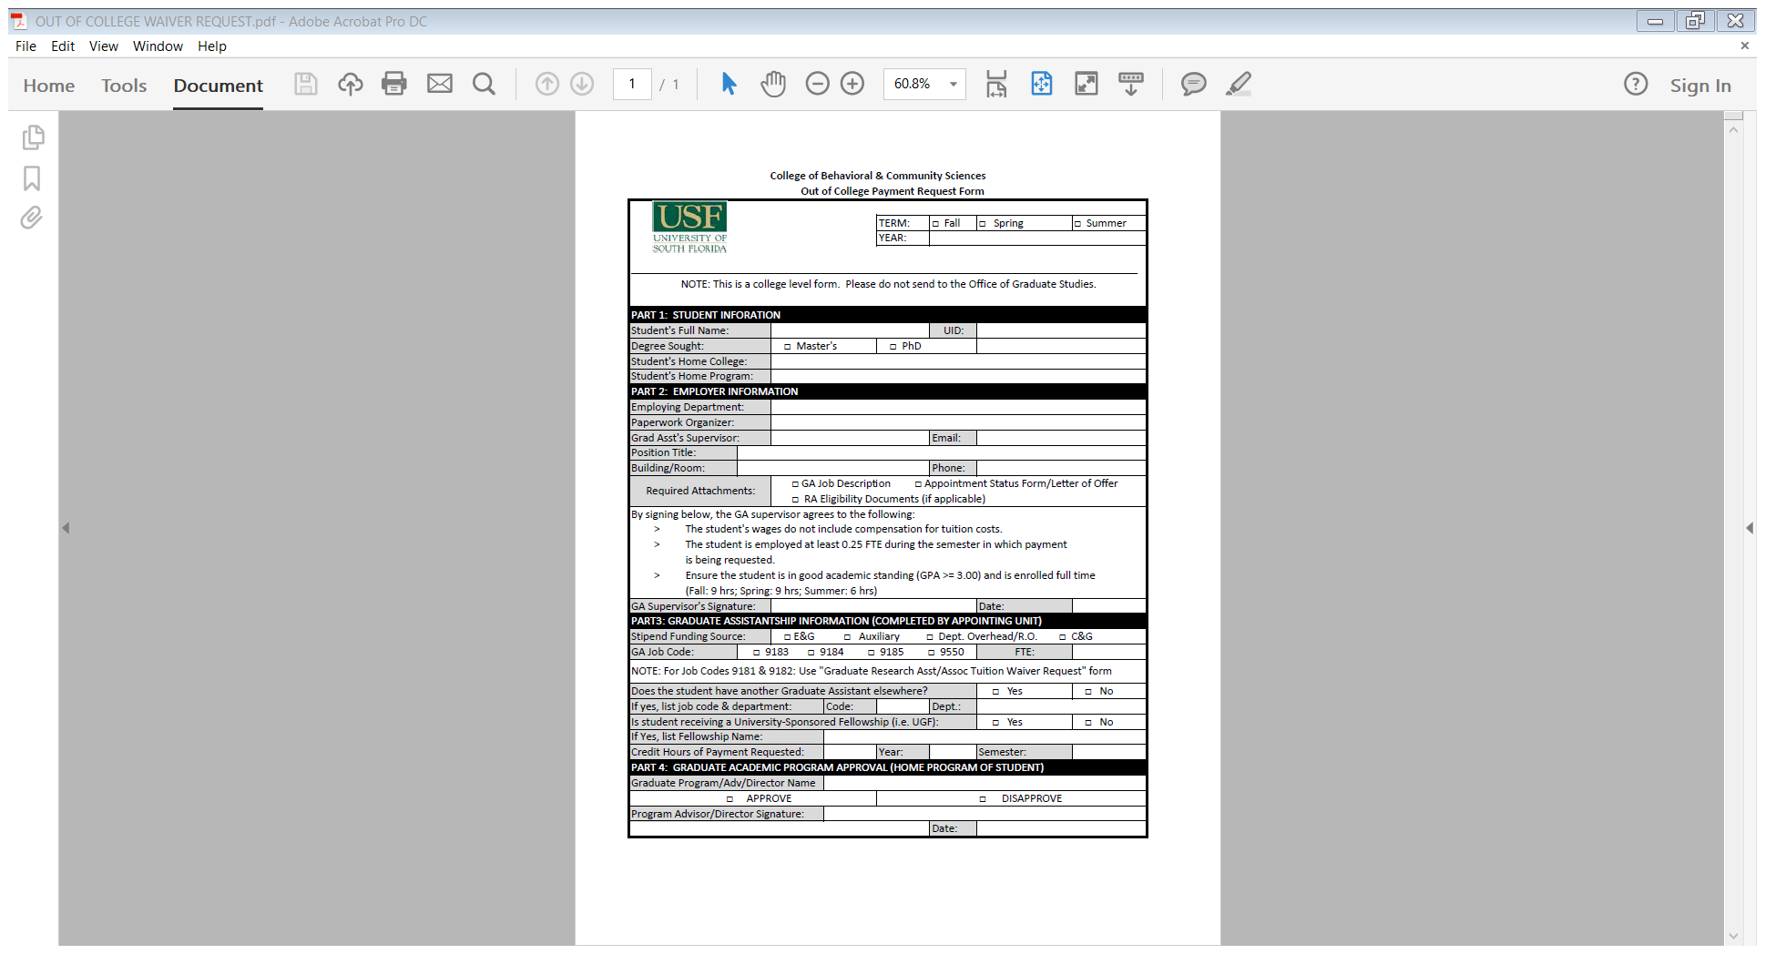

Slide 16

The maximum hours CBCS can cover for any fall/spring semester application are twelve (12) and nine (9) for summer semesters. Requests for payment of hours above 12 hours for fall/spring or 9 hours for summer for TA/GAs will now be made directly by department reps. using “Office of Graduate Studies Online Waiver Portal.” ** Reminder ** All fees incurred for students will be the student’s responsibility.

Slide 17
FTE Overage Approval Request
For Graduate Assistantship Tuition Payments
Graduate Assistants may be appointed up to a maximum of .50 FTE for a single assistantship. Programs who desire to appoint a Graduate Student, in any classification, more than .50 FTE up to .73 FTE, for a single or multiple appointments, must submit justification to the Office of Graduate Studies for approval. The justification should come from the student’s academic advisor (major prof for doctoral) not their supervisor. This is designed to ensure sufficient progress toward degree and that the department is aware of the student’s employment activity.

Slide 18

When requesting, please address these questions:
Please have the major professor comment on the student’s current progress toward the student’s degree.
Has the student taken/passed his/her qualifying exam? If not, when will it be taken?
Has the student had a prospectus meeting? How far along is the student on dissertation?
When is the student expected to graduate?

Slide 19
Students hired in non-GA positions on campus must also not exceed .73 FTE for the combined position and assistantship appointments. These appointments also count towards the total FTE. Programs who desire to appoint a Graduate Student, in any classification, more than .73 FTE, for single or multiple appointments, must submit justification to the Office of Graduate Studies for approval. Please note there are ACA and budget considerations to take into account in these cases. Please contact the office of Graduate Studies if you wish to do this (send an email to Joseph Butts {tron@usf.edu} and Ruth Bahr {rbahr@usf.edu}). Graduate assistants should be aware of the Internal Revenue Service guidelines for exemption from FICA. Please contact Human Resources at (813) 974-2970 for more information.

Slide 20

If you receive approval, SAVE THE EMAIL AS A PDF DOCUMENT so that it can be included with your Tuition Payment Request.
If you do NOT receive approval, adjustments to the student’s FTE will have to be made to be eligible for a tuition payment.

Slide 21
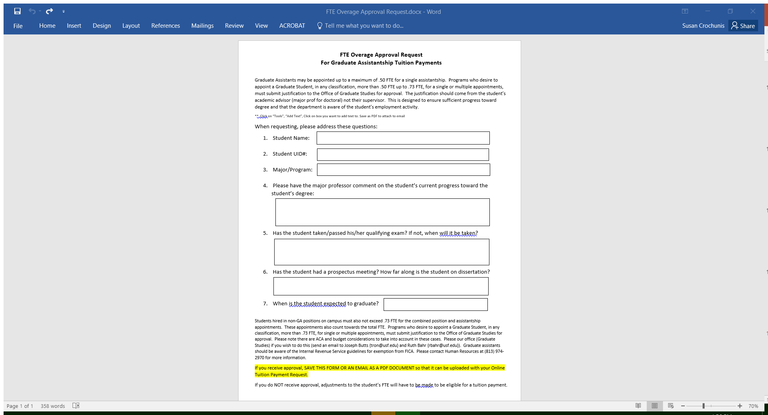

Slide 22
Qualtrics
Survey: CBCS Grad Payment

