Slide 1
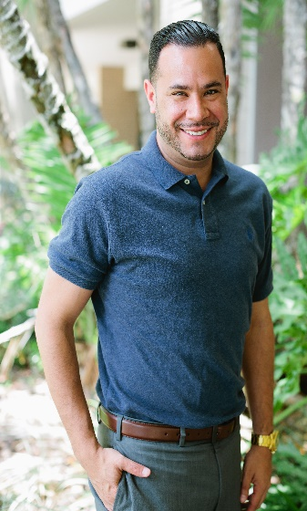
Using Program Evaluation to prepare for the Dissertation Process
Raymond Cabrera
UGS
Upward Bound Program

Slide 2
Evaluation is a systematic study designed and implemented to determine the value of an evaluand, providing a basis for guiding a decision making process”
(Rodriguez-Campos, 2005).

Slide 3
Risk identification in College success for First Generation/Low Income College Students | Risk Quantification | Risk Response | Risk Control
Navigating College Lower Graduation Rates Cost/Financial Aid Leaving home Friends/Relationships Time Management Course Rigor Need to work Eating habits | SEVERE Mental Health Sense of Belonging Mild Financial Stability Nutrition Stress Low Pressure | Pre-College Programs Advising Counseling Financial Literacy Tutoring Work Study Exercise/Eat Right Joining Clubs | Relationships with Faculty & Staff Selecting the right major Building resiliency and coping strategies Staying Involved

Slide 4
Research Questions
  How does college fit impact First Generation/Low Income students and their graduation rates?
    2 year/ 4 year schools
    Public/Private
    In State/Out of State
  What academic factors in high school contributed to college success?
    AP/Honors/Rigor
  How does resiliency and coping contribute to college success?

Slide 5
Class of 2005 to 2013
N=263 where at least
7 students attended a particular school
State Universities
Two Year
Private
FAMU 57.78 (26 of 45)
FSU 78.13 (25 of 32)
UCF 90.0 (9 of 10)
USF 73.08 (38 of 52)
HCC 16.84 (16 of 95)
Polk 50.00 (4 of 8)
St. Leo 41.6 (5 of 12)
SPC 33.3 (3 of 9)
Upward Bound 6 year Graduation Rates
Class of 08’-65 %
Class of 09’-58 %
Class of 10’-52 %
Class of 11’-43 %
*Students that may have graduated in 6+ years are not in calculated in these figures
*General Population has a 59% 6 year graduation rate
*First Generation/Low Income college graduation of 39%

Slide 6
Survey Question Examples
How would you rate on a scale of 1 to 5 (1-Ease, 5 Difficult)
  Financing your college education
  Transition to College
  Relationships with faculty and staff at your institution
  Managing stress
  Time management

