Slide 1
Effective Evaluation Presentations:
The Minto Pyramid Principle
Walter Chason
Dept of Measurement and Research
Barbara Minto. The Minto Pyramid Principle: Logic in Writing, Thinking, and Problem Solving. New and expanded ed, Minto International, 1996, ISBN: 0960191038.

Slide 2
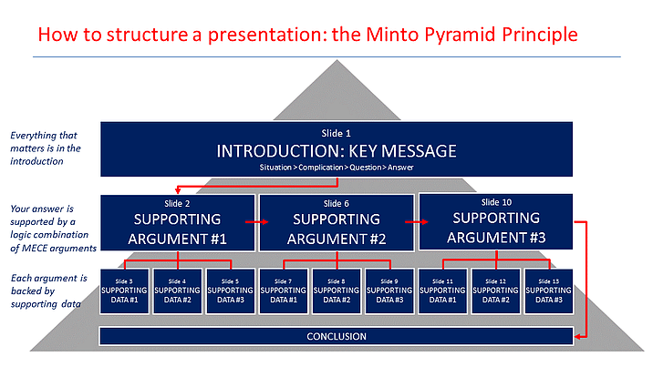

Slide 3
Step 1: Build Your Logic Bunker (SCQA)
Situation - Who or what are we talking about? What is the purpose of this presentation?
Complication - What is the problem? Why have I been called in?
Question – Define what it is that needs attention. A single, simple question.
Answer – Offer the brilliant solution/insightful conclusion you have developed, the process used to identify an issue, or the result of the investigation.

Slide 5
Step 2: Supporting Logical Arguments
Convincing disbelievers and solidifying supporters
Define individual arguments that, together, lead to the conclusion
Arguments should be MECE (Mutually Exclusive, Collectively Exhaustive)
If your topic is sufficiently complex, each supporting argument can have sub-arguments

Slide 6
Step 3: Supporting Arguments Need Supporting Data
Research or analysis that led to the evaluator’s conclusions
Need evidence or proof that make your arguments irrefutable
Pictures convey more information than words; use charts, graphs, or tables

Slide 8
Step 4: Write the Introduction/Abstract
Needs to be clear without jargon or complex ideas
Should address all SCQA points. People sometimes need to leave early or you run short on time
All essential information must be included in the introduction. This ensures everyone hears it.
The SCQA information provides the information in an understandable structure.
This will minimize interruptions

Slide 9
SCQA
Situation - Who or what are we talking about?
Complication - What is the problem? Why have I been called in?
Question – Define what it is that needs attention. A single, simple question.
Answer – Offer the brilliant solution you have developed, the process used to identify an issue, or the result of the investigation.

Slide 10
Step 5: Challenge Your Presentation Structure
External feedback is essential to creating a convincing presentation
Ask colleagues or boss to review your fleshed out SCQA outline.
Better to make changes to the structure now than after all the slides have been created.

Slide 11
Step 6: Create the Remaining Slides
Add slides based on the SCQA structure.
Pay particular attention to the data/evidence supporting each logical argument.
Ensure titles reflect the logical argument. People in the back may be only able to read the title.

Slide 13
Step 7: Conclusion
Summarize your SCQA structure
Restate your conclusion/summary findings
Focus on logical arguments that support your conclusion

Slide 14
Thank you!
Questions?

