Slide 1
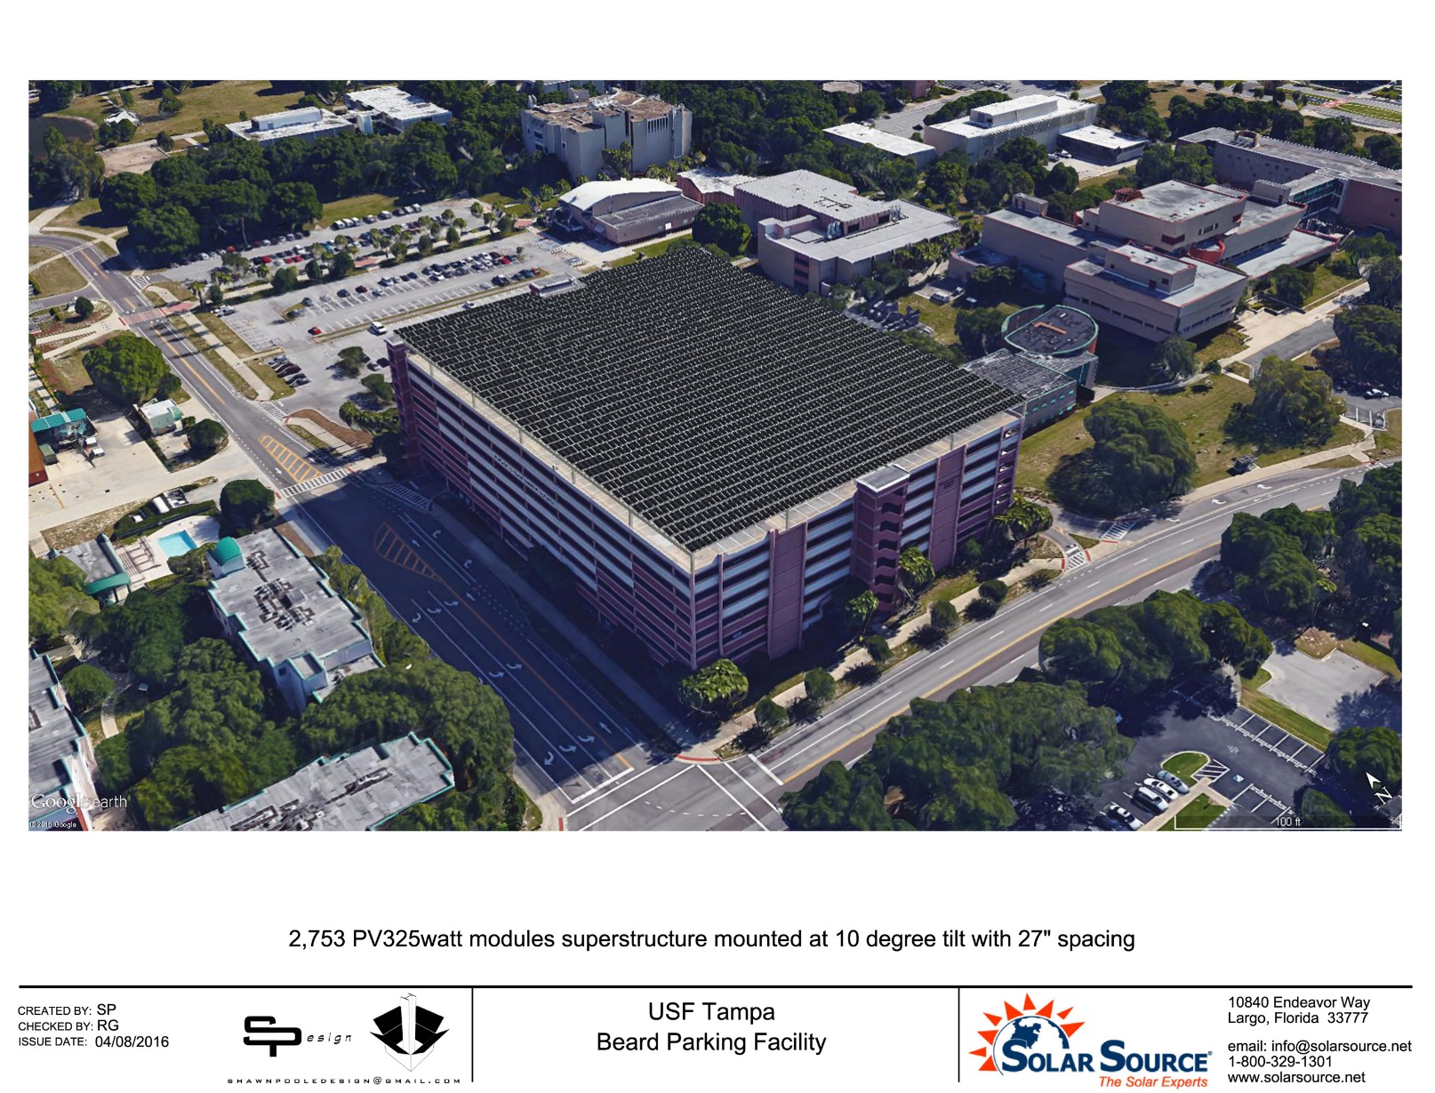
Solar PV at Beard Parking Facility (BDG)

Slide 2
USF President’s Climate Commitment
(American Colleges & Universities President’s Climate Commitment)
  Signed the Climate Commitment on April 12, 2008
  Requires reduction in carbon footprint and Greenhouse Gas (GHG).
  Commitment translated into specific goals.
    12% reduction in total emissions by FY 2017
    15% reduction in total emissions by FY 2020
    20% reduction in total emissions by FY 2025
    50% reduction in total emissions by FY 2040
    80% reduction in total emissions by FY 2050
    100% reduction (carbon neutral) in total emissions by FY 2070

Slide 3
Past Actions
  Office of Sustainability was established.
Student Green Energy Fund was created
Facilities Management established Sustainability Group
Comprehensive inventory of Greenhouse gases created.
Established a Plan of Action that will achieve target % reduction, provided funding is allocated.

Slide 4
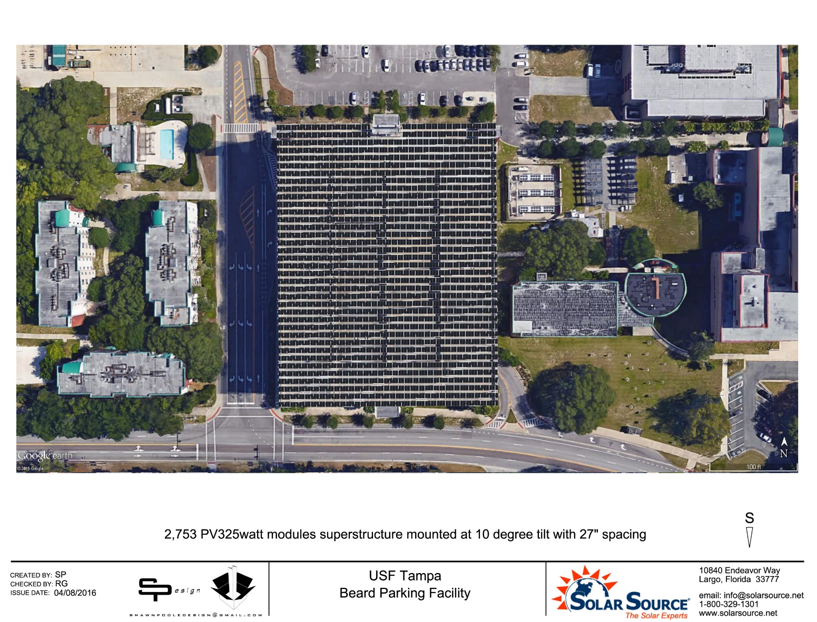
Solar PV at Beard Parking Facility (BDG)

Slide 5
Project Features, and Benefits to USF
TECO funded, owned, and maintained for 30 years. TECO expects to invest about $3 million.
About 795 kW capacity generating about 1,095,000 kWh/yr.
This will reduce carbon footprint by about 1%.
Generated electricity will belong to TECO but,
  USF will get the reduction in carbon footprint,
  improved STARS (Sustainability Tracking And Reporting System) ranking.
USF will receive rental income (amount to be negotiated) from TECO.
USF will receive covered parking on the top floor of the Beard Garage.
Student Affairs, Engineering Departments, PT&S in strong support.
General Counsel has reviewed the Easement Agreement.
Expected design and construction duration is 8 - 9 months.

