Slide 1
Collecting Biodigester Data

Slide 2
What data are you collecting?
Biogas production
Methane content
Presence of carbon dioxide
pH
Qualitative observations
  Digestate color
  Turbidity
  Signs of aerobic digestion (mold, fungus)
Any others relevant to your group’s research question?

Slide 3
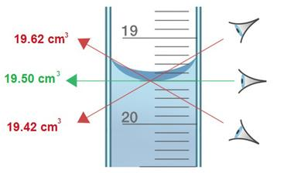
Biogas production
How do we read the water level in a graduated cylinder?
How do we know how much biogas is in the
graduated cylinder?
Measure the water level in the graduated cylinder.
Subtract the water level from the previous reading (or initial value).
Record your data in your data table for the day since startup.

Slide 4
Methane content of the biogas
Q: Biogas is mostly methane (CH4) and carbon dioxide (CO₂). Which is more useful to us?

Slide 5
Methane content of the biogas
A: Methane is more useful to us because it can be burned as fuel. Carbon dioxide is not combustible.

Slide 6
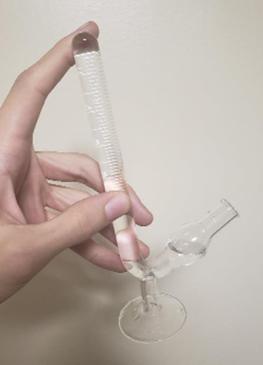
Measuring methane content
Materials:
3 molarity solution of Sodium hydroxide
(NaOH) -- available as lye -- or
Potassium hydroxide (KOH)
Fermentation tube
Syringe with blunt needle

Slide 7
Measuring methane content
Let’s practice with a fermentation tube!
Fill the tube with water
Fill the syringe with air
Inject the syringe of air into the
fermentation tube
Try to do this without letting any bubbles escape the tube and without spilling any water. Be careful, these fermentation tubes are typically very fragile! Be sure to use proper PPE.

Slide 8
Measuring methane content
You are using a strong basic solution – be careful and use proper PPE.
Over a basin or sink, carefully pour the NaOH or KOH solution into a fermentation tube, tipping it so that it is full up to the round bulb near the base (see image on previous slide).
Unclamp the third line of tubing extending from the gas T and withdraw 3 mL of biogas. Replace the clamp.
Carefully inject the gas into the base solution, making sure no bubbles escape.
Measure the final volume. All the gas at the top of the tube is methane. The methane content is the final volume at the top of the fermentation tube divided by the total injected volume (3 mL). It is typically expressed as a percent.

Slide 9
Measuring methane content
How does the fermentation tube method work?
What happens to the CO₂ and what happens to the NH₄ in the fermentation tube?

Slide 10
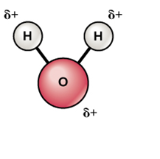
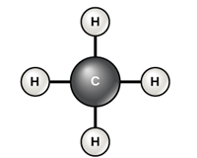
Measuring methane content
How does the fermentation tube method work?
What happens to the CO₂ and what happens to the NH₄ in the fermentation tube?
Psst… here’s a hint →

Slide 11
Measuring methane content
CO₂ is a gas, but it is polar and quickly turns into a different, non-gaseous product that dissolves in the water.
KOH _{(liquid)} + CO₂ _{(gas)} → K₂CO₃ _{(solid)} + H₂O _{(liquid)}
NaOH _{(liquid)} + CO₂ _{(gas)} → Na₂CO_{3 (solid)} + H₂O _{(liquid)}
NH₄ is nonpolar, so it is insoluble in water and passes through the solution.
Because biogas is a mixture of methane and carbon dioxide, everything at the top of the fermentation tube is methane.
Can you think of another gas besides methane that might pass through the solution?

Slide 12
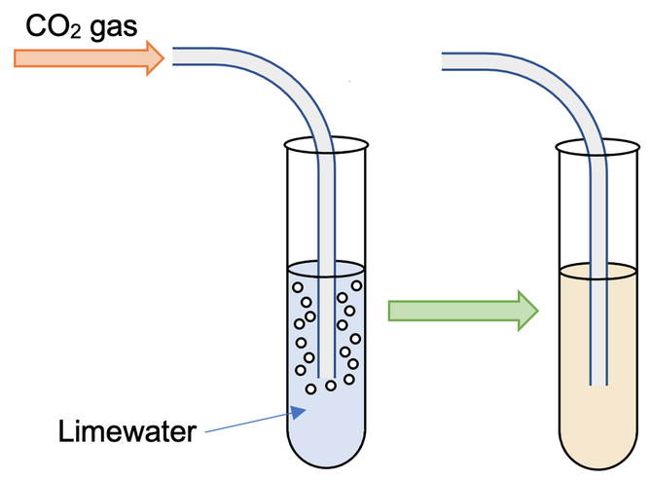
Detecting the presence of carbon dioxide
How do we know if carbon dioxide (CO₂) is present in the biogas?
Fill a test tube with lime water
Withdraw 3 mL of biogas from the biodigester
Slowly bubble the biogas through the lime water.
Observe the lime water. What do you see?
Carbon dioxide is present if the lime water becomes cloudy.
Elevise

Slide 13
Detecting the presence of carbon dioxide
Why does this method work?
Here’s a hint:
CO_{2(gas)} + Ca(OH)_{2 (aqueous)} → CaCO_{3 (solid)} + H₂O _{(liquid)}
Elevise

Slide 14
Detecting the presence of carbon dioxide
Why does this method work?
Here’s a hint:
CO_{2(gas)} + Ca(OH)_{2 (aqueous)} → CaCO_{3 (solid)} + H₂O _{(liquid)}
Calcium carbonate forms a solid precipitate, which is not soluble in water and precipitates.
Elevise

Slide 15
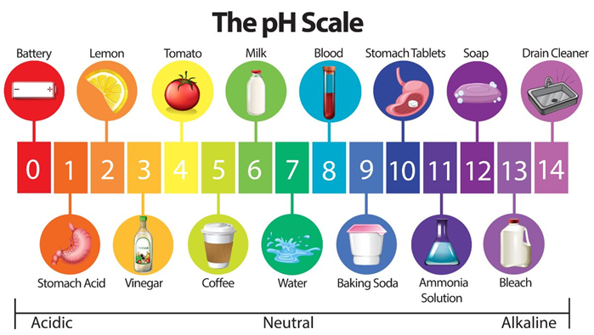
Measuring pH
We will use pH strips to determine the
acidity of the biodigester’s contents.
This can be done at the end of the experiment, or throughout the
experiment if you have a two-holed
rubber stopper and an extra access
point.
The optimum pH is between 6.5 and 8.5. A pH above or below this range will inhibit the microorganisms.

Slide 16
Measuring pH using pH Strips
Materials
• Sample of water before it is filtered.
• Sample of water after it is filtered.
• pH strips.
• Indicator chart on pH strip package.
Instructions
Test the water before it is filtered:
1. Place pH strip in water sample for 2 seconds.
2. Take the strip out of the sample and wait 10 seconds for color to stabilize .
3. Match color on strip with chart on package (at least two students should agree on the color match)
4. Write value on your data sheet.
Repeat with the filtered water.

Slide 17
Qualitative observations
How does the biodigester look?
  Digestate color
  Turbidity
  Signs of mold or fungus, usually on the surface of the liquid
  Record your observations for each measurement day.

Slide 18
Qualitative observations
Q: If we see signs of mold or fungus, what is happening inside the reactor?
Q: Why is it a problem?

Slide 19
Qualitative observations
Q: If we see signs of mold or fungus, what is happening inside the reactor?
Mold and fungus are aerobic organisms… their presence indicates air in the system.
Q: Why is it a problem?
Anaerobic microorganisms need anaerobic conditions to remain competitive in their ecosystem. These conditions give them competitive advantage, the ability to outcompete other organisms.
In aerobic conditions, they aren’t very competitive because they are slower at eating, growing, and reproducing than aerobic microorganisms.

Slide 20
Discussion questions
Are there any other tests you can think of performing on the biodigester?
What data would you collect with those tests, and what might it tell you about the processes happening within?

