Slide 1
Company Name
USF Bull Ring Accelerator Grant (BRAG) Presentation

Slide 2
Technology and Opportunity
Brief description/introduction to technology
What problem does this solve?
Define initial market
  Who is first adoptee?
  Beachhead market opportunity?
  Who will make purchasing decisions around the tech?
How is it better than what is already on the market?
Size of opportunity

Slide 3
Team Members
Names, positions, backgrounds, expertise, roles, accomplishments, experience in this field

Slide 4
I-Corps Summary
Lessons learned
Key insights
Why are you pursuing the commercialization of the technology?

Slide 5
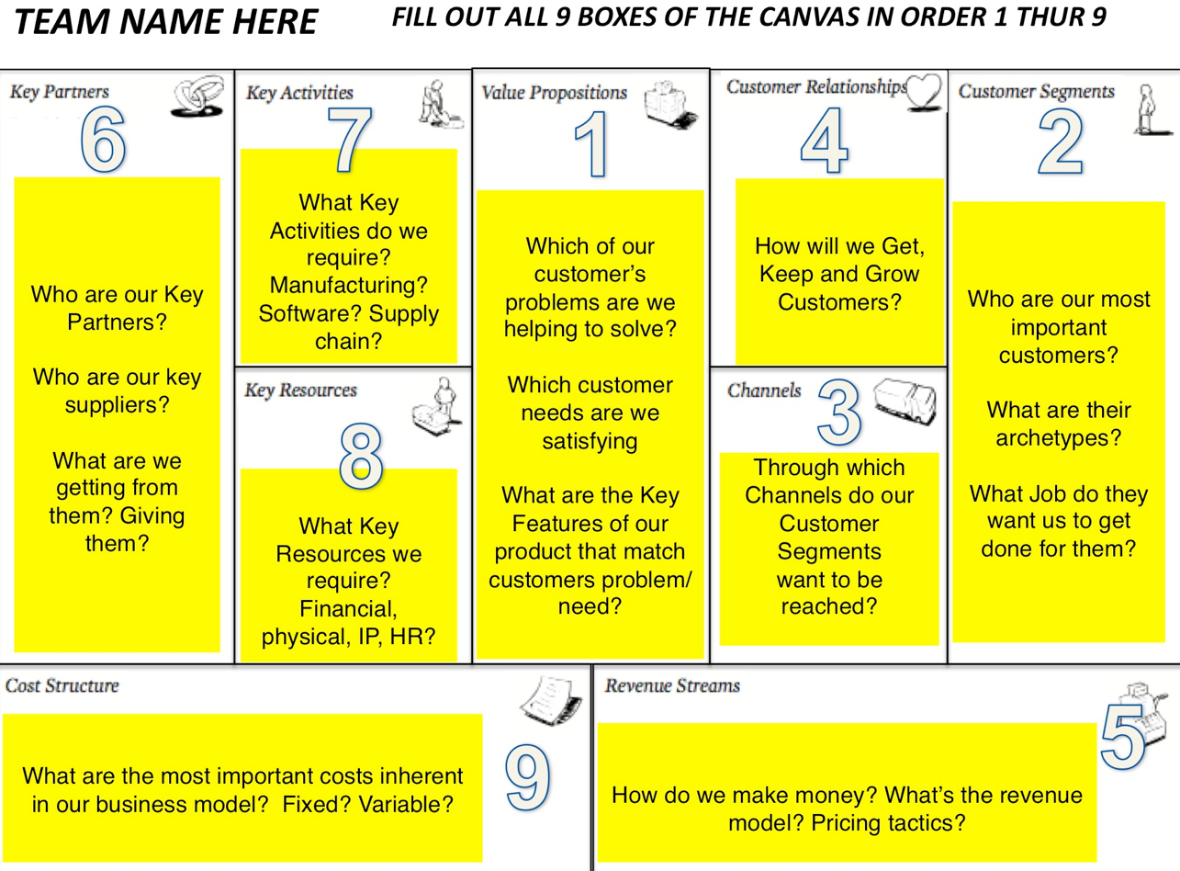
Business Model Canvas

Slide 6
Planned Use of BRAG Funds
Brief statement of how funds will be used – specific project(s) and activities
Why is BRAG funding necessary for the company to bring products to market?

Slide 7
Other Anticipated Resources
Leveraging of any additional funds
  FL High Tech Corridor
  Institute for Commercialization of Florida Technology
  Investments
  Other
Grants, proposals, and funding
  National Science Foundation Partnerships for Innovation
  SBIR/STTR
  Business plan and pitch competitions
  Other

Slide 8
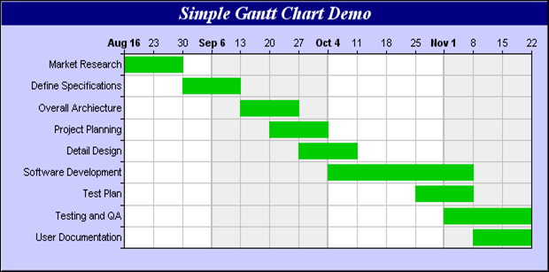
Commercialization Time Line
Activities, milestones, go/no-go decision points
Gantt chart showing planned schedule and funding

