Slide 1
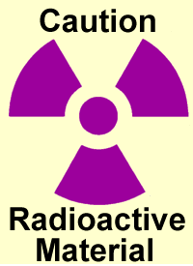
USF Annual Refresher Radiation Safety Training

Slide 2
USF RADIATION SAFETY
PERSONNEL CLASSIFICATIONS AND
TRAINING REQUIREMENTS
Principal Investigator (PI): This person is primarily responsible for the permit operation and the authorized use, supervision and training of their laboratory personnel.
Research Associate (RA): The RA can be a faculty/staff/post doctorate/graduate student. The RA must be a researcher with six months experience in handling radioactive materials and is authorized to supervise and train other laboratory personnel. Initial USF Radiation Safety training is required, followed by the completion of refresher training annually.
Radioisotope Worker (RW): The RW is a staff member or student of at least 18 years of age and who must be supervised by PI or RA. RWs must complete USF’s Initial Radiation Safety training. No previous radioisotope work experience is required. Refresher training is required annually.
This USF refresher training is for RA & RW personnel

Slide 3
Training Contents
Review of radiation safety fundamentals
ALARA
Common radioactive materials in research labs
USF Radiation Safety Requirements
Radioactive waste disposal
Emergency procedures
Summary of Requirements
Exam

Slide 4

1) Radiation Safety Fundamentals
Radiation is the release of energy by unstable nuclei. Ionizing radiation has the ability to alter the physical state of the atoms it interacts with, causing them to become electrically charged or IONIZED.
There are four main types of ionizing radiation. Alpha particles, beta particles, photons (gamma or X-rays) and neutrons. Most USF laboratory research uses radioisotopes that decay by emission of a beta particle.

Slide 5
Radiation Safety Fundamentals
Gamma and X-rays are forms of electromagnetic radiations or photons. They have both electric and magnetic properties. Gamma rays come from the nucleus when materials decay. X-rays are a result of electron removal or rearrangement in atoms. Gamma and X-rays can travel great distances and penetrate the body.
γ
0
0
Gamma and X-ray radiation have neither mass nor charge
Neutrons are heavy, uncharged particles that cause the atoms that they strike to become ionized.
n
0
1
Neutrons have an atomic mass of 1, but no charge

Slide 6
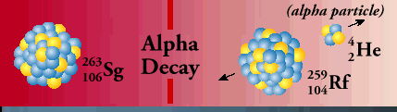
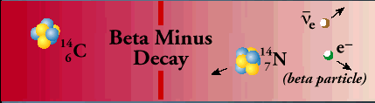
Radiation Safety Fundamentals
Alpha Particles consist of heavy, positively charged particles emitted by atoms of heavy elements such as naturally occurring uranium and radium and some human-made sources. Alpha particles are completely absorbed by the outer dead layer of skin and are therefore not a hazard outside the body. If alpha particles are taken into the body by inhalation or ingestion, they can directly expose internal tissues.
Beta Particles (positively or negatively charged electrons) are emitted from the nucleus during decay. Beta particles are more penetrating than alpha particles and can sometimes penetrate the skin, but like alpha particles, they are generally more hazardous when inhaled or ingested. Beta particles may be stopped by plastic or wood.

Slide 7
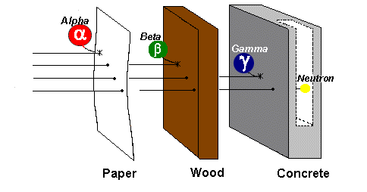

Radiation Safety Fundamentals
Placing material between the source of radiation and people working nearby is considered SHIELDING.
The following shielding guidelines can be used:
Alpha particles (α) stopped by paper
Beta particles (β) stopped by wood or Plexiglas
  Lead Beta shielding may lead to the production of x-rays and subsequently, dose to user.
Gamma (γ) and X-rays (X) stopped by lead or concrete
Neutrons (η) absorbed by hydrogen-rich materials (i.e. concrete)

Slide 8
Radiation Safety Fundamentals
Radiation Terms
Activity:
Radioactivity is a natural and spontaneous process by which unstable radioactive atoms decay to a different state and emit excess energy in the form of radiation
The curie is the unit of activity most often used in the United States and expresses the rate of radioactive disintegrations per unit time, based on the following:
One curie(Ci) = 3.7 x 10¹⁰ dps (disintegrations per second)
One millicurie(mCi) = 3.7 x 10⁷ dps = 1 x 10⁻³ Ci
One microcurie (µCi) = 3.7 x 10⁴ dps or 2.22 10⁶ dpm (1 x 10⁻⁶ Ci)
The S.I. unit of activity is the Becquerel(Bq), 1 Bq is equivalent to 1 dps

Slide 9
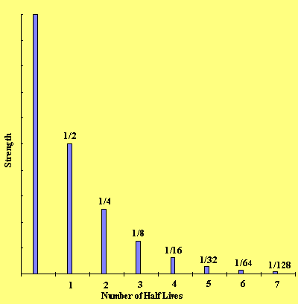
Radiation Safety Fundamentals
Half-life (T½) is the amount of time required for the activity of radioactive material to decrease by one half. Each radioisotope has a unique Half-life time period.
While there may be remaining activity in a sample containing a relatively longer-lived half-life, chemical breakdown may occur in the compound rendering a product unreliable over time.

Slide 10
Radiation Safety Fundamentals
Radiation Exposure: The Roentgen is
the unit of radiation exposure in air and
is expressed as the amount of ionization
per unit mass of air due to X or gamma
radiation.
Absorbed Dose: Radiation absorbed dose (rad) represents the amount of energy deposited per unit mass of absorbing material.

Slide 11
Radiation Safety Fundamentals
Dose Equivalent:
The measure of the biological effect of radiation requires a variable called the quality factor (QF). The quality factor takes into account the different degrees of biological damage produced by equal doses of different types of radiation. The unit of dose equivalent is the rem or mrem [m=milli or 1/1000 of a rem]
Damage from radiation depends on several factors such as whether the exposure was from internal or external sources.
External Exposure comes from a source outside the body, such as a medical x-ray. To do harm, the radiation must have enough energy to penetrate the body. If it does, three factors affect the radiation dose that the individual will receive:
The amount of time the individual was exposed
The distance from the source of radiation
The amount of shielding between the individual and the source of radiation.

Slide 12
Radiation Safety Fundamentals
Internal Exposure can occur when a radioisotope enters the body by inhalation, ingestion, absorption through skin, or through an open wound. If this happens, any kind of radiation can directly harm living cells. The damage the radiation produces depends on the following factors:
The amount of radioactive material deposited into the body
The type of radiation emitted
The physical characteristics of the element;
The half-life of the radioisotope (how fast it decays away)
The length of time in the body.
Radioactive material inside human body will cause an internal dose.
You can NEVER eat or drink in a posted radioactive material lab!

Slide 13
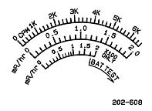
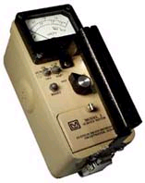
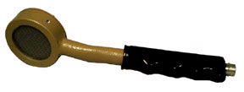
Radiation Safety Fundamentals
Using a Ludlum survey meter
Check battery condition – needle should go to BAT TEST line on meter
Turn large switch to the lowest scale – turn on audio switch.
Note meter “background” reading in a location away from radiation source.
Place probe (window face down) about ½ inch from surface being surveyed.
Try not to let the probe touch surfaces being surveyed.
Survey work area by slowly moving probe over surfaces, listen to audible “clicks” from survey meter speaker. You will hear a response before you see it!

Slide 14
2) ALARA
The University of South Florida (USF) is committed to the As Low As Reasonably Achievable (ALARA) concept for working with ionizing radiation. USF maintains a radiation safety program with the objective of maintaining all exposures to ionizing radiation ALARA. USF research operations with radioactive materials and/or radiation generating equipment provide a benefit to a large number of people. USF maintains an ALARA program to ensure our important work with ionizing radiation presents a very low risk to faculty, staff, students and general public.

Slide 15
ALARA
EXTERNAL RADIATION EXPOSURE CONTROL
X-rays and Gamma Rays: Your exposure to x-rays and gamma rays can be decreased using the following methods:
Time: Keep your time of exposure to a minimum. Design your experiment to minimize time in the radiation field. Be familiar with your experimental protocol so you can work quickly and efficiently.
Distance: Radiation intensity falls off quickly with distance (inverse square law), so maintain the maximum possible distance from the source at all times. If you double your distance from the radiation the intensity goes down by 75%.
Shielding: Use lead shielding.
Beta radiation: The main concern with Beta radiation is a skin exposure. The time and distance methods of exposure reduction for x-rays and gamma rays listed above also apply to beta radiation. When shielding beta particles, use Plexiglas, not lead. Beta radiation will interact with lead and will produce x-rays. Plexiglas approximately one-half inch thick will effectively stop beta particles in use at USF.

Slide 16
ALARA
INTERNAL RADIATION EXPOSURE CONTROL
Follow the precautions below to minimize internal radiation exposure:
Prevent absorption by changing your gloves frequently. Avoid touching your face while conducting experiments. Monitor your work area with survey meter, wash your hands, and check your hands and lab coat with a survey meter.
Prevent inhalation by using fume hood whenever you are using any volatile sources of radioactivity.
Prevent ingestion by never eating, or drinking in the laboratory. Never store food in refrigerators or freezers or other areas designated for chemical or radioactive material storage.
If you every suspect that you may have internal contamination – please contact USF Radiation Safety Officer Immediately (813-974-1194)

Slide 17
3) Common Research Radioactive Materials
Carbon 14 (C-14) Half life: 5730 years
Pure beta emitter: Eavg = 0.049 MeV Max range in air 24 cm Emax = 0.156 MeV Max range in H₂O 0.28 mm
Hazard - Internal Detection Wipe tests & Liquid Scintillation Counting (LSC)
Hydrogen 3 (H-3) Tritium Half life: 12.28 years
Pure beta emitter: Eavg = 5.7 keV Max range in air 6 nm Emax = 18.6 keV Max range in H₂O 6E-3nm
Hazard - Internal Detection: Wipe tests & LSC
Sulfur - 35 (S-35) Half life: 87.44 days
Pure beta emitter: Eavg = 0.049 MeV max range in air 26 cm Emax = 0.167 MeV max range in H₂O 0.32 nm
Hazard - Internal Detection: Wipe tests & LSC

Slide 18
Common radioactive materials in research labs
Phosphorus - 32 (P-32) Half life: 14.29 days
Pure beta emitter: Eavg = 0.695 MeV max range in air 790 cm Emax = 1.71 MeV max range in H2O 0.76 cm
Hazard – External skin & Internal Detection: Survey meter
Iodine-125 (I-125) Half Life: 60.14 days
Low energy gamma & X-rays – Typical shielding needed (0.5 mm of lead)
Hazard –External & Internal Detection: Survey meter
Chromium- 51 (Cr-51) Half Life 27.8 days
Low energy gamma & X-rays – Typical shielding needed (0.5 mm of lead)
Hazard –External & Internal Detection: Survey meter

Slide 19
Common Research Radioactive Materials
Toxicity
USF radioisotopes and relative toxicity group rankings
High
Medium to Upper
Medium to Lower
Low
None
I-125 and Cs-137
P-32, P-33, S-35,
C-14, Cr-51, Cd-109, Zn-65, and Rb-86
H-3
Tc-99m
Relative toxicity ranking of radioisotopes is based upon internal uptake through ingestion, inhalation, or absorption of radioisotopes.

Slide 20
Common Research Radioactive Materials
Survey Tequirements
USF’s day of use area survey requirements for most commonly used radioisotopes.
Lab uses Type of survey required
³H (Tritium) wipe tests
³⁵S wipe tests
¹⁴C wipe tests
³³P wipe tests
⁴⁵Ca wipe tests
⁵¹Cr meter readings
¹²⁵I meter readings
³²P meter readings
^{99m}Tc meter readings
¹³¹I meter readings

Slide 21
4) USF Radiation Safety Requirements
USF laboratories where radioactive materials are used must have:
Access to a radioisotope use notebook for records. Notebook must contain a USF radiation use permit for principal investigator (this designates approval of USF Radiation Safety Committee).
Impervious counter tops. Absorbent paper used in radioisotope work areas. Caution Radioactive Materials labels or tape on containers, pipettes, and equipment used for radioisotopes.
Transfer of radioactive material is prohibited without prior approval from USF Radiation Safety Officer (RSO).
When working with radioisotopes at USF you must wear a lab coat, safety glasses, and disposable gloves (using double gloves is recommended). You should wear pants and covered shoes (no sandals) while working in any research lab.

Slide 22
4) USF Radiation Safety Requirements
You must shield all sources of radiation not being used to an exposure rate less 0.2 mR/hr at one (1) foot from the shielding.
Personnel that have been issued personnel monitoring badges are required to wear them when working with radioactive material or when in a lab where radioactive material is used. Badges should be worn unshielded on breast pocket or collar. TLD finger rings are issued to personnel that handle beta-emitters with energies >150 keV or any gamma emitter and are to be worn so that the label is toward the palm of your dominant hand and inside glove.
Fume hoods are required when your lab uses tritium (H-3), sulphur-35 and iodine-131 or iodine-125 radioisotope stock vials. The face velocity, measured on a twelve-point grid [four points across and three points high], must average to 100 linear feet per minute with the sash at a reasonable working height. If your fume hood is not working correctly, stop work – close sash and contact the RSO.

Slide 23
USF Radiation Safety Requirements
Survey/Wipe Requirements
Incoming Radioisotope Package
You must conduct a wipe test on the outer vial holder and count on a Liquid Scintillation Counter (LSC) using wide (open) window. Attach LSC results to bottom of record of use sheet.
Daily Use
If you remove any activity from radioisotope stock vial containing:
P-32, I-125, or Cr-51 You must survey the area and equipment where radioisotope work was conducted with a survey meter. (Minimum six (6) locations.)
H-3, C-14, S-35, or P-33 You must wipe test the area and equipment where radioisotope work was conducted. (Minimum six (6) locations.)
Write survey results or affix LSC wipe results to undated lab schematics in space provided, mark survey and/or wipe locations on lab diagram, and keep results in radioisotope notebook.

Slide 24
USF Radiation Safety Requirements
Survey/Wipe Requirements
Weekly Storage Wipe Tests If the PI’s primary lab(s) have radioisotopes, then weekly wipe tests must be conducted on the outer surface of each lock box and waste container with radioactive materials present.
Affix LSC wipe test printout to pre-dated lab schematics, mark wipe locations on the lab diagram, and keep results in radioisotope notebook.
How do I determine if an area is “contaminated”?
If the open-window count exceeds 200 cpm above background, you should recount the wipe vial. If result is still above 200 cpm, you must decontaminate the area and perform another wipe test.
A meter reading two times background in any part of your lab area that has no nearby radioactive material storage or radioactive waste storage needs to be decontaminated. If area cannot be cleaned after two attempts, contact USF Radiation Safety office staff for assistance.
Additional information is provided on how to
perform a wipe test at the end of this training.

Slide 25
USF Radiation Safety Requirements
Record Keeping
Record of Radioisotope Use Sheet This sheet is issued with each radioactive shipment and is designated with an inventory number (R#) in the upper right-hand corner. Individual entries must be made at any time that an aliquot of activity is removed from the stock vial.
The practice of removing all of the activity from the original container and creating sub-stocks are to be recorded on this use sheet. After the entire radioisotope is used and the balance is zero, place record of use sheet by waste container for pick up by RS office staff. You may also mail (MDC 35) or fax completed record of use sheet(s) to USF radiation safety office.

Slide 26
USF Radiation Safety Requirements
Security of Inventory
Principal Investigators and staff shall provide security adequate to "prevent the unauthorized removal of radioactive material" from any location where radioactive material is used or stored.
Researchers must take the following steps:
Keep all radioisotope stock vials in a lock box approved by USF Radiation Safety. If the lock box breaks, cannot be locked, or if you cannot remove key, contact the USF Radiation Safety Office (974-1194) immediately to arrange for repair or replacement. When stocks vials are in use, they must not be left unattended at any time. All radioisotope stock vials must be secured when not in use. Control access to laboratories. Close and lock all entry doors when laboratory is unattended. Maintain an inventory of all radioactive materials. Conduct a visual check of stock vials during your weekly wipe test of radioisotope storage boxes. Mark the check box on (or add a note) the weekly lab survey sheet that inventory was checked. This sheet must be maintained in your radioisotope notebook. Report any missing inventory to the USF Radiation Safety Office immediately. Know who is in your laboratory. Persons without appropriate justification for being in lab should be asked to leave. Report concerns to proper authorities.

Slide 27
5) Radioactive Waste Disposal
All radioactive wastes must be segregated into three (3) general categories: dry solid, bulk liquid and scintillation (LSC) vials.
Dry solid radioisotope waste must be segregated into separate waste containers provided by RS office: P-32, P-33, S-35, I-125, Ca-45, Cr-51, Tc-99m, or other isotopes with a half-life less than 90 days. H-3 and C-14 waste may be placed together in a single waste container. No scintillation vials are allowed in dry waste containers.
Bulk liquid (water based) radioisotope waste must be disposed in containers provided by RS office. Most radioactive liquid waste can be combined into a single container (except Cr-51 and I-125, which must be separated).
Scintillation (LSC) vials must be segregated into separate waste containers provided by RS office. P-32, P-33, S-35, I-125, Ca-45, Cr-51, Tc-99m, or other isotopes. H-3, C-14 and/or routine wipe tests vials may be placed together in a single waste container. No waste tag entry is required for routine wipe test waste. Do not place solid waste (gloves, paper etc.) into vial waste containers. Scintillation cocktail must be the ecologically safe/biodegradable type.

Slide 28
Radioactive Waste Disposal
Waste Tags
Each lab will be issued multiple blank waste tags comprised of three different colored paper tags. Press down hard with a ballpoint pen to make sure that the entries are legible on the last sheet as this is your copy. A waste tag is required on each waste container for each category of waste that is ready for pickup.
The top of the waste tag must be completed for RS office to pick up waste. Date placed into waste container, isotope R#, the activity in microcuries (μCi) and initials of person placing waste into container must be included on waste tag. Multiple entries are allowed on waste tag if radioisotope and physical form are the same. If the tag is not ready or available near waste, RS office personnel will not remove waste from the area. Waste tags are both a record of the final disposition of your inventory as well as a record of the weight of the waste removed. After waste pick up, the pink copy of the tag(s) should be filed in the RED book.

Slide 29
Radioactive Waste Disposal
Example of properly filled out USF waste tags:
X Solid Liquid Vials
PI Name/Permit: __Gibbons/RS101_____
Isotope:______P-32_______________
Solid X Liquid Vials
PI Name/Permit: __Weaver/RS33_____
Isotope:______S-35_______________
Date
Disp.
R No.
Activity
(μCi)
Initials Disposer
Date
Disp.
R No.
Activity
(μCi)
Initials Disposer
3/12
20990
45.3
JH
4/6
19101
5.3
RL
3/15
21004
333
JV
4/15
20799
7.9
RL
Never use red or orange waste bags for radioactive waste!

Slide 30
Radioactive Waste Disposal
USF Guide for determining amount of activity in waste category
Lab procedure | % Liquid | % Solid | % vials
Labeling cells | 95 | 4 | 1
End labeling | 98 | 1 | 1
Hybridization | 50 | 49 | 1
Cell Free Synthesis | 90 | 1 | 9
Nick Translation | 50 | 49 | 1
Sequencing | 60 | 40 | 0
Iodination | 70 | 30 | 0
NOTE: This is a guide for common lab experiments using radioisotopes – the best way to determine activity in waste is to conduct direct activity measurements.

Slide 31
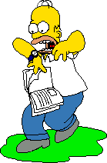
6) USF Emergency Procedures
IMPORTANT DEFINITIONS
Contamination - Radioactive material that is not contained and under the control of an authorized user.
Spill – Loss of control of radioactivity outside of a designed containment area. A spill involves radioactive contamination beyond the designated radioactive use area, which includes contamination on the floor, shoes, lab coat, and any equipment that is not designated as “Radioactive”.
Spill procedures are posted in all USF radioisotope labs on LAVA color paper.
Notify the USF Radiation Safety Office for ALL spills of radioactive materials!

Slide 32
USF Emergency Procedure
Minor Spills – Radioactive spills involving less than (<) 50μCi of activity and/or a survey meter reading of less than (<) 5 mR/hr at a distance of one foot. Minor spills require RSO notification as soon as possible.
PROCEDURES
NOTIFY: Notify persons in the lab that a spill has occurred.
PREVENT THE SPREAD: Cover the spill with absorbent paper.
REPORT: Report incident to USF’s Radiation Safety Office. In the event the RS office cannot be reached, utilize the “Radiation Emergencies” contact list on the lab door.
CLEAN UP: Use disposable gloves, lab coat, and eye protection. Cover the spill with absorbent material as quickly and as completely as possible to prevent spreading. To localize the contamination, wipe inward toward the center of the spill. Do not wipe back and forth or in a random fashion. Carefully fold absorbent paper and wipe up spill. Insert into a plastic bag and dispose of in the radioactive waste container. Include all other contaminated materials such as disposable gloves.
SURVEY: With a survey meter, check the area around the spill, and your hands and clothing for contamination. A swipe survey must be performed to demonstrate that decontamination results are below the limit of 200 cpm (open window). Retain all survey and wipe results in your radioisotope notebook for future reference.

Slide 33
USF Emergency Procedure
Major Spills – Radioactive spills involving MORE than (>) 50 mCi of activity and/or a survey meter reading of MORE than (>) 5 mR/hr at a distance of one foot. Major spills require immediate RSO notification.
PROCEDURES
CLEAR THE AREA: Notify all persons not involved in the spill to vacate the room.
PREVENT THE SPREAD: Cover the spill with absorbent pads, but do not attempt to clean it up. Confine the movement of all personnel potentially contaminated to prevent the spread.
SHIELD THE SOURCE: If possible, the spill should be shielded, but only if it can be done without further contamination or without significantly increasing your radiation exposure.
CLOSE THE ROOM: Leave the room and lock and stay by the door(s) to prevent entry.
CALL FOR HELP: Notify the Radiation Safety Office immediately. In the event the Radiation Control Office cannot be reached, utilize the “Radiation Emergencies” contact list on lab door.
PERSONNEL DECONTAMINATION: Contaminated clothing should be removed and stored in a plastic bag for further evaluation by the Radiation Safety Office. If the spill is on the skin, flush thoroughly and then wash with mild soap and lukewarm water.
DO NOT SCRUB SKIN!

Slide 34
Summary: Usage Requirements
In order to use radioactive material:
A red notebook is required containing all updated material
An approved workstation in good condition
Required PPE (lab coat, gloves, safety glasses)
Knowledge of location of Radiological Emergency Postings
Each day of use you must:
Indicate usage on ‘Record of Use’ form
Update the waste time on added contents
Survey the work area following work with radioisotopes
If you notice a problem with your survey
meter, notify the Radiation Safety Office.

Slide 35
Summary: Wipe Test Requirements
Wipe tests are required when:
Initially
  Upon receiving a package containing radioactive material, conduct a wipe test the outside of the storage vial
Each Use (removal of radioisotope from stock vial)
  Conduct a wipe test in the work area after each use of radioactive material (H-3, C-14, S-35, or P-33)
Weekly
  Conduct a weekly wipe test of any and all areas where radioactive material is being stored

Slide 36
How to Perform a Wipe Test
Create a background sample consisting of a new/unused dampened cotton swab and at least 3 ml of “safe scintillation cocktail in a scintillation vial . This can be re-used.
Dampen (with tap water) a cotton-tipped swab.
Wipe an area of approximately 100cm² (about the size of a U.S. dollar bill).
Place the cotton tip into a scintillation vial with at least 3 ml of “safe” scintillation cocktail
Count the sample and background vials in a Liquid Scintillation Counter (LSC) set to “open” or “wide” window.
The results should be reviewed and data taped on the appropriate lab schematic, sign and date the form.

Slide 37
Commonly used pre-fixes and Suffixes
10¹² tera
10⁹ giga
10⁶ mega
10³ kilo
10⁻¹² pico
10⁻⁹ nano
10⁻⁶ micro
10⁻³ milli
Common quantities of radioactive material ordered for research
1 x 10⁻⁶ Ci = 1 micro-Curie =1 μCi
1 x 10⁻³ Ci = 1 milli-Curie =1 mCi
1,000 μCi = 1 mCi

Slide 38
Common units and symbols
Radioactivity: Curie (Ci) SI Unit: (Bq)
Exposure: Roentgen (R) SI Unit: (C/kg)
Absorbed Dose: (Rad) SI Unit: (Gy)
Dose Equivalent: (Rem) SI Unit: (Sv)
Common Conversions:
1 Ci ~ 3.7 x 10¹⁰ Becquerel
1 Becquerel ~ 1 disintegrations per second (dps)
1 Roentgen ~ 0.000258 C/kg
1 Roentgen ~ 0.877 Rad
100 Rad ~ 1 Grey
100 Red ~ 1 Seivert
1 Liter ~ 61.024 in³

Slide 39
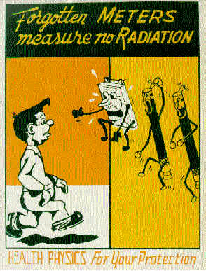
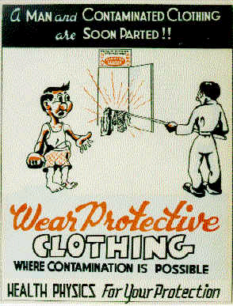
7) Exam
Print out USF radiation refresher exam sheet.
Using a black pen select best answer to each question on refresher exam sheet.
PRINT NAME on exam sheet and mail to RS Office @ MDC 35 or fax to 974-7091
Contact USF RSO with any questions @ 813-974-1194

