Slide 1

USF Campus Food Waste Recovery
Project Leads: Whitney Fung, Li Zhu, Phillip Dixon, & Gviana Goldberg
Student collaborators: Sam Gibbons, Robin Rives, & Shelby Petersen
Faculty Advisors:
Dr. Thomas Henry Culhane, Patel College of Global Sustainability
Dr. Sarina Ergas, Engineering
Dr. David Himmelgreen, Anthropology
Dr. Jennifer Marshall, COPH
Notes:
Whitney – introduce the project and project team
Everyone can introduce themselves and state year, program, and interest in this project

Slide 2
Collaborators
Mr. Tom Schlick, Mr. Nainan Desai, & Ms. Suchi Daniels (USF Facilities)
Ms. Jessica Cicalese & Mr. Paul Mack (USF Dining Services/Aramark)
Mr. Scott Grace (USF Athletics)
Dr. Joseph Dorsey (Patel College of Global Sustainability)
Drs. Jenny Friedman & Laurel Graham (Sociology)
Ms. Katie Jones (USF Feed-a-Bull)
Dr. Mahmooda Pasha (USF Social Marketing Group)
Dr. Russell Kirby (Public Health)
Dr. Peter Stiling & Jason Richardson (USF Office of Sustainability)
Ms. Laurie Walker (USF Botanical Gardens)
Dr. Qiong Zhang (Engineering)
Mr. Dell DeChant (Religious Studies)
Notes:
Whitney will state collaborators

Slide 3
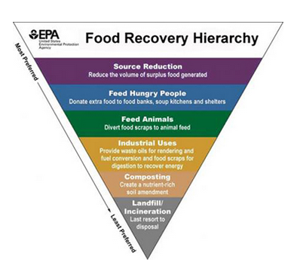
What is food waste/recovery?
Food waste: discarding or alternative (non-food) use of food that is safe and nutritious for human consumption along the entire food supply chain (FAO, 2014)
Food recovery: process of preventing and diverting wasted food, or using food waste in other ways before it ends up in our landfills (EPA, 2017)
Notes:
We also wanted to review the EPA Food Recovery Hierarchy which explains the most preferred method of food recovery to the least preferred

Slide 4
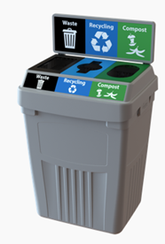
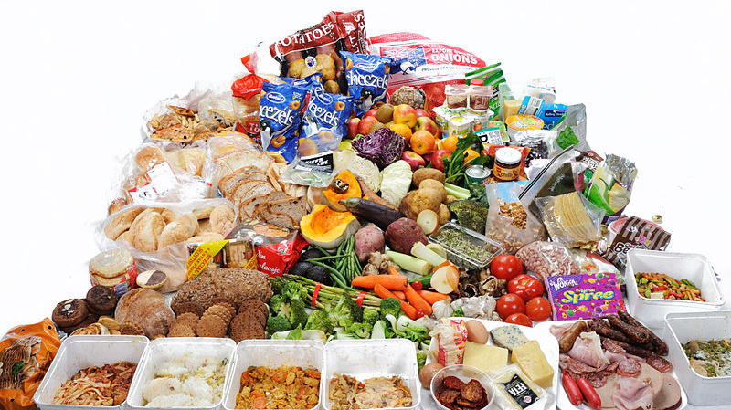
Pre & Post-Consumption Food Waste
Notes:
Focus of this project is on food recovery, specifically of USF Aramark/Dining Services food waste

Slide 5
Project Goals
Pilot test to recover post consumption food waste
Reduce greenhouse gas emission
Promote sustainability on campus
Increase student well-being & awareness of sustainable food systems
Notes:
State goals

Slide 6

Why is our project important?
↓ GHGs & ↑renewable energy
Increase student engagement and campus sustainability
Research, teaching, & practice
Exemplar for the Association for the Advancement of Sustainability in Higher Education
↓ GHGs & ↑renewable energy
Increase student engagement and campus sustainability
Research, teaching, & practice
Notes:
Adds to the USF Sustainability Tracking, Assessment, & Rating System
This project proposes to divert food waste from the landfill which will support hunger-relief efforts and reduce methane gas emission; this would provide an innovative way to garner credits in the AASHE STARS report. Although similar strategies are used on other campuses, food waste is currently not incorporated in the USF Campus Recycling and Energy Conservation Program nor are there food recovery efforts that remain on campus that generate renewable resources. This project proposes food recovery on campus or within the local area to support charities, supported by faculty and staff, and reduces carbon footprint in a closed loop system.
Image source: https://www.flickr.com/photos/ajc1/6724888431

Slide 7
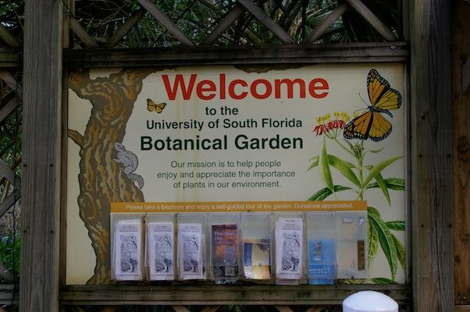


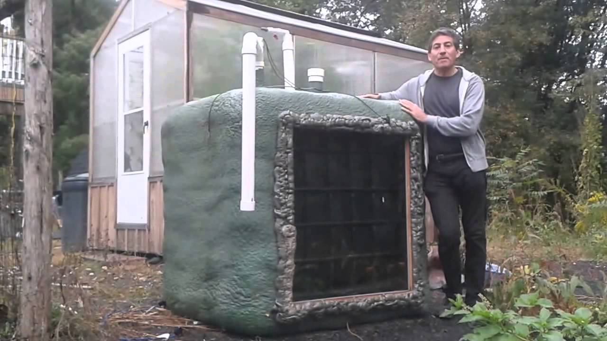







For a greener campus and student environment…
2. Food waste (and yard) recovered by anaerobic digesters to produce organic fertilizer & biogas at 4 sites (Botanical Gardens, USF Athletics recreational area, USF Facilities) +1 composting site
3. Fertilizer and biogas will be assessed for feasibility (economically, nutritionally, environmentally)
1. Edible food waste donated to pantries and inedible food recovered through the campus recycling program & energy conservation program
USF Facilities (2)
USF Facilities – Sustainability & LEED
Project team (OPS students) to transport food & develop logistics
Implementation of food waste recovery
Evaluate safety & efficacy of bioenergy production
Assessment of program impact on student well-being
Notes:
This is our vision and these were all the collaborators that support our project. In terms of food recovery, we start first with the food waste – edible food will be donated to local pantries and/or the Feed a Bull pantry. Inedible food will be recovered to feed the biodigesters. Second, the project team consisting of the hired students and volunteers will coordinate the transportation of the food waste. We met with Bill Land, the Director of USF Environmental Health and Safety to make sure we have all the gear and precautions in place for the food waste transportation (cleaning, pick/up, etc.). The students will pick up from Aramark (specific dining sites coordinated with Operations Manager) and drop off to feed the digesters; there are 4 as shown on this map. Lastly, the outputs of the biodigesters will be monitoring for safety and productivity. As we’ve stated, this is a pilot test so through these logistics and processes, the project team will develop SOPs and reports that show productivity of the fertilizer and nutrient analyses of what’s produced.
Described in the proposal in detail, this project has kind of three separate phases – implementation which is the day to day pick up/drop off of food, the evaluation of the efficacy of the biodigester outputs, and the assessment of impact on student well=being. We want this to be a student-engaged process where we are all responsible for food waste and recovery.
Need:
Logistics of transporting the food waste
We have USF Aramark’s support in working with dining sites to provide food waste, which the project team (OPS students) will coordinate pick-up and drop off to the biodigesters. USF Facilities has already completed a space impact form to build the double IBC tank biodigesters (request approved), and we have met with Suchi Daniels and Nainan Desai to discuss the logistics of implementation of the biodigesters. We have discussed the four pilot sites with USF Facilities: OPM100 area (2), USF Botanical Gardens (already built), and USF Athletics area near tennis courts. Design of the biodigesters is provided by USF professor Dr. Thomas Culhane and in partnership with anaerobic digestion experts in the College of Engineering. We will also collect data from one compost site (already existing at OPM100 and managed by USF Facilities) to compare the feasibility of both options.

Slide 8
Projects
 | Methods | Output/Outcome
College of Public Health | Project planning, implementation, and evaluation Impact assessment on student well-being | Evaluation, lessons learned, & recommendations for improvement
College of Public Health Dept. of Anthropology Dept. of Sociology Social Marketing Group | Formative evaluation/Needs assessment Campus-wide survey (food waste, food insecurity, etc.) Interviews with stakeholders | Student interest, awareness, & needs Faculty/staff support, barriers, and recommendations
Patel College of Global Sustainability USF Aramark | Anaerobic digestion Sustainable food production | Campus food waste audit
Dept. of Engineering | Bioenergy production Waste management (trash sort?) Anaerobic digestion (solid, liquid) | Safety, productivity, and effectiveness of biodigesters as a renewable energy source and fertilizer source
Social Marketing Group College of Public Health USF Aramark | Literature review & development of curriculum | Social Marketing plan for student food recovery and waste prevention Food Waste Reduction Curriculum for USF students

Slide 9
Long-term Sustainability Plan
Interdisciplinary, student OPS team will coordinate the logistics of this feasibility pilot project to incorporate into existing campus projects
Meetings/progress reporting quarterly with advisory group, work plan with each Department, and weekly with USF Facilities
Supported by USF entities (Aramark, Facilities, and Athletics) who are willing to explore future expansion of project
  See letters of support

Slide 10
Cost/Environmental Benefits
Cost benefit | Amount | Environmental benefit
Money saved from transporting yard waste off campus | $10,000 by Athletics | Reduces carbon emissions from transportation
Money saved paying for fertilizer | $75,000 by Athletics for fertilizer and chemicals | Reduces environmental contaminants from using chemicals and synthetic fertilizer; may improve nutrient composition of soil
Money saved from using biogas as renewable energy source |  | Reduces methane gas emissions
Notes:
From Tom:
Our shrub fertilizer purchase this year is 4 tons (8,000 lbs.) @ $845/ton. This equates to $.43/pound. If the nutrient analysis from the bio-digester product comes in at a mid-level N-P-K, which I think it will, it could be comparable to the analysis of our purchase.
Using about 8lbs per gallon of produced liquid nutrients then the savings roughly equates to $3.44 per gallon of nutrient liquid produced. So, filling a standard 5-gallon bucket would save about $17.20.
There are additional benefits to the produced nutrients versus synthetic fertilizer including secondary and micro nutrients, amino acids and humic acids.
From Scott:
In FY 2015 we removed 25 loads of yard waste (top soil, grass clippings, landscape debris) each load was a mini wheeler which can carry up to 18yds of material. Each load was approximately $300. I do not have any weights. In FY2018 so far we have removed 28 loads (18yds each) at $180 per load plus three 30yd dumpsters of yard waste removed by Republic Waste. I am estimating we will be above $10000 by the end of FY2018. The weight of the material removed by Republic was approximately 4 tons. I don’t have information on the second half of FY 2016 or the first half of FY 2017. I was working for Campus Recreation during that time. The numbers for 2015 should be a good average moving forward.
Scott & Tom: Cost/bill paid to purchase fertilizer? By fiscal year is fine (they would know that it has to be scaled down) Average fertility bill is $45000. The average chemical bill is $30000. This will slightly decrease depending on the quantity and quality of the bio digesters output and if this can be scaled up to produce compost from yard waste.
Tom: Cost/bill paid to purchase gas that methane could potentially replace (golf carts, lawn mowers, etc.) - If you give me the amount of gas used/paid for by month as well as the cost, that should be fine? I will just note that we don’t know how much we can replace yet, but if a fleet of 6 golf carts is 10% of the total amount of golf carts, that’s not bad J Depending on how much methane can be generated and how easily equipment can be converted, Athletics has a large fleet of utility carts (electric, gas, diesel).

Slide 11
What is the operating cost reduction for calculating ROI?
  Energy production from food waste (food production, distribution, cooking, etc.)
  Costs to dispose food waste (USF Aramark)
  Costs to dispose yard waste (USF Facilities and Athletics)
  Costs for grounds maintenance/ purchase of chemicals and fertilizer (USF Facilities and Athletics)
  Intangible benefits but great ROI – social impact and environmental awareness for students to reduce carbon footprint on campus
Notes:
While there is not necessarily a large amount of cost benefit for this pilot project, we see this as having a large potential to reducing cost in the future.

Slide 12
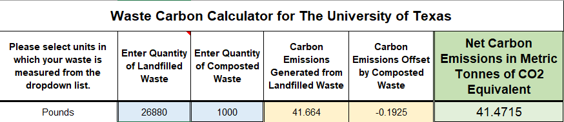
Notes:
20 gallons per day for two sites (of four sites) each day
50% food waste and 50% H2O at best
20*7=140 gallons /2 =70 gallons food waste = 560 pounds food waste per week

Slide 13
SGEF Funding Request
Total projected cost ~ $25,600.00
    Includes all research/biodigester materials, student support, and development/implementation of a student educational campaign to achieve a zero-waste campus and adopt Sustain-A-Bull practices.
Biodigesters last for five to seven years and can continue to be used in the long run.

Slide 14
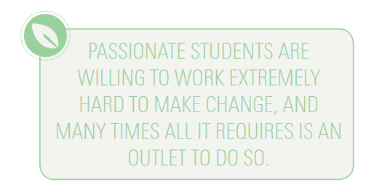
USF Campus Food Waste Recovery
Notes:
https://files.eric.ed.gov/fulltext/EJ920384.pdf
Overall, we just see this project as a holistic and very promising project that will pave the way for campus to be more sustainable because of the interdisciplinary nature, emphasis on students, and the awareness and outreach of the food waste recovery plan. This is not a new idea, but our project is even more innovative because we propose a closed loop food system that also supports the Feed a Bull food pantry. Every time we tell someone about this project, they are so excited and we hope that we get the opportunity to do something about food recovery and food waste on this campus.

Slide 15

For a greener campus and student environment…
Thank you! Questions?
USF Facilities – Sustainability & LEED
Notes:
Thank you to the council for your time and giving us this opportunity to share our ideas and present.

