Slide 1
CMS Workshops:
Assets and Components

Slide 2
Assets
Assets are preconfigured global elements that are used to:
Provide consistent information across all pages (e.g. student enrollment number)
Protect the integrity of information (e.g. a student testimonial with image)
Only Content Managers can create Assets.

Slide 3
Types
Web Content
The asset is configured with a mini-WYSIWYG Editor.
It may include basic formatting.
Plain Text
The asset is configured with plain text only.
Source Code
Created by the UCM Digital Team only.
More complex content, forms, etc.

Slide 4
Components
Form-based type of reusable content that gathers information and adds it into complex design elements.
Available Components
Arrow Link
Blockquote
Date
Faculty
Info Section

Slide 5
Arrow Link
Creates linked text alongside an arrow that animates with a mouse hover to call attention to the item.

Slide 6
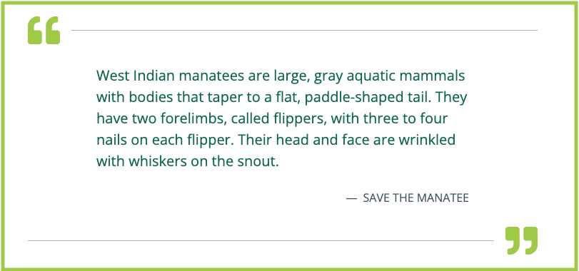
Blockquote
Creates a callout quote on a page, using larger font and quotation marks.

Slide 7
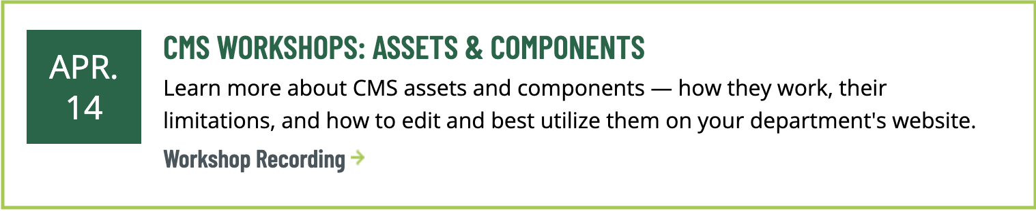
Date
Creates a calendar/event-like element that displays information, a link, and a large date block.

Slide 8
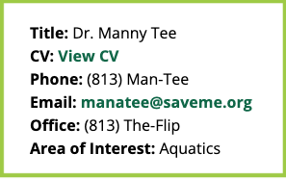
Faculty
Creates a text section on a page to include faculty contact information, CV, etc.

Slide 9
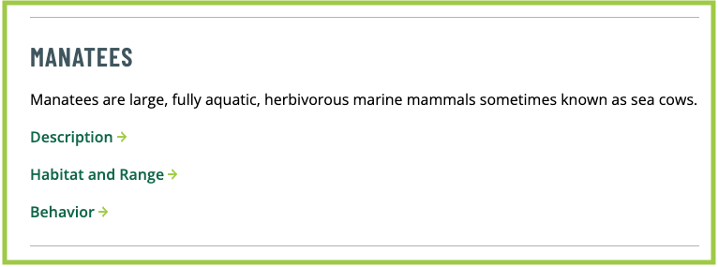
Info Section
Creates organized sections, typically including links related to a particular topic.

