Slide 1
Anticoagulation and Aging
Sam Harris, 6/11/2025

Slide 2
Content Outline
Epidemiologic data and background info
Indications for anticoagulation (AC) and standard of care
Risks of anticoagulation
Alternatives
Reversal
Discussion

Slide 3
Background
Coming from a background working in the ER, my thoughts on anticoagulation were previously biased by my experiences. My hope for this presentation was to ascertain the facts surrounding the risks/benefits of anticoagulation in the aging population, so I can have unbiased shared decision making/goals of care conversations with my patients going forward, and share with you all what I have learned

Slide 4
Background continued
It is estimated that over 8 million people in the united states are on anticoagulation, and the proportion of patients on anticoagulation increases with age
The most common reason for these patients to be on AC is atrial fibrillation (roughly two thirds of all patients)
Atrial fibrillation is the most common sustained abnormal heart rhythm, and after the age of 85 the prevalence is 10%.
Notes:
JAMA Network Open. 2022;5(11):e2242964. doi:10.1001/jamanetworkopen.2022.42964.

Slide 5
Background continued
Other common indications for AC include deep venous thrombosis (DVT), pulmonary embolism (PE), and artificial heart valves
The risk for atrial fibrillation, DVT/PE, valvular abnormalities, and stroke all increases with age, thus it makes sense the majority of patients on anticoagulation are elderly

Slide 6
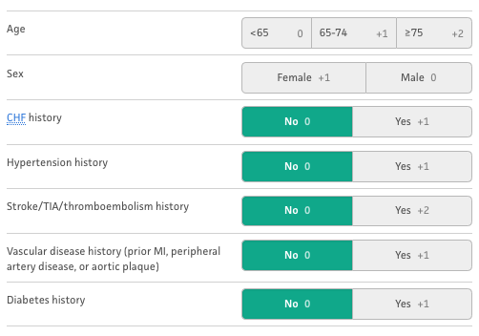
Atrial fibrillation
CHA₂DS₂-VASc Score for Atrial Fibrillation Stroke Risk

Slide 7
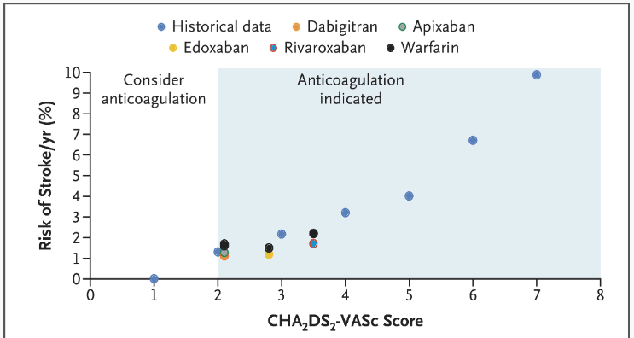
Notes:
https://www.nejm.org/doi/full/10.1056/NEJMcp2023658

Slide 8
Atrial fibrillation
CHA₂DS₂-VASc score next steps:
For men with a score of 0 and women with a score of 1, anticoagulation is not recommended
For men with a score of 1 and women with a score of 2 it should be a conversation
For men with a score of 2 and women with a score of 3, it is recommended
Antiplatelet therapy has been shown to not be effective
Notes:
https://www.mdcalc.com/calc/801/cha2ds2-vasc-score-atrial-fibrillation-stroke-risk#next-steps

Slide 9
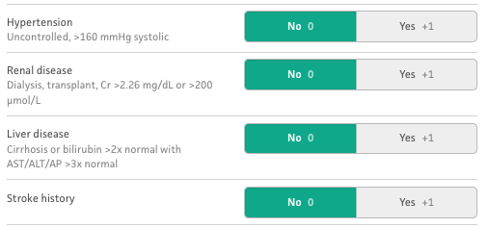
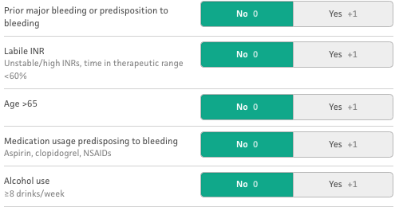
Atrial fibrillation
HAS-BLED Score for Major Bleeding Risk

Slide 10
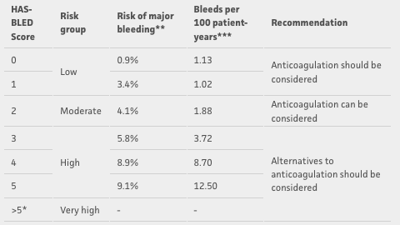
Atrial fibrillation
HAS-BLED Score next steps:
Notes:
Major bleeding was defined as intracranial hemorrhage, bleeding requiring hospitalization, bleeding with hemoglobin decrease >2 g/L, or bleeding requiring transfusion
https://www.mdcalc.com/calc/807/has-bled-score-major-bleeding-risk#evidence

Slide 11
Atrial fibrillation
Many of the factors that increase bleeding risk also increase stroke risk, and the risk of ischemic stroke in most cases outweighs the risk major bleeding. Modifiable risk factors should be addressed. If risk is extremely high such as HAS-BLED score of 4 or higher or other circumstances such as recent intracranial hemorrhage, then alternatives should be discussed
As you can see this conversation is complex and individualized for each patient. The choice to start or withhold anticoagulation should take all these factors into account and should be a shared decision.
Notes:
Thrombosis and Haemostasis. 2022;122(10):1625-1652. doi:10.1055/s-0042-1750385.

Slide 12
DVT/PE
For initial treatment of DVT, standard of care is 3 months of anticoagulation therapy, although there are cases when initial therapy is sometimes extended for 6 or 12 months.
In some cases, it is recommended to continue anticoagulation indefinitely for secondary prevention. Usually when a DVT is unprovoked, or related to malignancy, and bleeding risk is low or moderate.
There are no excellent tools at this time for predicting recurrence rate of DVT, but there is data from multiple studies including
meta-analyses available to clinicians to help guide decision making
Notes:
https://www.uptodate.com/contents/selecting-adult-patients-with-lower-extremity-deep-venous-thrombosis-and-pulmonary-embolism-for-indefinite-anticoagulation?search=anticoagulation&topicRef=95395&source=see_link
Antithrombotic therapy for VTE disease: Antithrombotic Therapy and Prevention of Thrombosis, 9th ed: American College of Chest Physicians Evidence-Based Clinical Practice Guidelines.
Risk of Recurrent Venous Thromboembolism: A Danish Nationwide Cohort Study.

Slide 13
DVT/PE
Other tools used to assess bleeding risk:
VTE-BLEED
The ACCP model
The RIETE score
Notes:
https://www.uptodate.com/contents/selecting-adult-patients-with-lower-extremity-deep-venous-thrombosis-and-pulmonary-embolism-for-indefinite-anticoagulation?search=anticoagulation&topicRef=95395&source=see_link
Antithrombotic therapy for VTE disease: Antithrombotic Therapy and Prevention of Thrombosis, 9th ed: American College of Chest Physicians Evidence-Based Clinical Practice Guidelines.
Risk of Recurrent Venous Thromboembolism: A Danish Nationwide Cohort Study.

Slide 14
DVT/PE
The decision to continue indefinite anticoagulation for DVT/PE again comes down to a shared decision-making conversation using the available data to predict recurrence, the available tools to predict bleeding, and factoring in patient preference. If a patient is at high risk for recurrence and low risk for bleeding the decision is usually easy. If a patient is high risk for bleeding it is common to advise against lifelong anticoagulation even in the setting of high risk of recurrence.
Dose reducing the medications can be considered as well as many studies have shown similar efficacy when used long term
Notes:
https://www.uptodate.com/contents/selecting-adult-patients-with-lower-extremity-deep-venous-thrombosis-and-pulmonary-embolism-for-indefinite-anticoagulation?search=anticoagulation&topicRef=95395&source=see_link

Slide 15
Mechanical Heart Valves
Warfarin is used in this population. Generally, it is never appropriate to discontinue anticoagulation other than for short time periods under medical supervision. Notable exceptions would be during surgery, acute life-threatening bleeding, or end of life care.

Slide 16
IVC Filter
IVC filters have not been shown to reduce mortality. They do reduce risk of PE but they also increase the risk of DVT. They are recommended in the setting of acute DVT to reduce the risk of PE if a patient is unable to use anticoagulation, but they are not a good long-term strategy to replace anticoagulation for DVT.
Notes:
Chest. 2021;160(6):e545-e608. doi:10.1016/j.chest.2021.07.055.

Slide 17
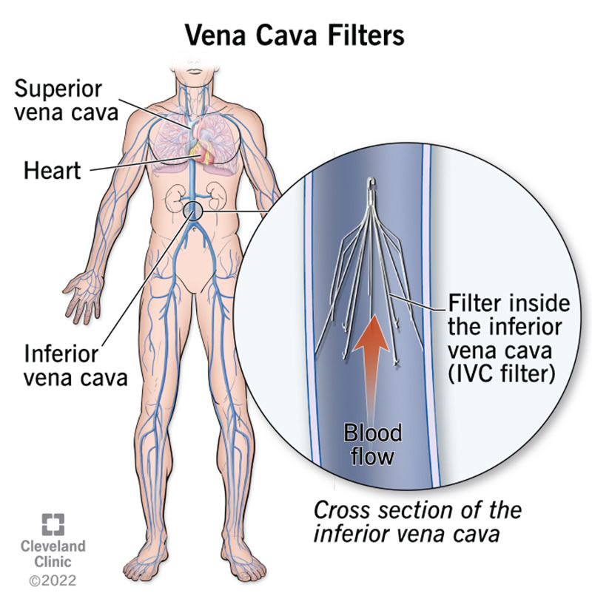
Notes:
https://my.clevelandclinic.org/health/treatments/17609-vena-cava-filters

Slide 18
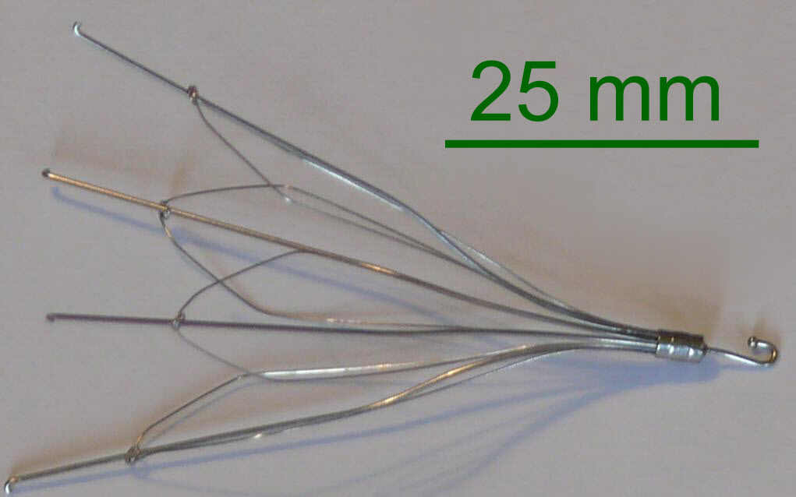
Notes:
https://en.wikipedia.org/wiki/Inferior_vena_cava_filter

Slide 19
Watchman Device (left atrial appendage closure)
Watchman device has been shown to reduce mortality, not just compared to placebo, but is actually superior to warfarin. It is non inferior to warfarin in ischemic stroke prevention.
DOACs are still the standard of care due to lack of large long-term studies of left atrial appendage closure devices, but the studies up to this point have shown watchman to be noninferior.
Watchman device is a reasonable alternative to medical therapy to consider if there are contraindications to anticoagulation
in atrial fibrillation
Notes:
Journal of the American College of Cardiology. 2017;70(24):2964-2975. doi:10.1016/j.jacc.2017.10.021.
The American Journal of Cardiology. 2023;200:135-143. doi:10.1016/j.amjcard.2023.05.044.
Journal of the American Heart Association. 2024;13(16):e034815. doi:10.1161/JAHA.124.034815.

Slide 20
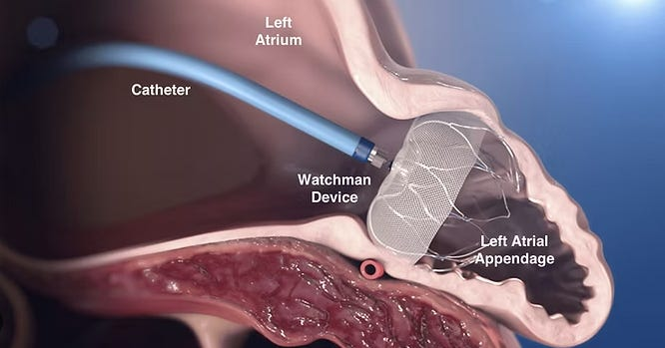
Notes:
https://gregorykatz.substack.com/p/does-the-watchman-device-prevent

Slide 21
Anticoagulation Reversal
Kcentra – 4 factor PCC- $3,000-$10,000 per dose
Andexanet alfa- $20,000-$55,000 per dose
Praxbind - $5,000-$6,000
Notes:
https://wikem.org/wiki/Anticoagulant_reversal_for_life-threatening_bleeds

Slide 22
Discussion
DOACs generally come with less bleeding risk than warfarin and require less monitoring
These conversations are very individualized and it's hard to make generalizations regarding the decision to stop anticoagulation unless you have a mechanical heart valve, but in general the risk of mortality is higher when stopping AC for atrial fibrillation as opposed to DVT. The rate of recurrence for DVT may be high, but it does not come with as high of an associated mortality risk.

Slide 23
The end
Thank you

