Slide 1
Biosand Filter Education
MCCANN & USF Collaboration

Slide 2
Presentation outline
Major sources of water and scarcity issues
Water quality issues
Conventional water treatment processes
Types of water treatment at home
Biosand filtration
What you will do in this project

Slide 3
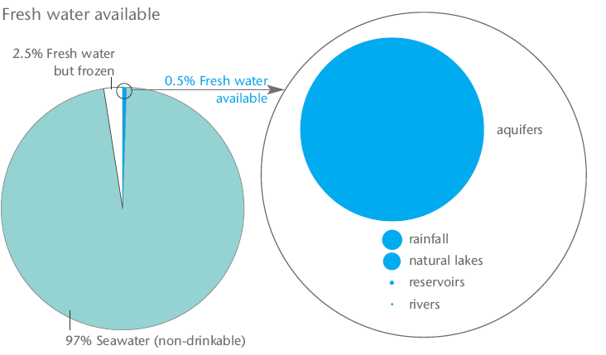
Global Water Sources - How much is accessible?

Slide 4
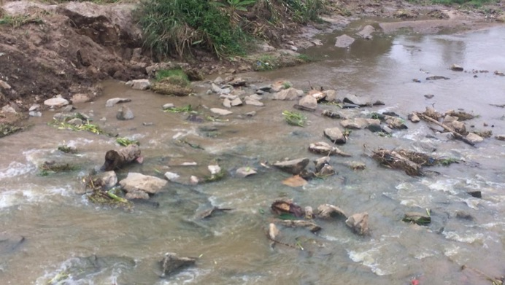
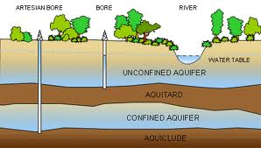
Sources of Water
Surface water
Rivers
Lakes
Ground water
Unconfined aquifer
Confined aquifer
Alternative sources
Rainwater harvesting,
Greywater,
Reclaim Water,
Desalinated seawater and brackish water
Notes:
Major Freshwater sources are surface water and groundwater

Slide 5
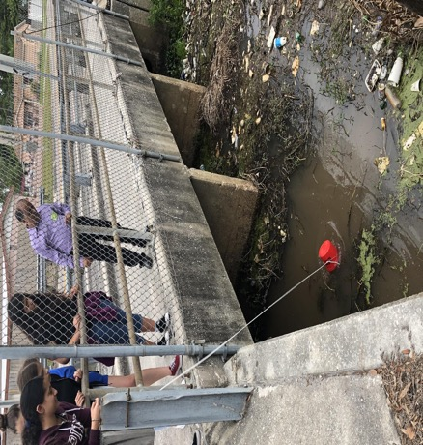
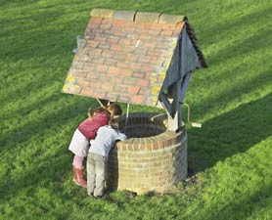
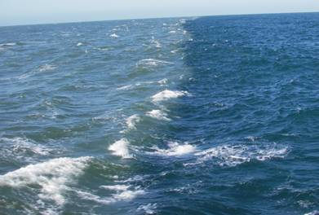
Would you drink water from a well, river or sea?

Slide 6
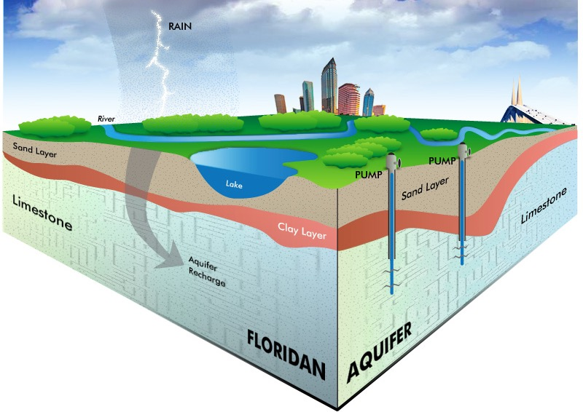
Where does our water come from?
https://www.tampabaywater.org/water-supply-source-groundwater

Slide 7
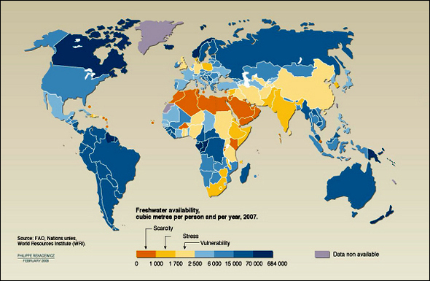
Many countries have limited freshwater sources

Slide 8
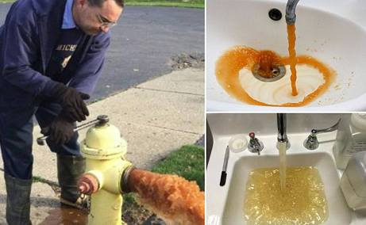
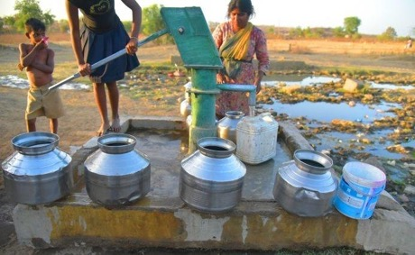
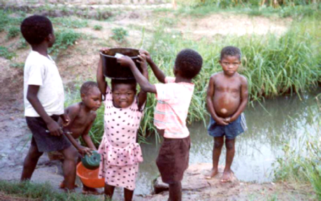
Do you know that ….
Almost 800 Million people lack access to safe drinking water – more than 2 times the population of USA

Slide 9
Global Water Supply Problems
https://www.youtube.com/watch?v=4V-KoJGGJ4s
Notes:
https://www.youtube.com/watch?v=yPxMOzN0Uq4

Slide 10
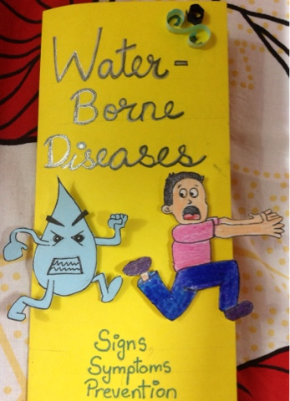
Do you know that ….
Every day more than 6,000 people die due to water borne diseases- most of these are children below the age of 5.

Slide 11
Household Uses of Water
Toilets – 28%
Showers/baths/personal hygiene – 19%
Clothes washing – 22%
Kitchen/dishes – 3.4%
Drinking/cooking – 4%
Garden – highly variable -10-75%
Pools
Others?

Slide 12
What makes water unsafe?
The most important things that make water dirty and unsafe include:
Solids from soil
Micro-organisms from wastewater, garbage, soil
Chemicals from houses, streets, industries and farms

Slide 13
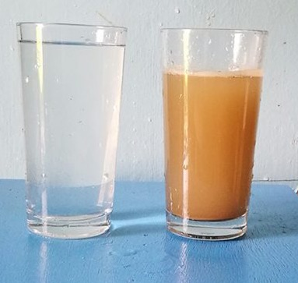
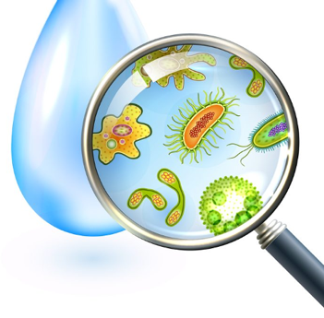
Clean vs. Dirty Water
How can you tell if the water is clean or dirty?
By using our senses
color
smell
taste
But not all contaminants can be detected using our senses
Therefore, we need to do water quality tests

Slide 14
Common contaminants in water
Physical: sediment or organic material suspended in the water
Chemical: nitrogen, salts, pesticides, metals, and human or animal drugs
Biological (microbiological): bacteria, viruses, protozoan, and parasites
Radiological: plutonium, uranium, radon

Slide 15
How do we purify water?

Slide 16
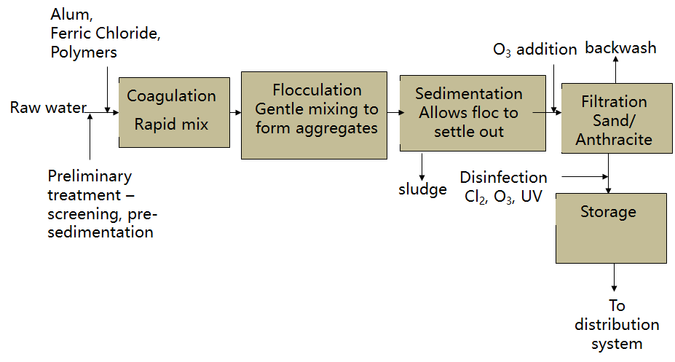
How do we purify water?

Slide 17
How do you purify your water at home?

Slide 18
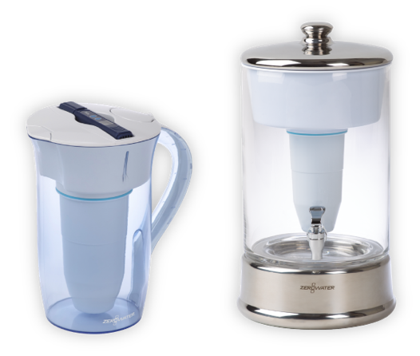
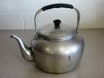
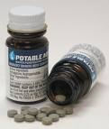
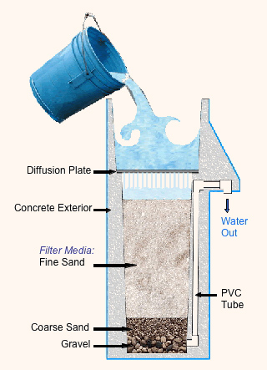
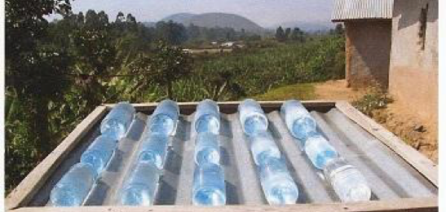
Water Treatment at Home
Boiling
Chlorine tablets
Pitcher Filters
Solar disinfection
Ceramic filters
Biosand filters

Slide 19
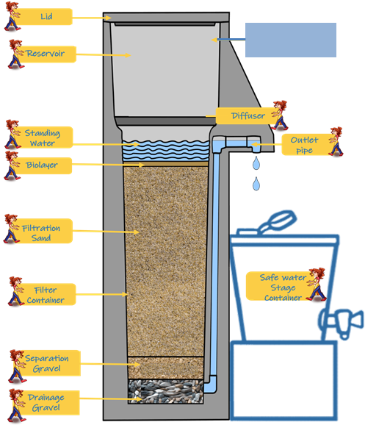
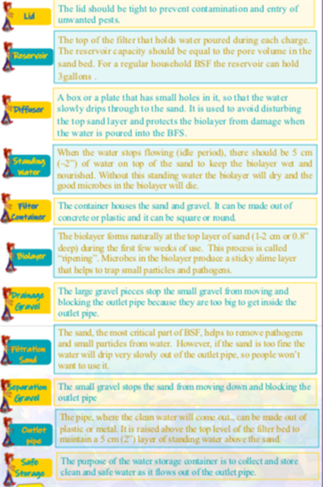
Biosand Filter Components

Slide 20
Gravel and sand layers
Sand Layer: The main layer that purifies the water. At the top of the sand a biological layer grow - biolayer or Schmutzdecke
Sand layer (size <0.7 mm)
21.4 “

Slide 21
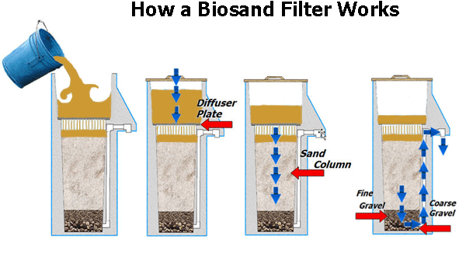
BSF – How it works

Slide 22
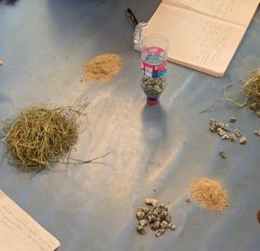
What can a BSF remove?
Suspended solids
Organic matter
Microorganisms

Slide 23
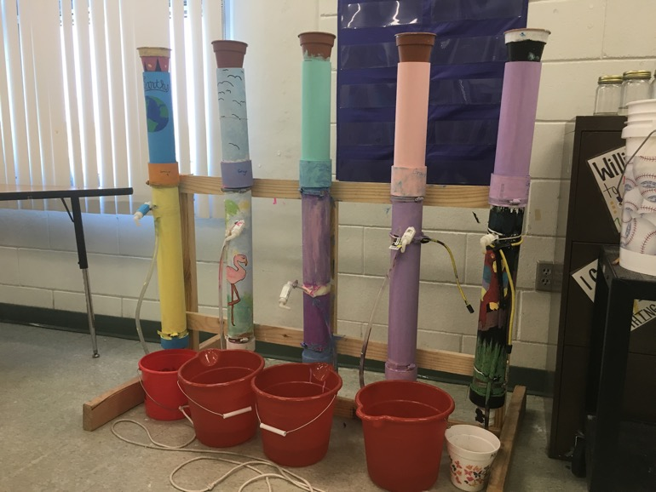
How does a BSF remove particles?
Mechanical trapping
Adsorption
Predation
Natural die-off

Slide 24
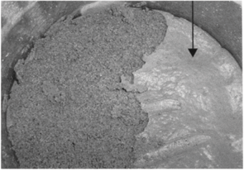
The Biolayer
Biolayer develops at the top of the sand
It develops over time – its ripening period
When the biolayer grows too much, the flow through the filter slows down
Then the BSF needs to be cleaned.

Slide 25
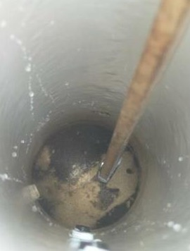
How do you clean a BSF?
Mix the top sand layer by hand or with a stick
Scoop out the dirty water
You may need to do this more than one time

Slide 26
What can an advanced BSF remove?
Nitrate
Fluoride
Lead
Arsenic

Slide 27
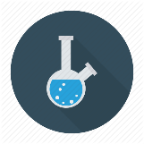
What you will do in this project
?
Learn how to do measurements
Come up with research questions
Design experiment
Collect and analyze data
Report findings to USF and possibly others

Slide 28
Questions?

Slide 29
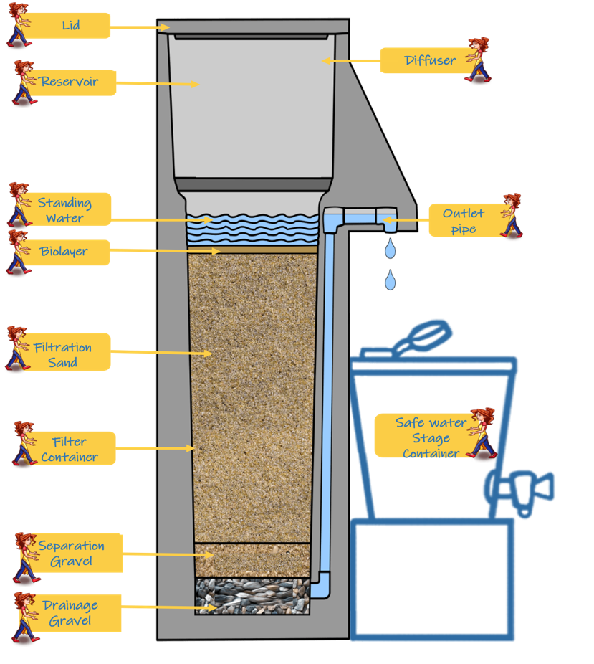
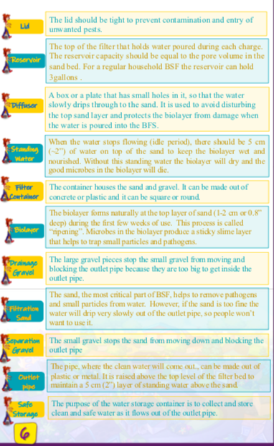
Biosand Filter

