Slide 1

Writing a research question
about Biosand filters

Slide 2
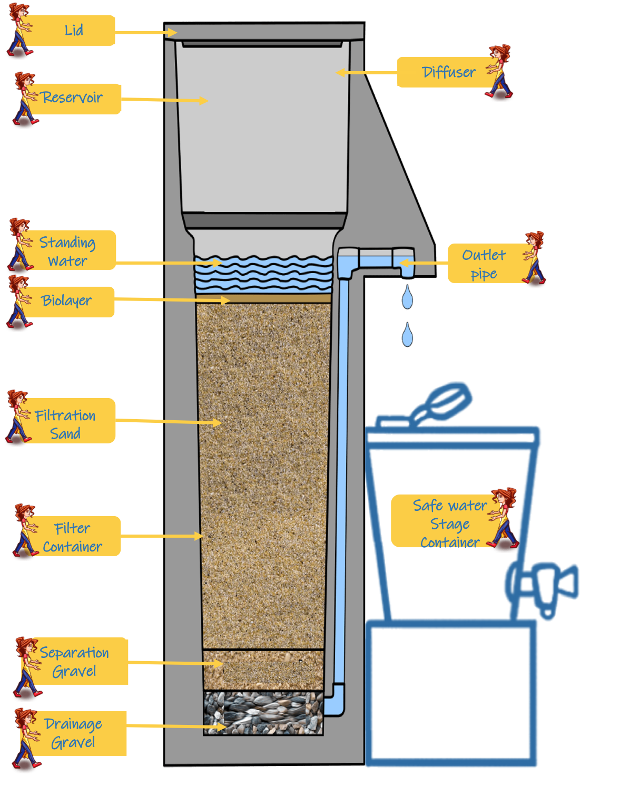
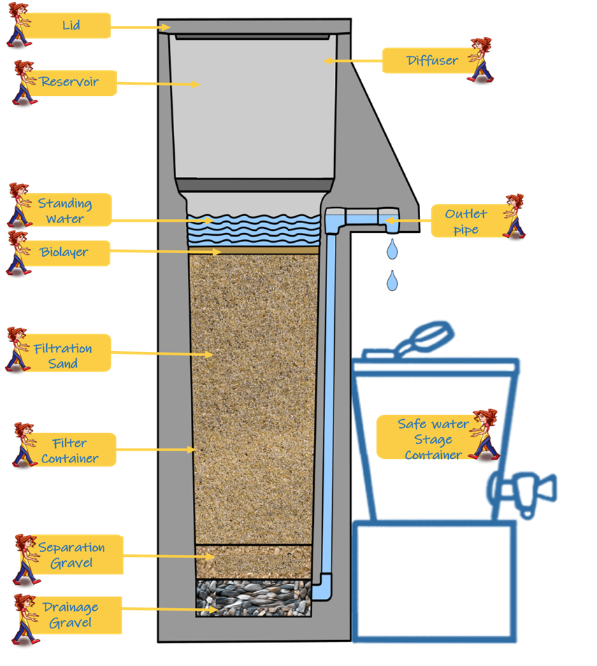
Biosand Filter

Slide 3
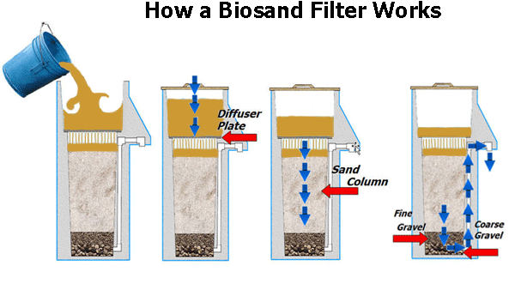
BSF – How it works

Slide 4
BSF – what can it remove?
Suspended solids
Organic matter
Microorganisms

Slide 5
How are pathogens and solids removed?
Mechanical trapping
Adsorption
Predation
Natural die-off

Slide 6
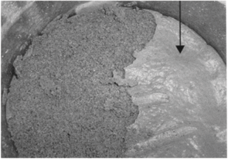
The biolayer plays key role
Biolayer develops at the top of the sand
It develops over time – it is called ripening period
When the biolayer grows too much, the flow through the filter slows down
Then the BSF needs to be cleaned.

Slide 7
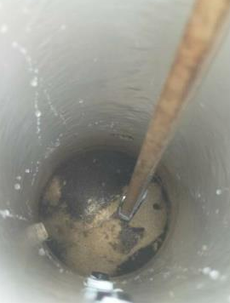
How do you clean BSF
Mix the top sand layer by hand or with a stick
Scoop out the dirty water
You may need to do this more than one time

Slide 8
Writing the research question
A research question needs to be in this following format:
How does A affect the B of C?

Slide 9
How does A affect the B of C?
A= Independent variable (something that you change)
B= Dependent variable (must be something that is measured)
C= The subject of your experiment (thing that you will be experimenting on)

Slide 10
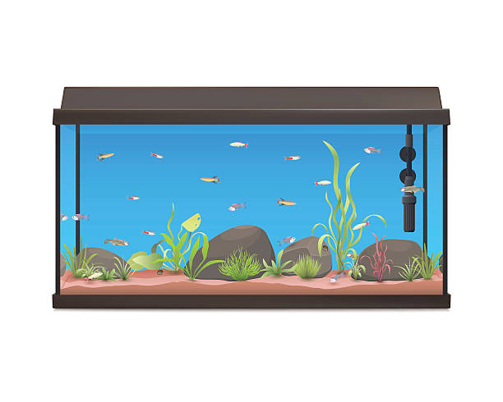
A= Independent variable – what you change
Suppose you are interested in what affects the quality of the water in a fish tank …
What could you change to affect the water quality?

Slide 11
B = Dependent Variable - What you measure.
2) What types of data can you observe and record for the fish tank?

Slide 12
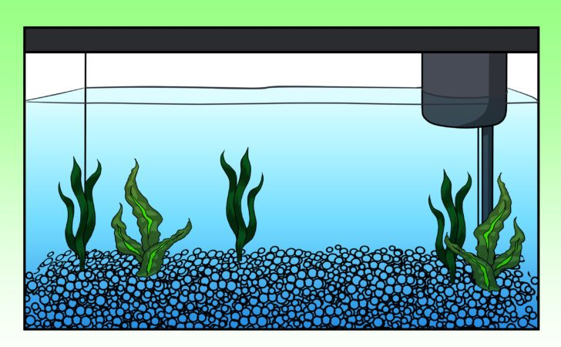
C = Subject
The specific subject of your experiment.
The fish tank from the example.

Slide 13
How does A affect the B of C?
A= Independent variable (something that you change)
B= Dependent variable (must be something that is measured)
C= The subject of your experiment (thing that you will be experimenting on)

Slide 14
Example: research question for a fish tank
How does changing the amount of food given to the fish affect the turbidity of the water in the fish tank?

Slide 15
Example research question for the Biosand filter
How does changing the charging volume affect the turbidity of the water that comes out of the Biosand filter?

Slide 16
Possible variables
Cleaning frequency of the biolayer
Charge volume (amount of water added to the BSF each day).
Resting period between charges, e.g., everyday, three times/week)
Depth of the sand layer in the BSF
Variables related to the charging water, e.g., salinity, turbidity

Slide 17
Possible measurements
Flow rate
Turbidity
Non-harmful indicator bacteria
pH

Slide 18
Try writing research questions
Come up with at least three research questions about the Biosand filter using this format:
“How does__________ affect the __________ of the Biosand filter?”

Slide 19
Next steps
How would you set up the experiment to answer your question?
What will remain constant? What will you change?
What measurements will you make?

Slide 20
Questions?

